Slide 1

Physical Training

Slide 2
Learning
Outcomes
1.2.b. Applying the principles of training
Principles of training
By the end of this topic you should …
know the following definitions of principles of training and be able to apply them to personal exercise/training programmes
  specificity
  overload
  progression
  reversibility

Slide 3

TASK: working in groups of 3 or 4 match the ‘Principles of training’ listed below to the description given on the task cards….
Applying the principles of training
Specificity
Progression
Overload
Reversibility
How you Did you Do

Slide 4
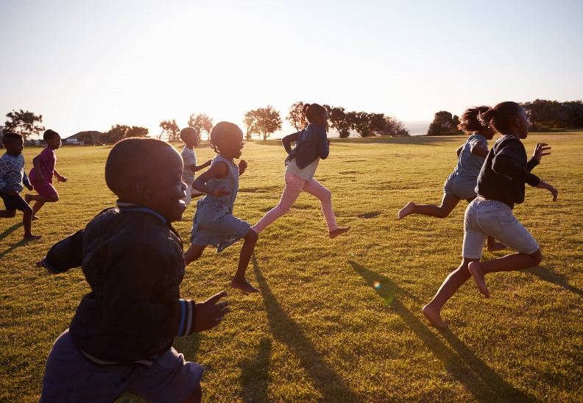
How can we remember these principles of training easily?
Specificity
Progressive
Overload
Reversibility
For Fitness
  Send
  Pupils
  On
  Runs
Task: Come up with your own Acronym!

Slide 5
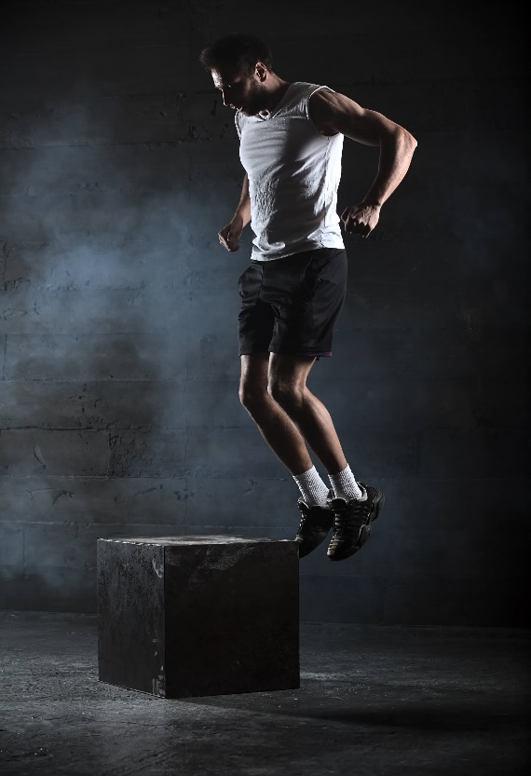
Applying the principles of training
Specificity: The training must be matched to the needs of the sporting activity and individual.
Example – A sprinter would carry out more anaerobic training because the event is mostly anaerobic in nature.
It is not just energy systems that need to be Specific – muscle groups and actions involved in the training also have to be as Specific as possible.
TASK: Can you come up with another example?
How about the game of rugby?
Think of different positions
Plyometrics for basketball players
WHY?
Why should you NEVER use someone else’s training programme?

Slide 6
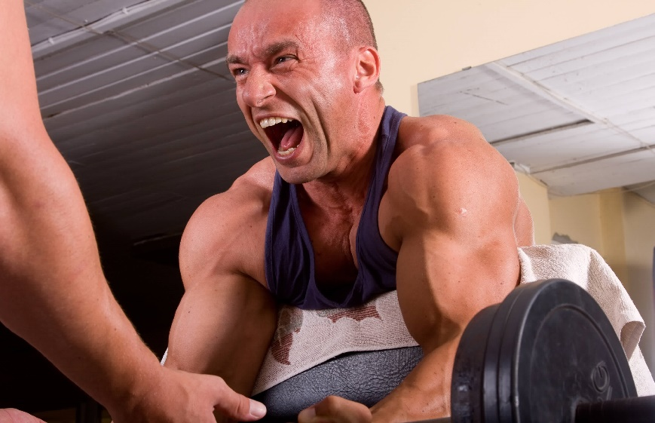
Applying the principles of training
2. Overload: The body must work harder than normal so there is some stress and discomfort.
Adaptation and progress will follow Overload because the body will respond to the stress.
Example – in weight training the lifter will eventually attempt heavier weights or increase reps in order to create Overload.
Overload can be achieved by increasing Frequency, Intensity and the duration (Time) of the activity.
Task: Can you come up with another example?
How about on the field of play?

Slide 7
Applying the principles of training
3. Progression: Not only do we need to include Overload in our training, it must also become gradually more difficult.
Example a Weight Lifter will be able to increase the weight they can lift over time as they increase their intensity, duration and frequency of training.
Caution – it is important not to ‘over do it’ otherwise no training benefit will happen!

Slide 8
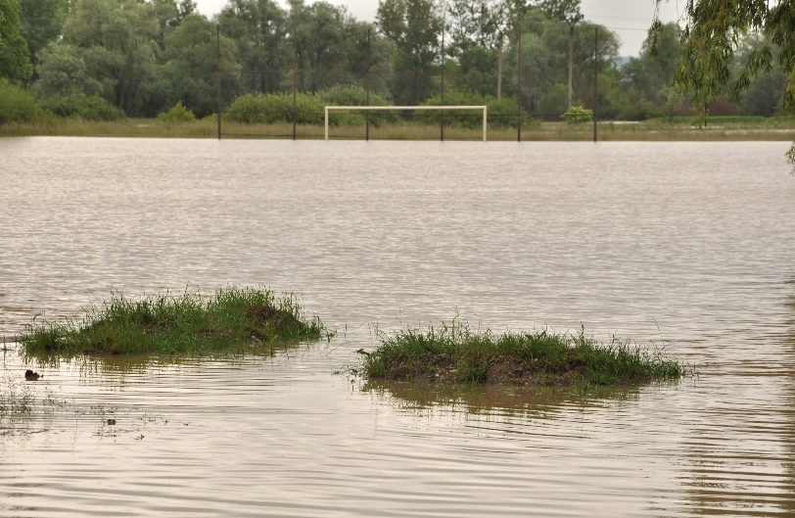
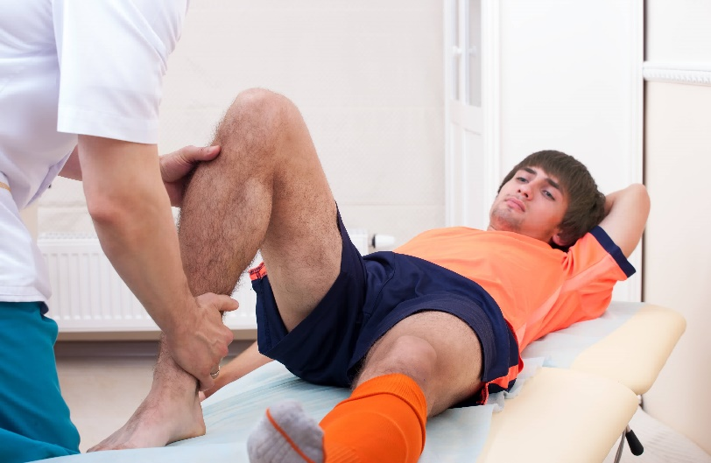
Applying the principles of training
4. Reversibility: Any adaptation that takes place as a result of training will be lost if you stop training.
Use it or Lose it!!!!!!
Example - a track athlete’s VO2max and Strength will decrease if they injure themselves and are unable to train for a period in time.
Task: Can you come up with another example of how and when reversibility may set in?

Slide 9
TASK:
In Teams Pick a Sport and Write a Plan to outline a six-week programme and justify your activities by referring to all the principles of training listed below.
Applying the principles of training
Specificity
Progression
Overload
Reversibility
Week Number | Session 1 Monday | Session 2 Wednesday | Session 3 Friday | Session 4 Sunday
1 | ?? | ?? | ?? | ??
2 | ?? | ?? | ?? | ??
3 | ?? | ?? | ?? | ??
4 | ?? | ?? | ?? | ??
5 | ?? | ?? | ?? | ??
6 | ?? | ?? | ?? | ??
So How Did We Do?

Slide 10
Applying the principles of training
These are ‘rules’ which if followed, allow your training programme to be more effective.
This should have a positive impact on your performance.

Slide 11
TASK: working in groups of 3 or 4 match the FOLLOWING listed below to the description given by the teacher…. [put your Answer on a post-it note and stick it to the board]
Applying the principles of training
FREQUENCY
INTENSITY
TIME
TYPE
Important Note:
These are NOT principles of training, merely elements to consider in your training programme.

Slide 12
TASK: Stick your Post-it Note in the correct Column….
Applying the principles of training
Frequency | Intensity | Time | Type

Slide 13

Optimising Training - FREQUENCY
Frequency: The Number of Training Sessions Each Week
How often you exercise or train depends on your ability level and fitness level.
Example: an elite athlete may train every day whereas a lower level club player may train once a week.
Task: Come up with your own example of how frequency of training may differ in your sport

Slide 14
Optimising Training - INTENSITY
Intensity: How Hard you Train!
The individual needs of the performer need to be taken into consideration as optimal training zones for distance athletes are different to sprint athletes.
Example: a Sprinter might work really hard using HITT training for a short period of time whereas a lone distance athlete will work at a lower intensity but over a longer period.
Task: Come up with your own example of how intensity of training may differ in your sport

Slide 15
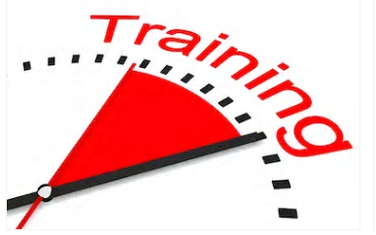
Optimising Training - TIME
Time: How Long you Train for!
This is the length of the training session and not part of it (as in circuits)
This should definitely take into account the intensity of which the athlete is training and their chosen sport.
Task: Come up with your own example of how length of training may differ in your sport

Slide 16
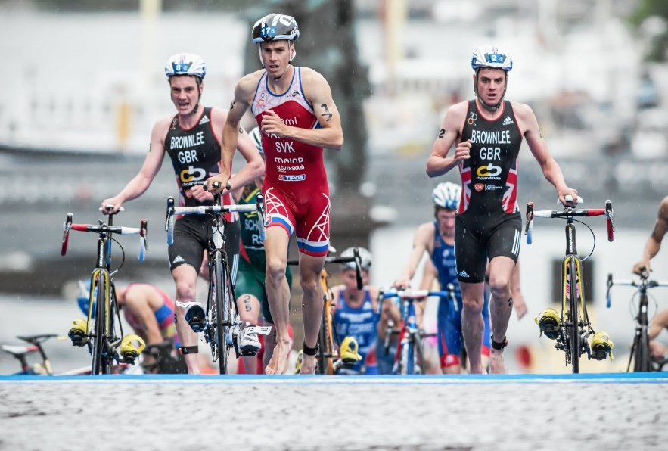
Optimising Training - TYPE
Type: Which method of Training you Use!
You MUST consider the needs of your chosen sport and what you want to get out of your training before you choose what type of training to use.
Example: The Brownlee Brothers (triathlon) – will train all areas of fitness but pay particular attention to aerobic and muscular endurance because of the nature of their sport.
Task: Come up with your own example of how intensity of training may differ in your sport

Slide 17
TASK:
In Teams complete the following…..
Applying the principles of training
So How Did We Do?
 | Cardiovascular Endurance | Muscular Endurance | Speed | Strength | Flexibility
Frequency
Intensity
Time
Type
Progressively Overload
 | Cardiovascular Endurance | Muscular Endurance | Speed | Strength | Flexibility
Frequency | Whole body exercise 3-5 days per week | Each major muscle group should be trained 2-3 days per week | 2-3 days per week | Each major muscle group should be trained 2-3 days per week | Daily (a minimum of 3 days per week)
Intensity | Moderate to vigorous (6085% maximum heart rate) | Light to moderate (less than 50% 1RM) | 90-100% maximal speed | Frequency | Frequency
Time | 30-60 minutes/day | 15–20 repetitions 1-2 sets Rest intervals of 2–3 min between each set A rest of at least 48 h between sessions. | Less than 10 seconds 4-20 repetitions Work : rest ratio of at least 1:6 | 8-12 repetitions 2-4 sets Rest intervals of 2–3 min between each set A rest of at least 48 h between sessions | Static Stretched 10–30 s 2-4 repetition
Type | Continuous | Weight training | Interval /HIIT | Weight training | Stretching
Progressively Overload | by increasing time, frequency, and/or intensity | by increasing resistance, and/or repetitions per set, and/or frequency | by increasing frequency, intensity and/or number of repetitions | by increasing resistance, and/or repetitions per set, and/or frequency | by stretching to the point of feeling tightness.

Slide 18
Learning
Outcomes
Applying the principles of training
By the end of this topic you should …
Know the definition of the elements of FITT (Frequency, Intensity, Time, Type)
Apply these elements to personal exercise and training programmes.
Know different types of training, definitions and examples of:
  continuous
  fartlek
  interval
  circuit training
  weight training
  plyometrics
  HIIT (High Intensity Interval Training)
Optimising
training

Slide 19
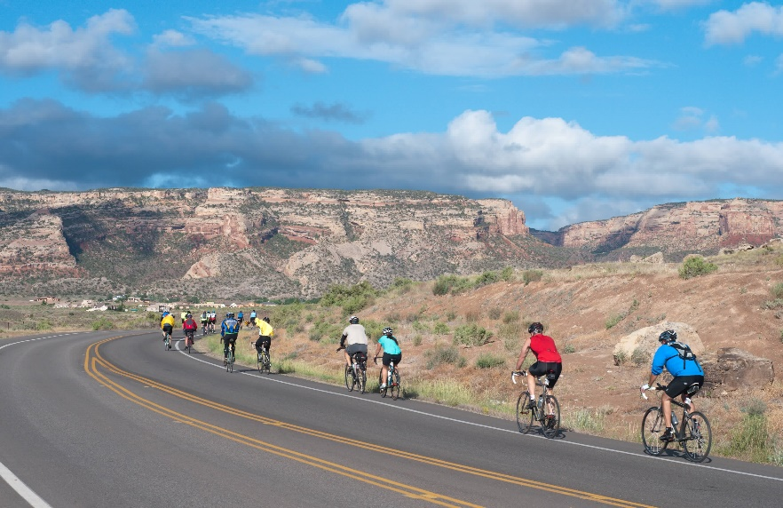
Types of Training - Continuous Training
Continuous Training
A method of training that seeks to maintain or improve Cardiovascular Endurance.
Features:
Activity that continues for an extended period of time without rest.
Stresses the AEROBIC System.
Carried out at a steady rate with low intensity.
Adaptions:
Heart will get bigger and stronger allowing greater delivery of blood (& O2) to the working muscles
Example:
Long distance Running, Cycling or Swimming
(30min-2hrs @ low intensity)

Slide 20
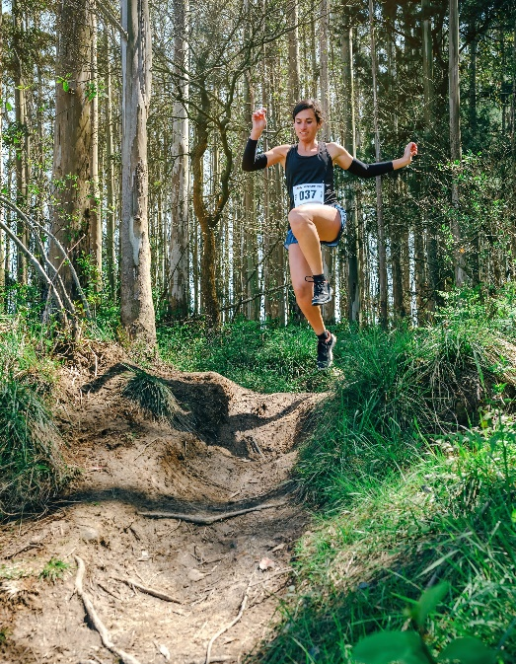
Types of Training – FARTLEK training
Fartlek Training
Also known as ‘SPEED PLAY’ (Swedish) often used to maintain or improve aerobic endurance
Features:
The Speed, Intensity and often Terrain (gradients & surface – sand, mud etc.) are varied throughout the training session
Can train both Aerobic and Anaerobic systems
Can often add enjoyment to otherwise tedious training sessions with variations in speed, intensity and terrain.
Adaptions:
Can force the body to adapt in a way that it can better delay the onset of lactic acid build up
Example:
Ideal for team sports as it replicates the efforts of a player / athlete in a game like situation (run, walk, jog, sprint, rest, repeat)

Slide 21
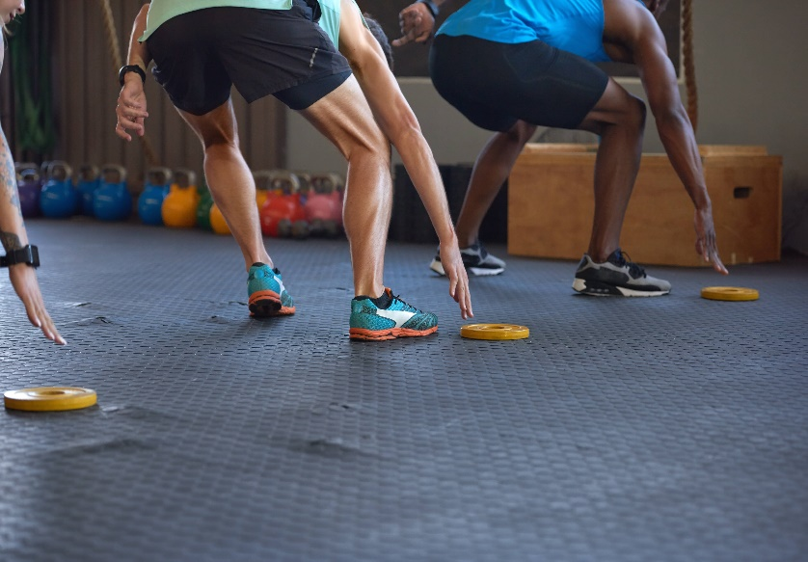
Types of Training – INTERVAL training
Interval Training
A type of training which features distinct periods of work followed by periods of rest
Features:
One of the most popular forms of training for both anaerobic and aerobic endurance.
Adaptable to the individuals needs and sports
The following must be taken into consideration when designing an Interval training session…
  Duration
  Speed / Intensity
  Number of Sets / Repetitions
  Duration of rest periods
  Type of training used (aerobic / anaerobic)
Example:
Ideal for team sports such as football, hockey and rugby (sprint 30m, rest, repeat 5 times)

Slide 22
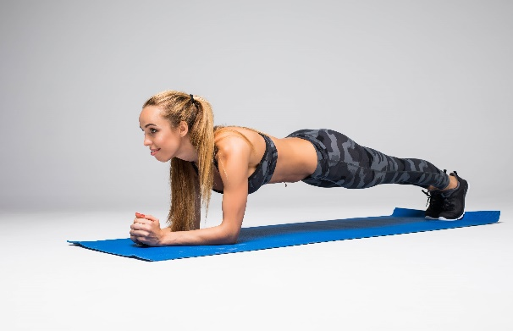
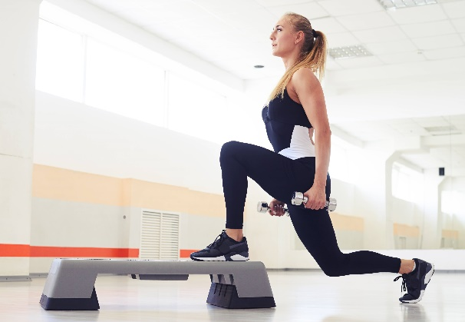
Types of Training – Circuit training
Circuit Training (Interval Training)
A method of training that incorporates different stations to stress / overload different muscle groups
Features:
Involves a number of ‘exercise stations’ arranged in a particular way called a circuit
Can use either repetition number (20 press-ups) or timed periods for each station (30 secs)
Can be adaptable to any performers activity / sporting needs
NO muscle group should be worked on two stations consecutively.
Can incorporate skills as well as exercises
Usually 11 – 15 stations in each circuit
Easily changed as individuals progress
Individuals can complete different circuits at same time as each other.
Example:
Skipping – Press Ups – Squats – Dips – Crunches – Rest – Repeat

Slide 23

Types of Training – Weight training
Weight Training (Interval Training)
A form of training that involves the use of resistance to overload muscle groups and force adaptions that grow muscle tissue
Features:
Weighted exercise are performed in a circuit
6-8 Reps (High Weight 70Kg) = Muscular Strength
10-12 Reps (Lower Weight 15Kg) = Muscular Endurance
Muscle groups are overloaded / stressed forcing the body to adapt
Adaptions:
Micro tears occur in the muscle fibres which then, through suitable rest time and diet) grow back larger in size and there fore collectively stronger.

Slide 24
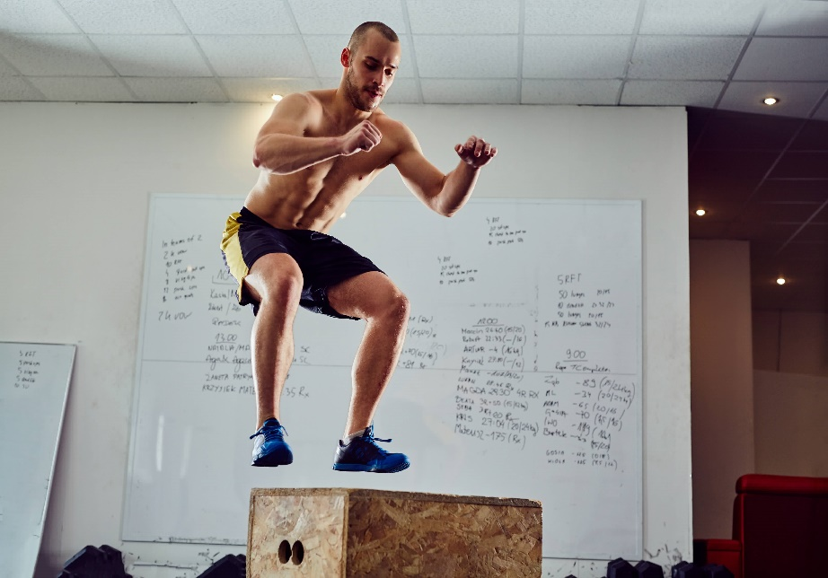
Types of Training – Plyometrics
Plyometrics (interval training)
A form of training that involves rapid and repeated stretching and contracting of muscles designed to increase strength and power
Features:
Sometimes called depth jumping
Type of training used to develop Power and dynamic strength
Improves the speed in which muscles contract (Power)
Involves bounding, hopping and jumping.
Example:
Any sport that involves sprinting, throwing and jumping will benefit from this type of training such as Basketball, netball or rugby

Slide 25

Types of Training – HIIT training
High Intensity Interval Training (HIIT)
A Cardiorespiratory training technique that alternates brief speed and recovery intervals to increase the overall intensity of a work out.
Features:
Training at a high exertion level typically performed over 30 sec - 3 min interval
The higher the intensity (80-90% max HR) the shorter the speed interval
Recovery intervals are shorter or equal to speed intervals
Typically lasts no longer than 30mins
Adaptions:
This type of training not only improve performance but also improves the ability the muscles to burn fat.

Slide 26
Learning
Outcomes
Applying the principles of training
  By the end of this topic you should …
  Understand the Key components of a warm up, including the effects on:
  pulse raising mobility
  stretching
  dynamic movements
  skill rehearsal.
  Know the Physical benefits of a warm up
  Warming up muscles
  Body temperature
  Heart rate
  Flexibility of muscles and joints
  Pliability of ligaments and tendons
  Blood flow and oxygen to muscles
  The speed of muscle contraction
  Understand the key components of a cool down and be able to apply examples
  low intensity exercise
  stretching
  Know the benefits of a cool down
  Helps the body’s transition back to a resting state
  Gradually lowers heart rate
  Gradually lowers temperature
  Circulates blood and oxygen
  Gradually reduces breathing rate
  Increases removal of waste products such as lactic acid
  Reduces the risk of muscle soreness and stiffness
  Aids recovery by stretching muscles.
Optimising training
(contd …)

Slide 27
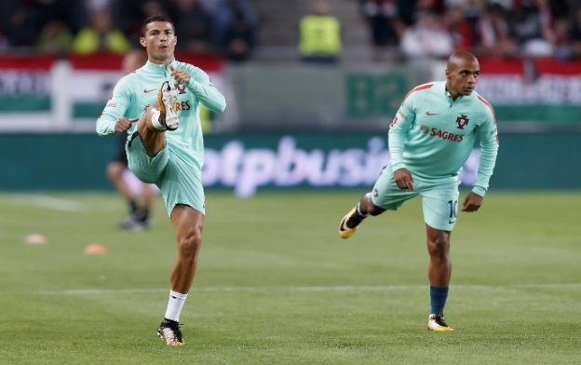
The key components of a warm up
Warm Up: Preparing the body for activity in order to reduce the risk of injury
Component 1: Pulse Raising exercises - to slowly raise heart rate and gradually increase body temperature
      e.g. jogging / cycling
Component 2: Mobility exercises that take joints through their full range of movement e.g. high knees / arm swings
Component 3: Stretching can include static or dynamic type stretches e.g. lunges, walking hamstring stretch.
Component 4: Dynamic Movements that show a change in speed and direction e.g. shuttle runs
Component 5: Skill Rehearsal or practising the common movement patterns and skills that will be used in the activity e.g. dribbling drills for football, shooting in basketball.
Task: Design a warm up routine for your own sport that you will perform in every training session

Slide 28
Physical benefits of the warm up
Warms up the muscles & prepares the body for physical activity
Increases Heart Rate (release of adrenaline)
Increases blood flow and oxygen to working muscles
Decreases the likelihood of injury and muscle soreness (DOES NOT PREVENT INJURY
Increase in Body Temperature (increased energy production)
Increases Flexibility of muscles and joints
Increases Pliability of ligaments and tendons
Increases speed of muscle contraction

Slide 29
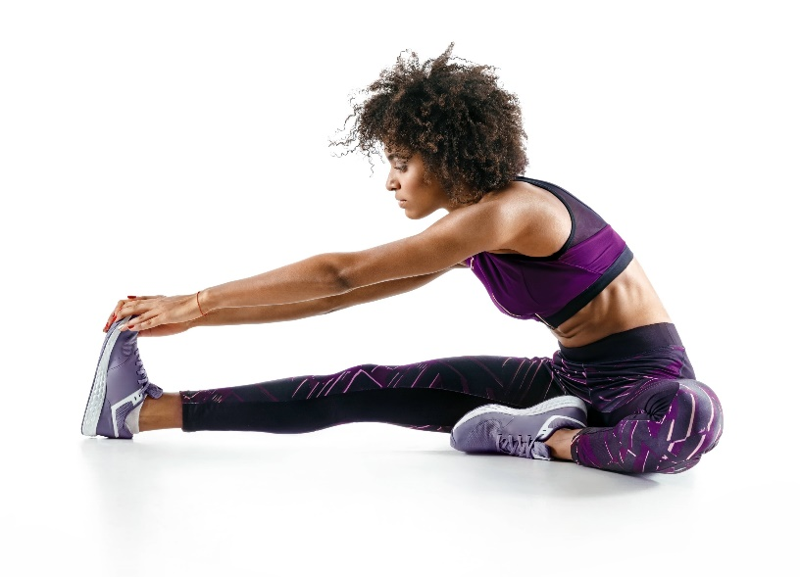
Components of the cool down
The Cool Down: Retuning the body to a state of rest after physical activity
Component 1: Low Intensity Exercises
aimed to gradually lower Heart Rate and reduce the body’s core temperature
Examples - light jogging
Component 2: Stretching
includes steady and static stretches which are held for longer than in the Warm Up, example 15 seconds.
Examples - hamstring stretch & triceps stretch

Slide 30
Physical benefits of the cool down
The Cool Down is essential to an effective training session.
Cool downs allow Oxygen to flush through muscle tissue and get rid of Lactic Acid.
The Cool Down is crucial in…
Helping the body’s transition back to resting state
Gradually lowering heart rate
Gradually lowering temperature
Circulating blood and oxygen
Gradually reducing breathing (respiratory) rate
Increasing the removal of waste products such as lactic acid
Reducing the risk of muscle soreness and stiffness
Reducing the risk of damage to joints
Aiding recovery by stretching muscles
Exam Tip:
You must always include GRADUALLY when writing about lowering heart rate/breathing rate/temperature.
Task: Design a cool down routine for your own sport that you will perform in every training session

Slide 31
OCR Resources: the small print
OCR’s resources are provided to support the delivery of OCR qualifications, but in no way constitute an endorsed teaching method that is required by the Board, and the decision to use them lies with the individual teacher. Whilst every effort is made to ensure the accuracy of the content, OCR cannot be held responsible for any errors or omissions within these resources.
Our documents are updated over time. Whilst every effort is made to check all documents, there may be contradictions between published support and the specification, therefore please use the information on the latest specification at all times. Where changes are made to specifications these will be indicated within the document, there will be a new version number indicated, and a summary of the changes. If you do notice a discrepancy between the specification and a resource please contact us at:
resources.feedback@ocr.org.uk.
© OCR 2018 - This resource may be freely copied and distributed, as long as the OCR logo and this message remain intact and OCR is acknowledged as the originator of this work. OCR acknowledges the use of the following content:
Please get in touch if you want to discuss the accessibility of resources we offer to support delivery of our qualifications: resources.feedback@ocr.org.uk
4 > Elementary school boys and girls running in an open field / Monkey Business Images / Shutterstock.com 5 > Athlete jumping / bezikus / Shutterstock.com 6 > Bodybuilder training in a gym / Istvan Csak / Shutterstock.com 8 > Flooded soccer pitch / Marcel Jancovic / Shutterstock.com 8 > Knee of injured football player / Capifrutta / Shutterstock.com 13 > Hand with pen mark calendar / Pretty Vectors / Shutterstock.com 16 > Triathlon Varga Brownlee brothers / / Shutterstock.com / ED 19 > 2000 participants cycle toward Colorado National Monument / Linda Armstrong / Shutterstock.com / ED 20 > Young woman jumping participating in a trail race through the forest / David Pereiras / Shutterstock.com 21 > Anonymous people reaching lunging in gym as they run fast short sprints in gym / Daxiao Productions / Shutterstock.com | 22 > Young attractive woman practicing yoga / F8 studio / Shutterstock.com 22 > Young woman holding dumbbells while being in squat position in a health club / By ArtFamily / Shutterstock.com 23 > Fitness asian woman doing exercise and lifting barbell weights in sport gym / Peera_stockfoto / Shutterstock.com 24 > Box jump exercise / baranq / Shutterstock.com 25 > Young woman in sportswear doing exercise during intensive circuit training in gym class / Jacob Lund / Shutterstock.com 27 > Cristiano Ronaldo of Portugal warms up with Joao Mario of Portugal / Laszlo Szirtesi / Shutterstock.com 29 > Sporty girl stretching her hamstring / RomarioIen / Shutterstock.com

