Slide 1
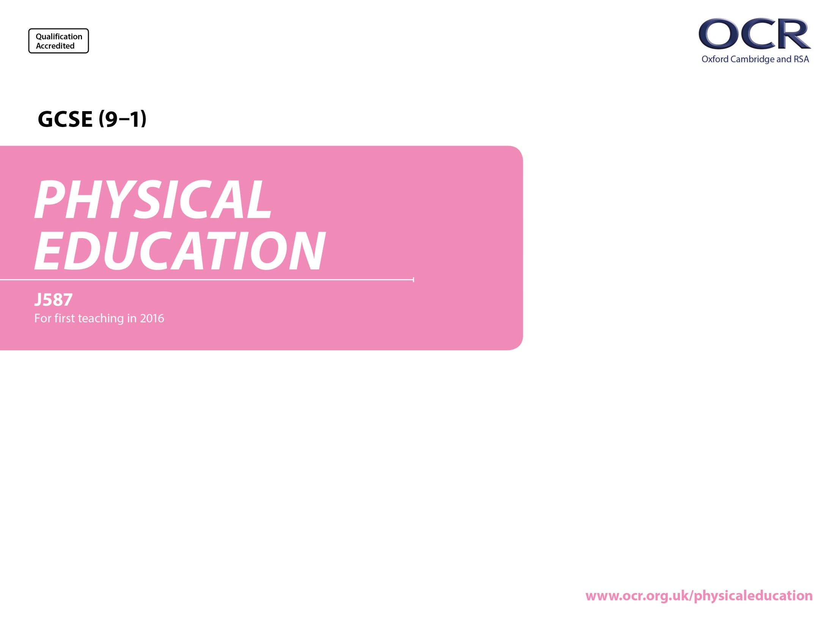
Applied Anatomy and Physiology

Slide 2
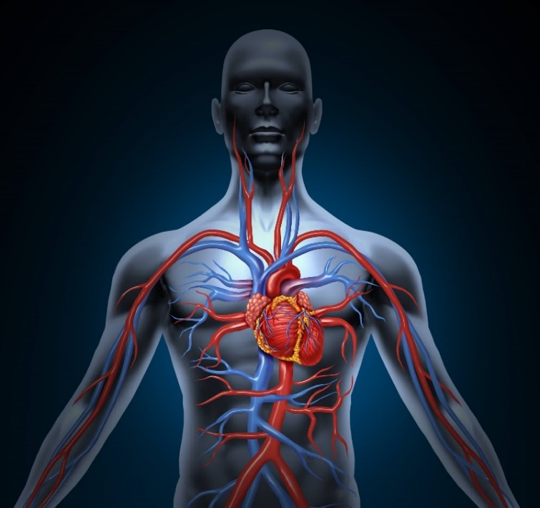
Structure and function of the cardiovascular system
Learning Outcomes
1.1.d. The Cardiovascular and respiratory systems
By the end of this topic you should …
Know the double-circulatory system (systemic and pulmonary)
Know the different types of blood vessel
  arteries
  capillaries
  veins
Understand the pathway of blood through the heart:
  Atria
  Ventricles
  Valves of the heart
  Septum and major blood vessels
  Aorta
  Pulmonary artery
  Vena cava
  Pulmonary vein
Know the definitions of:
  Heart Rate
  Stroke Volume
  Cardiac Output
Know the role of red blood cells.

Slide 3
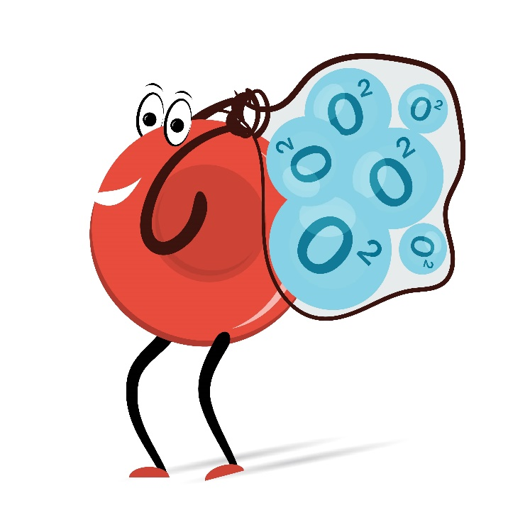
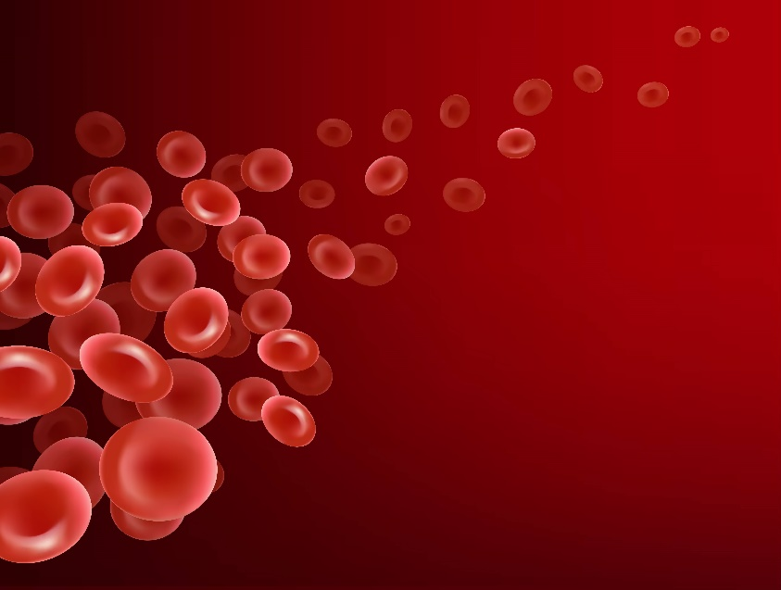
The Cardiovascular and respiratory systems
THINKING QUESTIONS…...
HOW DO WE GET OXYGEN TO OUR MUSCLES?
HOW DOES
BLOOD TRAVEL THROUGH OUR BODY?
WHICH ORGAN IS MORE IMPORTANT
HEART OR LUNGS?

Slide 4
The cardiovascular system
So What do we Know Already?
Structure and function of the cardiovascular system
TASK: add to the spider diagram any words you would associate with the cardiovascular system
Heart Rate (BPM)
The
HEART
Blood Vessels
The Human Cardiovascular System
Blood Pressure
Red blood cells
Oxygenated & deoxygenated Blood
Transport of Oxygen around the body

Slide 5
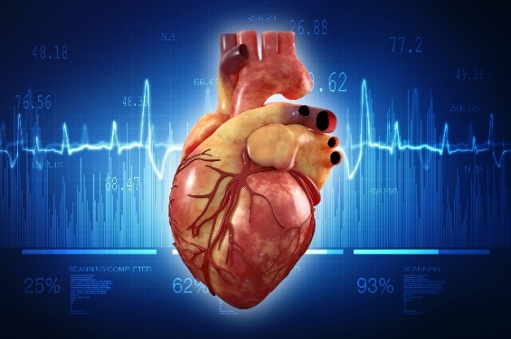
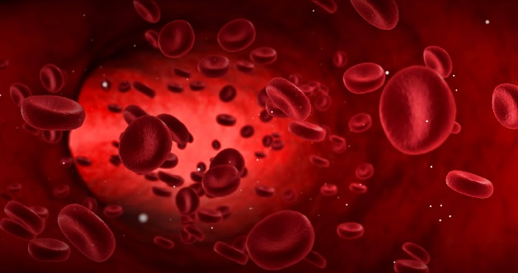
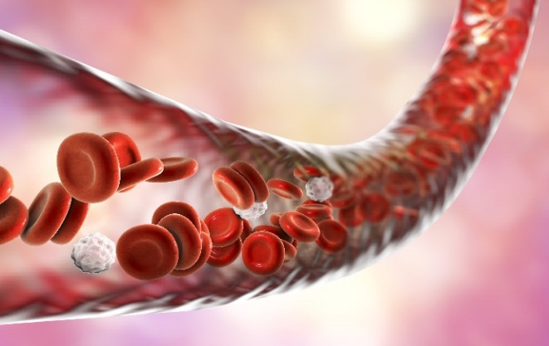
Structure and function of the cardiovascular system
What is the Cardiovascular system?
The cardiovascular system consists of the
Heart
Blood
Blood Vessels
Heart rate (aka Pulse Rate) is the number of times the heart Beats Per Minute (BPM).
Resting Heart Rate should be between 60-80 BPM (72 often regarded as the average resting Heart Rate).
TASK: find and take your Resting HR
The Heart is a muscular pump, which pushes blood around the body’s network of blood vessels.

Slide 6
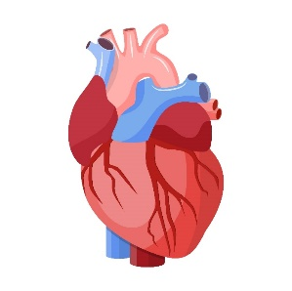

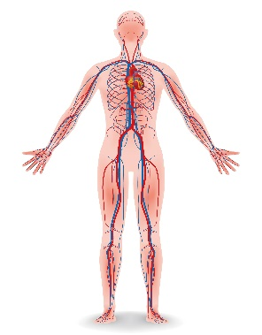
Structure and function of the cardiovascular system
The heart - Is a muscular pump, which pushes blood along the many blood vessels in the body
Blood – Blood is pumped around the body by the heart and has two functions.
.
Blood vessels – Run throughout the body allowing blood to travel to organs, muscles etc.
(3 types - Arteries, Veins & Capillaries).
What does the cv system do?

Slide 7
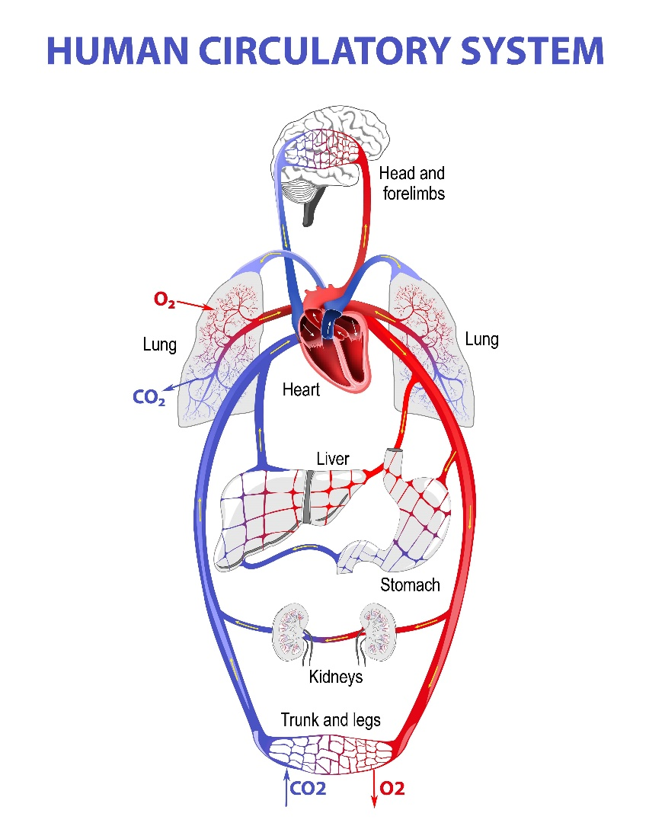
Structure and function of the cardiovascular system
Cardiovascular System
The Function of the Cardiovascular system is
    To supply the body with oxygen & nutrients
    To remove waste products (e.g. CO2)
The heart operates a
double circulatory system
in which blood flows through the heart twice.
1. Pulmonary circulation
i.e. blood flow between the heart and lungs.
2. Systemic circulation
i.e. movement of blood from the heart through the rest of the body (excluding the lungs), then back to the heart.

Slide 8
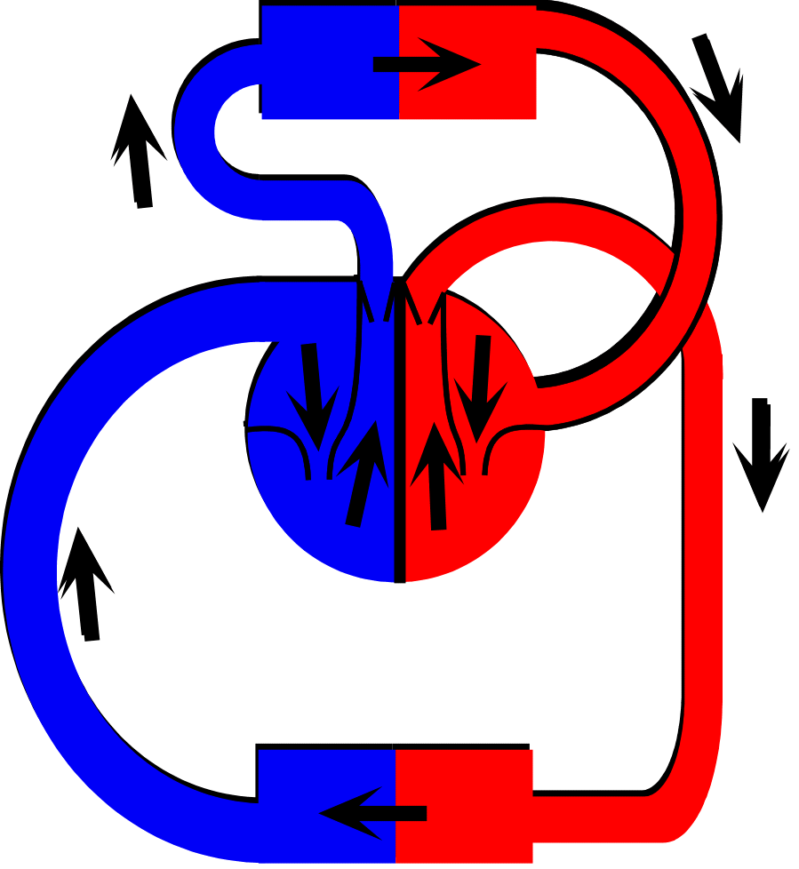
Structure and function of the cardiovascular system
How Blood is Pumped around the Body
Blood flows around the body in a ‘figure of eight’ circuit, passing through the heart twice on each circuit.
Lungs
Blood travels Away from the heart through Arteries (A).
(A)
(A)
Blood returns to the heart through veins (V).
(V)
(V)
There are 2 separate ‘loops’ to the circuit:
Heart
The top loop – carries blood from the heart to the lungs and back.
The bottom loop – carries blood from the heart to all over the body and back.
Body

Slide 9
Structure and function of the cardiovascular system
Blood vessels
Once blood leaves the heart, it is transported around the body in three main types of blood vessels:
  Arteries
  Veins
  Capillaries
https://www.youtube.com/watch?v=PgI80Ue-AMo&list=PL806169ECA3C97794

Slide 10
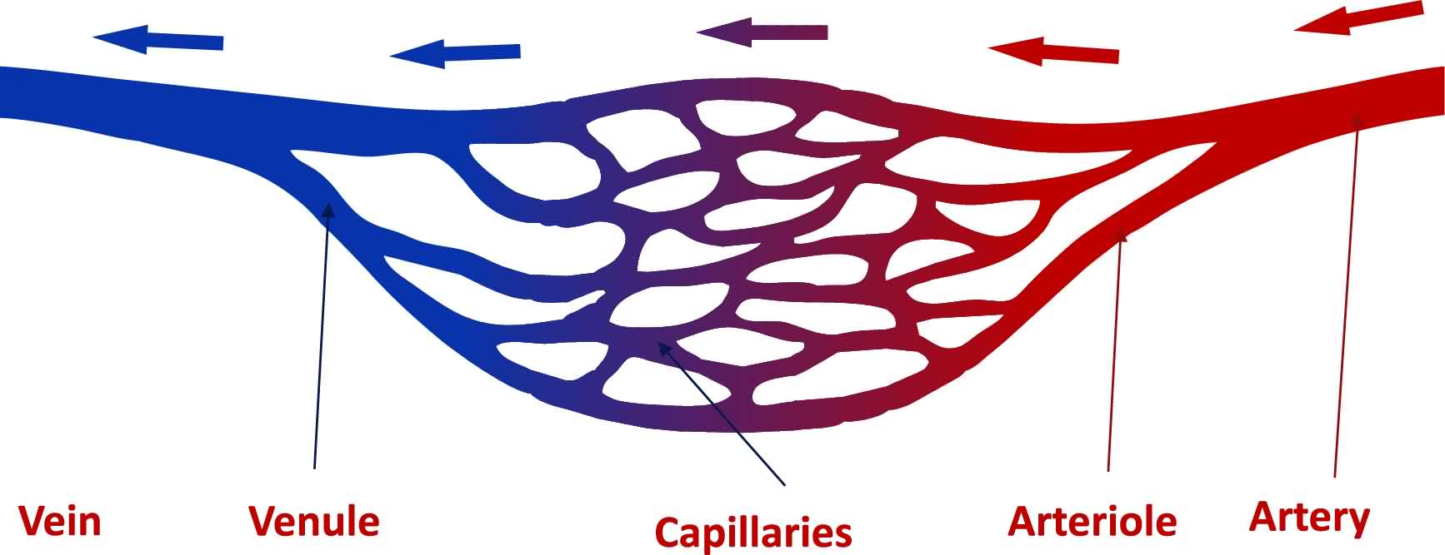
Structure and function of the cardiovascular system
Veins
transport blood from all over the body back to the heart and lungs for re-oxygenation.
Arteries
transport the oxygenated blood away from the left side of the heart.
Veins carry blood under a low pressure
Arteries carry blood under a high pressure
They are blue because they carry blood that is full of waste products, and are low in oxygen.
The largest artery in the body, connected directly to the heart, is the Aorta.

Slide 11
Structure and function of the cardiovascular system
An unique feature of Veins is that they have valves.
Like the valves in the heart, they are there to prevent a backflow of blood.
The blood must flow in one direction only,
against gravity in most cases, back to the heart.
https://www.youtube.com/watch?v=hXrZI4P4hYg

Slide 12
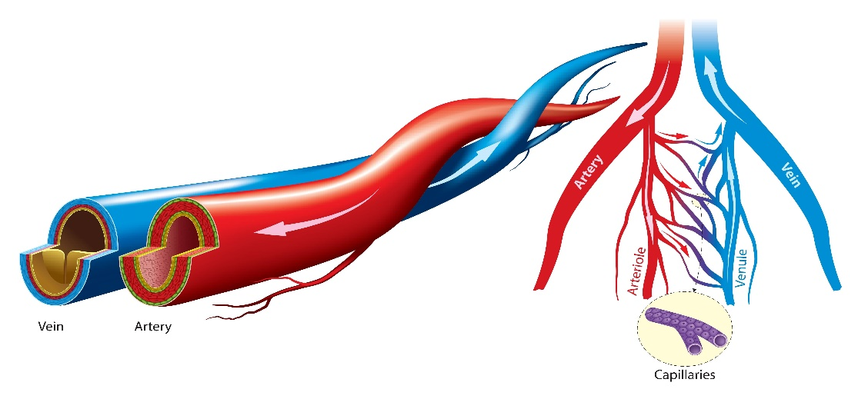
Structure and function of the cardiovascular system
Capillaries are small blood vessels that carry blood to and from the body’s cells.
They are one cell thick and are exchange points where oxygen and carbon dioxide cross into the tissue cells (muscles) from the arterioles.
https://www.youtube.com/watch?v=CjNKbL_-cwA

Slide 13
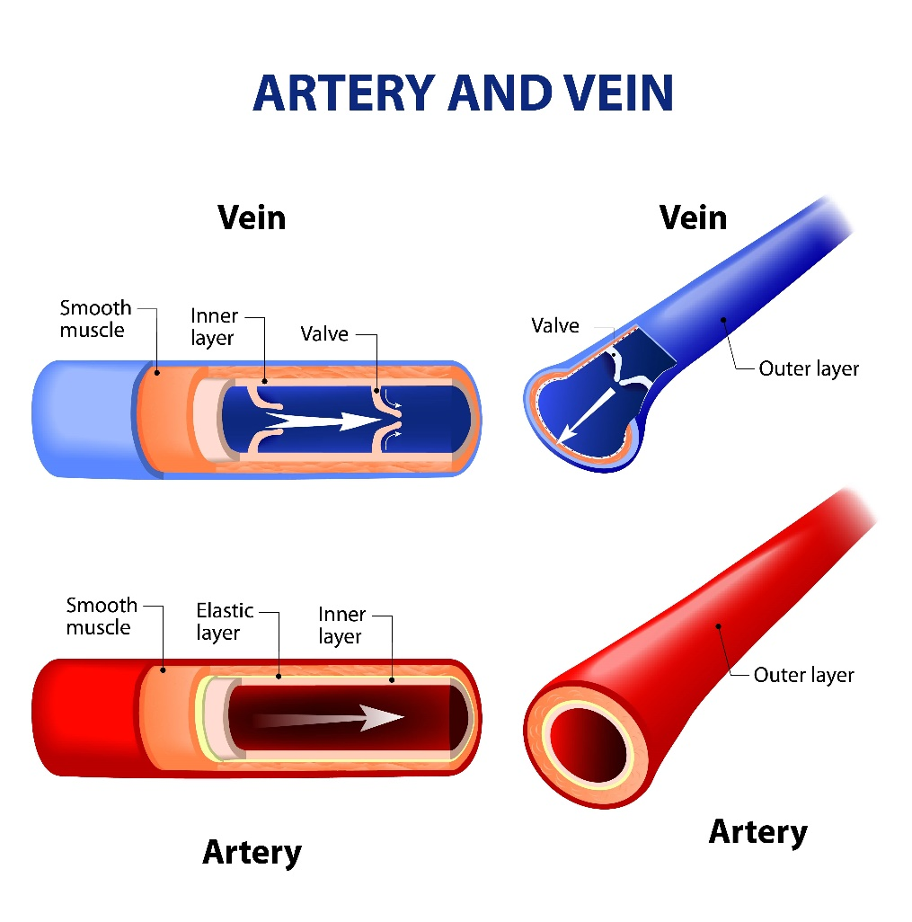
Structure and function of the cardiovascular system
  ARTERIES
  Take blood away from the heart
  Walls are thick and elastic
  Has small lumen
  Has a pulse and blood travels in spurts
  Have no valves
  VEINS
  Take blood to the heart
  Walls are thin
  Has large lumen
  Has no pulse and blood travels smoothly
  Have valves

Slide 14
Structure and function of the cardiovascular system
The role of red blood cells
Red blood cells carry oxygen from the lungs to the muscles & Removes CO2 from muscles to lungs.
Contain a red-coloured compound called haemoglobin which bonds with oxygen to form oxyhaemoglobin.
These cells are responsible for carry oxygen to working muscles.
Without these cells performers would fatigue and stop.
How do red blood cells help a sports performer?

Slide 15
Structure and function of the cardiovascular system
Redistribution of blood during exercise
During exercise, blood flow to muscles increases to meet the increase in oxygen demand.
This redirection of blood flow to the areas where it is most needed is known as
vascular shunt.

Slide 16
Structure and function of the cardiovascular system
Redistribution of blood during exercise
The body uses two mechanisms to control this redistribution.
1. Vasoconstriction (narrowing) of blood vessels to areas of the body not involved in exercise (stomach, brain etc).
2. Vasodilation (expanding) of blood vessels suppling blood to areas of the body involved in exercise (working muscles).
Result is greater blood flow (carrying oxygen) to working muscles.
Think about the following:
Where is the blood needed when you exercise?
Where is blood needed just after a meal?
What will happen to blood vessels around the muscles?

Slide 17
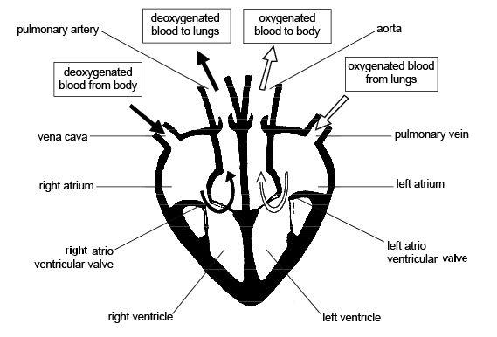
Structure and function of the cardiovascular system
TASK: Label the diagram below in your table groups…

Slide 18
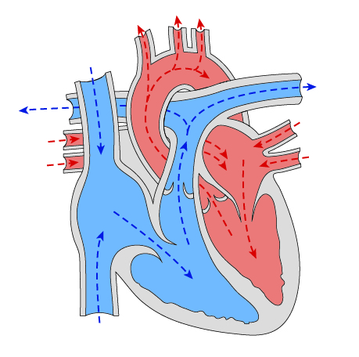
Structure and function of the cardiovascular system
TASK: Label the diagram below

Slide 19
Structure and function of the cardiovascular system
The ANSWERS
LEFT ATRIUM
RIGHT ATRIUM
An upper chamber receiving
oxygenated blood from the lungs
An upper chamber receiving
de-oxygenated blood from the body.
RIGHT VENTRICLE
LEFT VENTRICLE
A lower chamber containing
de-oxygenated blood, to be pumped to the LUNGS
A lower chamber containing
oxygenated blood, to be pumped around the body.
Notes:
Photo by: © istock Photo

Slide 20
Structure and function of the cardiovascular system
Main blood vessels
Pulmonary vein
Vena Cava
Returns
oxygenated blood to the heart.
Returns deoxygenated blood to the heart.
Pulmonary artery
Aorta
Carries deoxygenated blood from the heart to the lungs.
Oxygenated blood is pumped at high pressure from the heart to the body
REMEMBER:
Pulmonary circulation – i.e. blood flow between the heart and lungs
Systemic circulation – i.e. movement of blood from the heart through the rest of the body (excluding the lungs), then back to the heart
Notes:
Photo by: © istock Photo

Slide 21
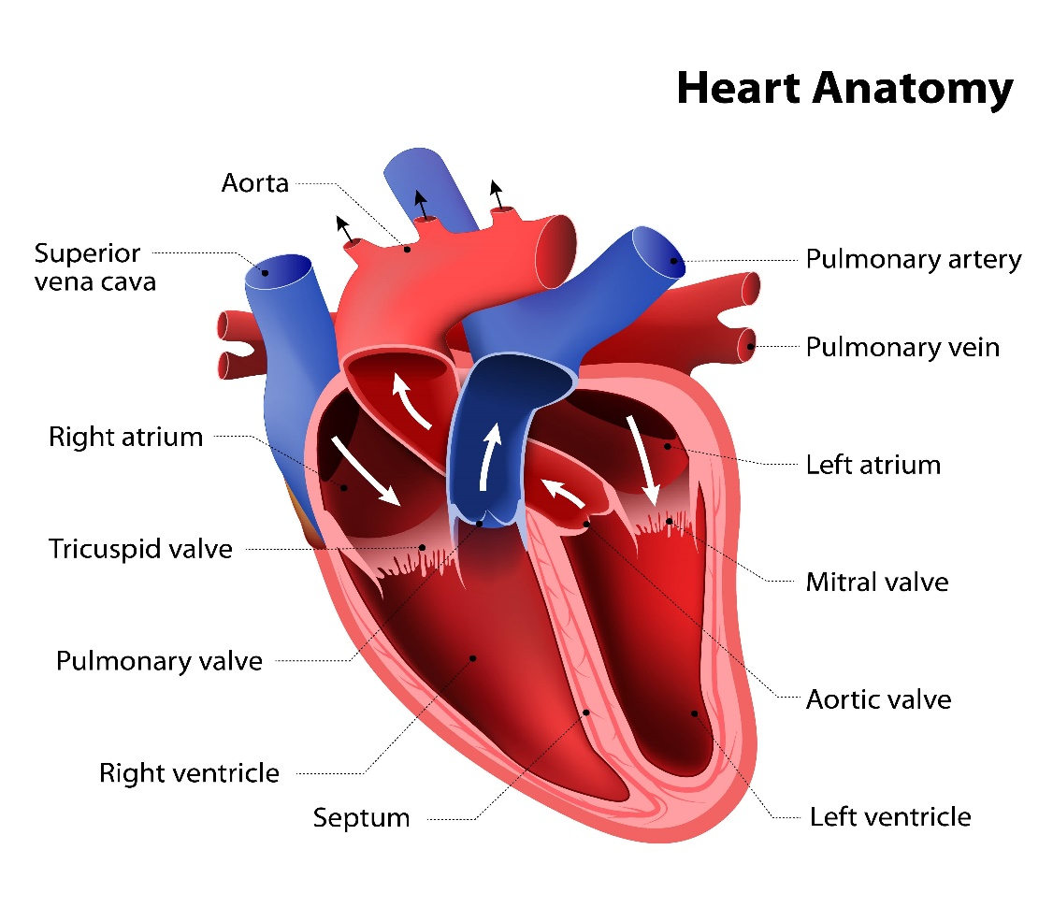
Structure and function of the cardiovascular system
Other important structures of the cardiovascular system
Prevent blood flowing back into the left atrium.
Bicuspid valve
Prevent expelled blood flowing back into the heart.
Semi-lunar valves
Prevent blood flowing back into the right atrium from the ventricle.
Tricuspid valve
The wall dividing the left and right sides of the heart.
Septum
Notes:
Photo by: © istock Photo

Slide 22

Structure and function of the cardiovascular system
The ANSWERS
Bicuspid valve
Semi-lunar valves
Prevent blood flowing back into the left atrium.
Prevent expelled blood flowing back into the heart.
Septum
The wall dividing the left and right sides of the heart.
Tricuspid valve
Prevent blood flowing back into the right atrium from the ventricle.
Notes:
Photo by: © istock Photo

Slide 23
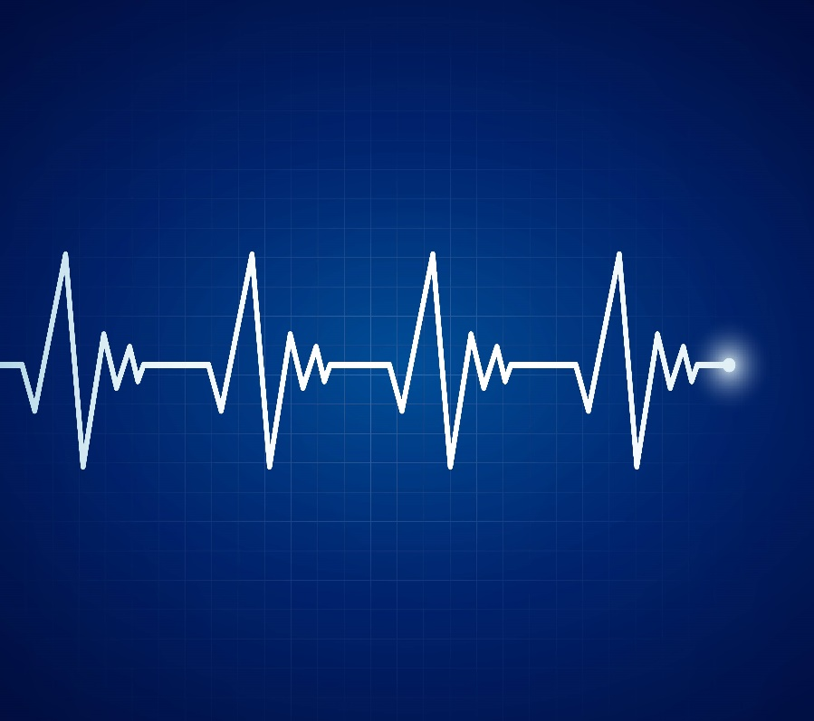
Structure and function of the cardiovascular system
The Cardiac Cycle
The heart makes two very important sounds:
Lub / Dub!
The systole and diastole.
Remember this process starts in the right atrium and right ventricle moving to the left atrium and finally the left ventricle.
Systole: The heart emptying.
The heart contracts
Diastole: The heart filling with blood.
The heart is relaxing

Slide 24
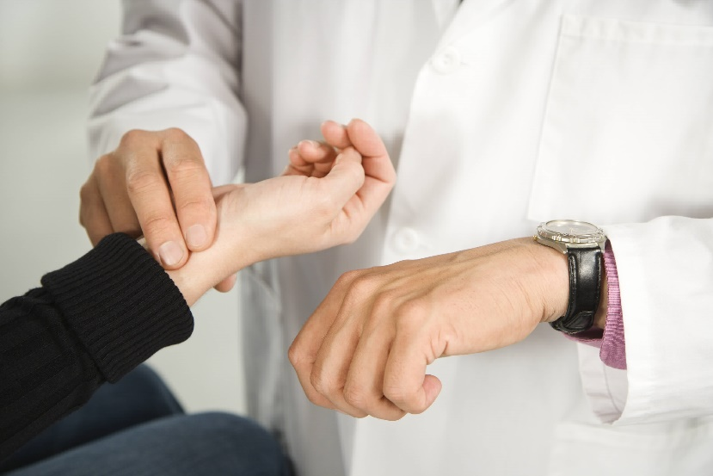
Structure and function of the cardiovascular system
Key Terms You NEED to know
Heart rate (HR)
The heart contracts and relaxes in a rhythm, which produces a heartbeat (started by an electrical impulse from the Sino-Atrial (SA) Node)
Measurement of the Heart Rate = Beats per Minute (HR=Bpm)
Average resting HR = 75bpm
Measuring Heart Rate:
Done by checking the Radial Pulse
Index and middle fingers on the palm side of the wrist just below the thumb.
TASK: Record your own Resting Heart Rate is it normal?

Slide 25
Structure and function of the cardiovascular system
Key Terms You NEED to know
Stroke Volume (SV):
  The volume of blood pumped out of the heart by each ventricle during one contraction
  Measurement of the Stroke Volume = milliliters per beat (ml per beat)
Cardiac Output (Q):
  The amount of blood ejected from the heart (Left Ventricle) in one minute
  Measurement of the Cardiac Output = litres/min
The higher the cardiac output, the more oxygen can be delivered to the muscles and the longer and harder the athlete can work
Cardiac Output (CO)
Stroke Volume (SV)
Heart Rate
(HR)
Notes:
60 × 90 = 5400 ml

Slide 26
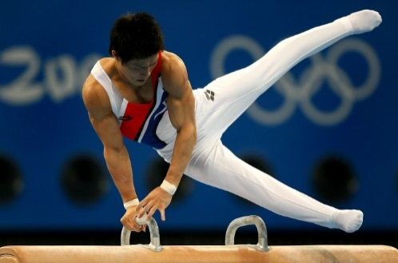
Structure and function of the cardiovascular system
Interpreting heart rate data & graphs
Figure 2 below shows Freddie’s cardiovascular and respiratory measurement taken at rest and during exercise.
Rest
Heart rate (bpm) | Stroke volume (ml) | Breathing rate (number per min) | Muscle temperature
72 | 60 | 18 | Normal
During exercise
Heart rate (bpm) | Stroke volume (ml) | Breathing rate (number per min) | Muscle temperature
156 | 140 | 48 | Hot
Describe what the tables tell you?
Discuss why these changes have taken place?

Slide 27
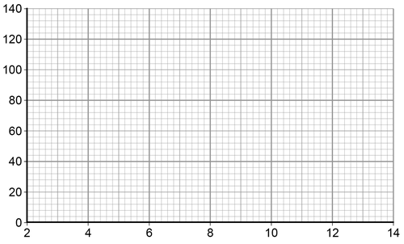
Structure and function of the cardiovascular system
Interpreting heart rate data & graphs
TASK: Plot the information shown in the table on the graph paper below to show how heart rate has changed over time. Label the axes and join up the points to make a line graph.
Time (minutes) | 2 | 4 | 6 | 8 | 10 | 12 | 14
Heart rate (beats per minute) | 68 | 80 | 104 | 120 | 120 | 140 | 90
Describe what the graph tells you?

Slide 28
Extension Task:
A musical quiz on the circulatory system (Heart quiz)
https://www.youtube.com/watch?v=T2iVqTckmPQ

Slide 29
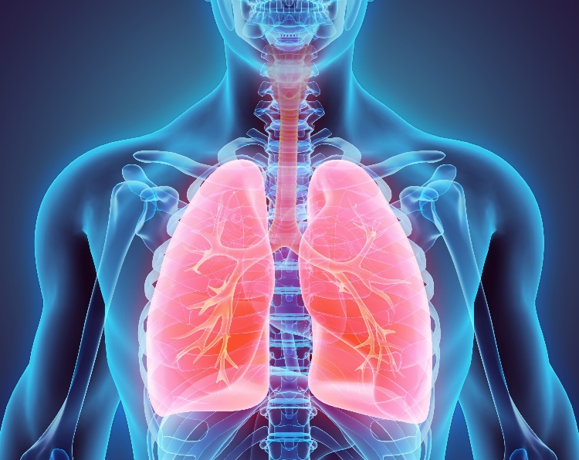
Structure and function of the Respiratory system
Structure and function of the respiratory system
Learning Outcomes
By the end of this topic you should …..
Understand the pathway of air through the respiratory system
Know the role of respiratory muscles in breathing
  Diaphragm
  Intercostals
Know the definitions of :
  Breathing Rate
  Tidal Volume
  Minute Ventilation
Understand about alveoli as the site of gaseous exchange

Slide 30
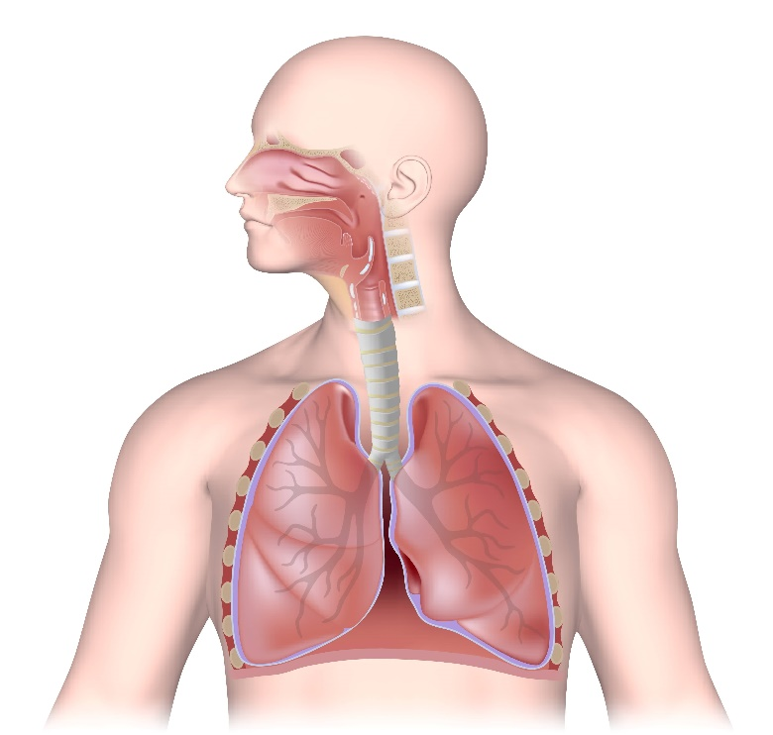
Structure and function of the Respiratory system
The pathway of air
TASK: What do you already know? Can you label the diagram below?

Slide 31
Structure and function of the Respiratory system
The pathway of air
Oxygen travels along the following pathway from the mouth/nose to the alveoli.
The Respiratory System has 2 main Functions:
To ensure Oxygen is brought into the body
To ensure Carbon Dioxide is removed from the body
Nose
Mouth
Bronchi
Trachea
Bronchioles
Lungs
Alveoli

Slide 32
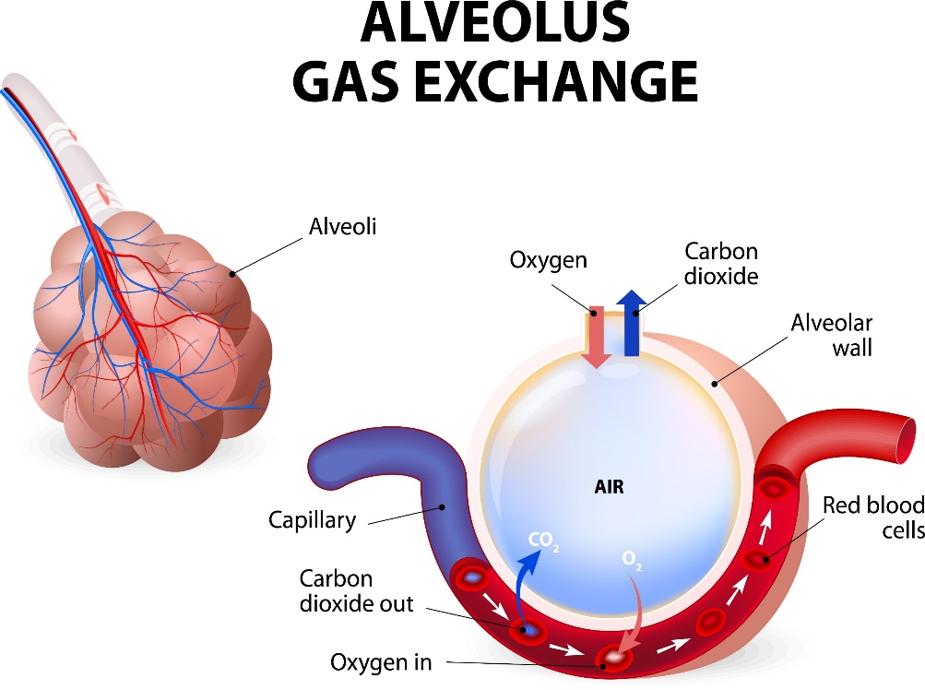
Structure and function of the Respiratory system
Gaseous exchange at the alveoli
Gaseous exchange takes places at the alveoli.
The alveoli are tiny air sacks inside the lungs.
When you breathe in, they fill with air.
The following features assist the process of gaseous exchange:
The alveoli are covered in tiny capillaries (blood vessels).
Gases can pass through the thin walls and travel into the blood stream.
With training this process of gaseous exchange becomes more efficient and therefore improves performance

Slide 33
Structure and function of the Respiratory system
Gaseous exchange at the alveoli
A large blood supply. An increased red blood cell content increases the amount of oxygen supplied to muscles and other body tissues.
Oxygen combines with the red blood cells to form oxyhaemoglobin.
The same haemoglobin also transports carbon dioxide back from the tissues to the lungs.
Capillaries are very near to alveoli, so diffusion distance is very short.
Large surface area of alveoli allows diffusion to take place.
Moist thin walls (one cell thick) of the cells promotes quick diffusion.

Slide 34
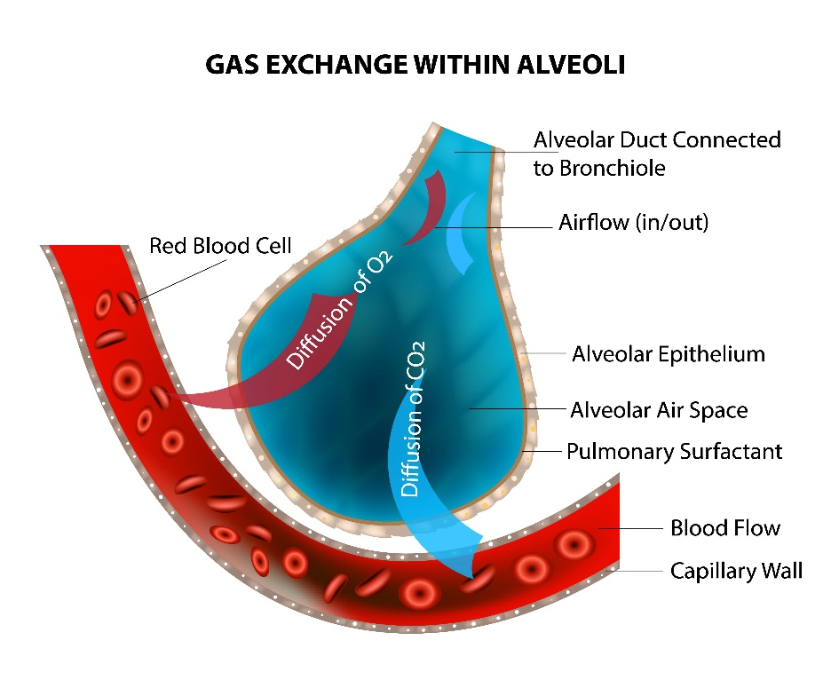
Structure and function of the Respiratory system
Gaseous exchange at the alveoli
Gases will always move from areas of high concentration to areas of a low concentration.
Alternatively think of it as….
A gas will always move from areas where there is more of it, to areas where there is less of it

Slide 35
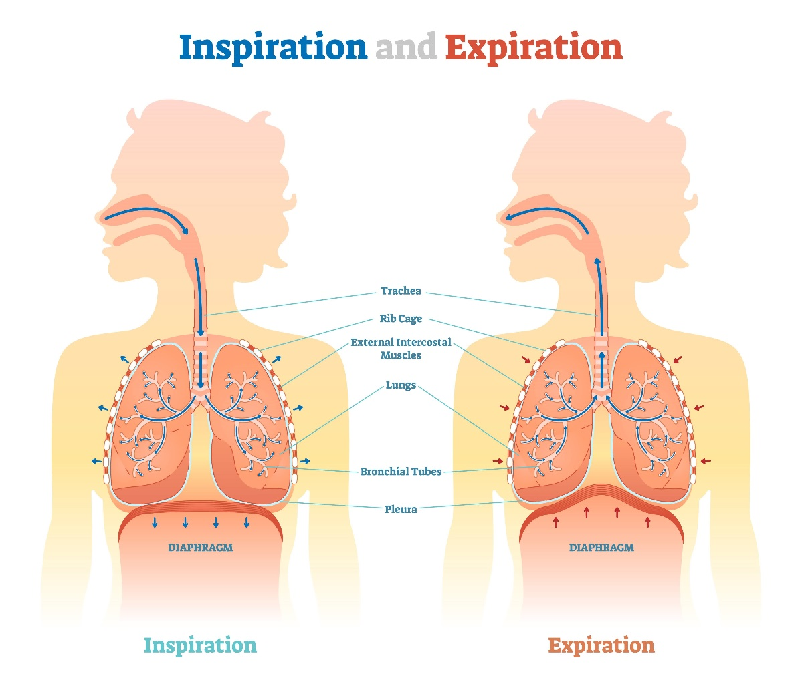
Structure and function of the Respiratory system
The mechanics of breathing
Breathing is the first stage in supplying oxygen to our body cells.
When breathing in (inspiration):
The intercostal muscles contract, lifting the ribs upwards and outwards causing the chest to expand.
The diaphragm contracts. It pulls down and flattens out the floor of the rib cage.
The lungs increase in size as the chest expands.
The pressure inside our lungs falls as they expand. The higher higher pressure of air outside means air is now sucked into the lungs through the nose and mouth.

Slide 36
Structure and function of the Respiratory system
The mechanics of breathing
When breathing out (expiration):
The intercostal muscles relax. The ribs move downwards and inwards under their own weight. The cheat gets smaller.
The diaphragm relaxes. It is pushed back into a domed position by the organs underneath it.
The lungs decrease in size as the chest gets smaller. They are squeezed by the ribs and diaphragm.
The pressure inside the lungs increases as they get smaller. The air pressure outside is now lower than in our lungs. Air is forced out of the lungs through the nose and mouth.

Slide 37
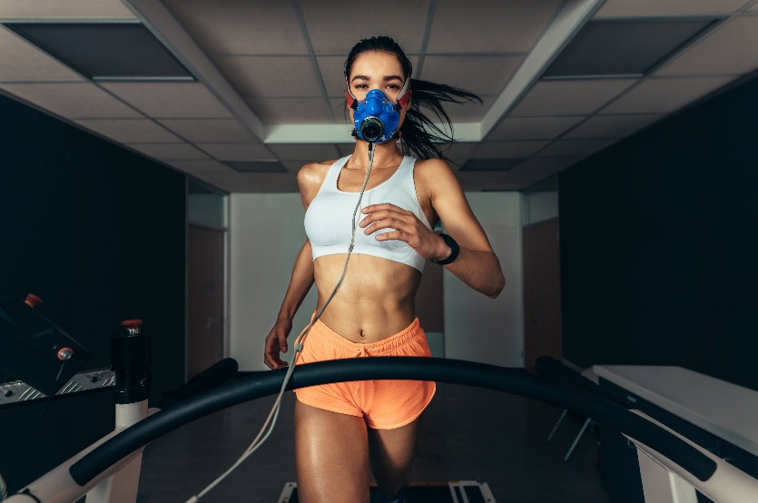
Structure and function of the Respiratory system
Tidal Volume
The volume of air inspired or expired per breath.
This increases during exercise.
Breathing Rate
The number of breaths per minute.
The typical respiratory rate for a healthy adult at rest is 12-20 breaths per minute.
Minute Ventilation
The minute ventilation is the amount of air a person breaths in a minute.
This is calculated using the following equation:
  Minute ventilation = Tidal Volume x Respiratory Rate.
TASK:
Look at the two tidal volume readings below.
What changes have taken place and why?
Tidal volume:
This is the amount you breathe in and out in one normal breath.
Name | Tidal volume at rest (ml) | Tidal volume during exercise (ml)
James | 500 | 3500

Slide 38
Structure and function of the Respiratory system
Breathing volumes and exercise
Name | Tidal volume at rest (ml) | Tidal volume during exercise (ml)
James | 500 | 3500
Exercise causes an increase in breathing rate and depth of breathing.
This is due to a greater need for oxygen in the body and removal of carbon dioxide. .
Tidal volume can increase up to 5-9 times during exercise.
At rest = 0.5L
During jogging = 3L

Slide 39

Structure and function of the Respiratory system
Cardiovascular and respiratory System
Responses by the respiratory and cardiovascular system do not work in isolation.
The demands of exercise cause changes in both systems and one cannot work without the other.
i.e. An increase in breathing rate means more oxygen is inhaled and can only benefit the body if heart rate increases too to pump more blood to working muscles.

Slide 40
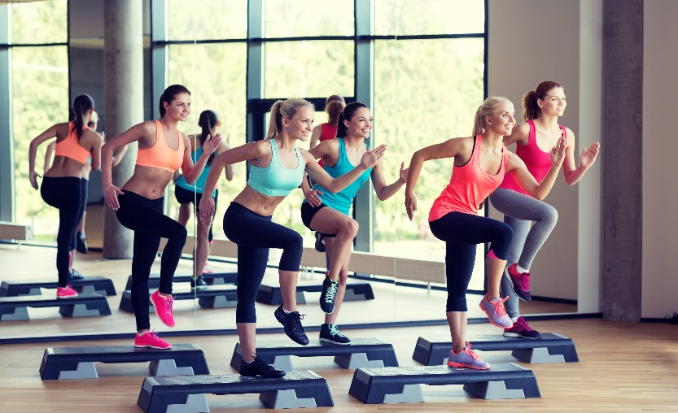
Aerobic & anaerobic Respiration
Aerobic and anaerobic exercise
Learning Outcomes
By the end of this topic you should …
Know the definitions of:
  Aerobic Exercise
  Anaerobic Exercise
Be able to apply practical examples of aerobic and anaerobic activities in relation to intensity and duration.

Slide 41
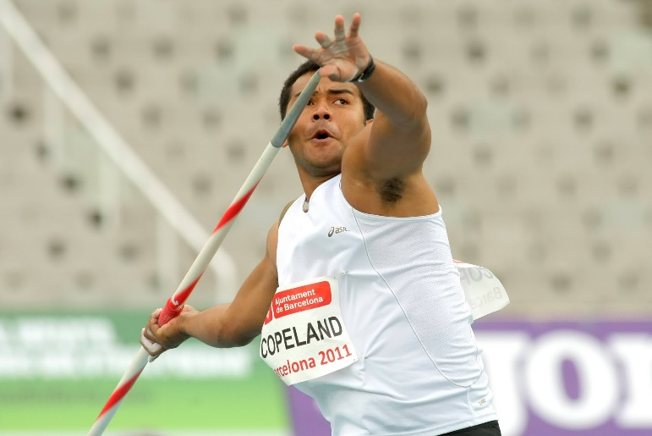
Aerobic Vs Anaerobic
Aerobic & anaerobic Respiration
Anaerobic Activity Working WITHOUT Oxygen
Maximal Effort: When we work at this rate it is not possible to supply the muscles with oxygen they need to release energy for the exercise, so we work without oxygen anaerobically and repay the OXYGEN DEBT once the exercise is complete (Lactic Acid)
Example: (Short, Sharp, Powerful Movements) e.g. Javelin Throw, Shot Putt, 100m Sprint, etc…
Aerobic Activity Working WITH Oxygen
When the demand for oxygen does not overwhelm the body and we are able to supply the working muscles with the oxygen needed to release the required energy for the exercise.
glucose
energy
+ carbon dioxide
+ water
glucose
energy
+ lactic acid

Slide 42
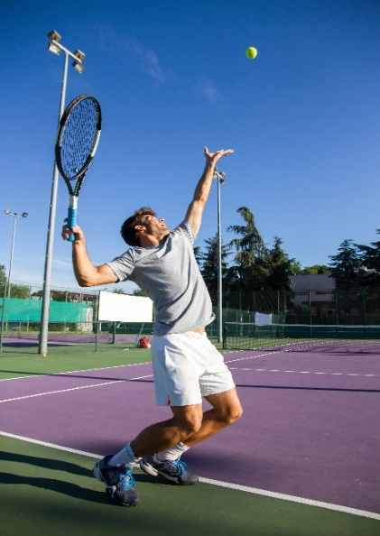
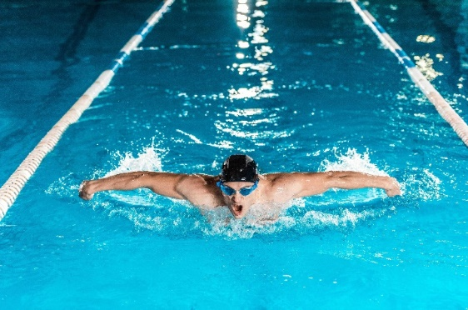
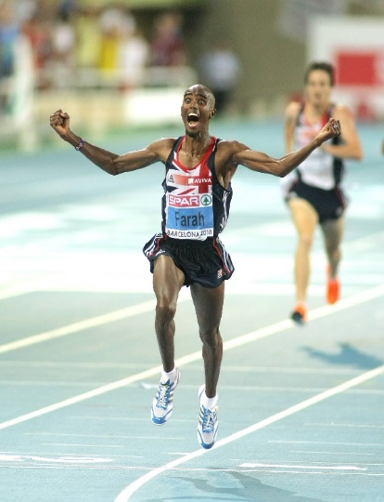
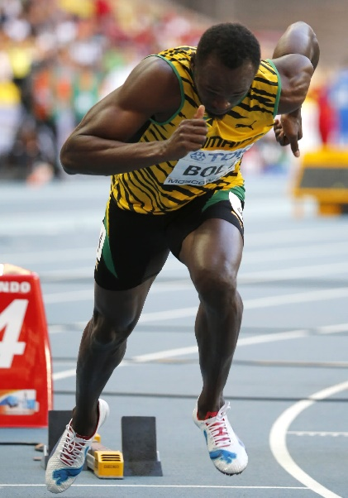
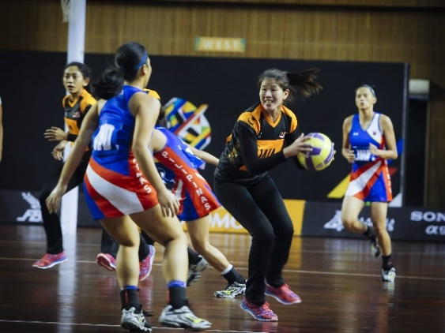
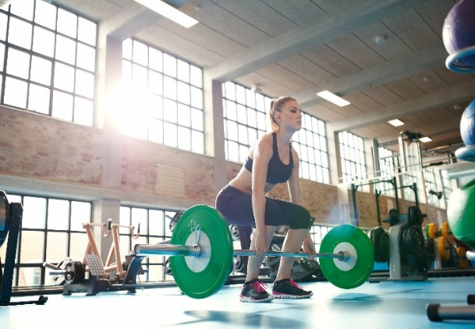
Aerobic & anaerobic Respiration
Anaerobic and Aerobic exercise
TASK: Which respiration system do you think the follow sportspeople mainly use?

Slide 43
Aerobic & anaerobic Respiration
Extension Task
Cardiovascular and Respiratory system
Describe the process of inspiration in particular the role of the diaphragm and intercostal muscles?
Explain the purpose of arteries and veins in the body?
Describe the route of blood from the Vena Cava to the Aorta.
Explain the route of oxygen from the trachea to the muscles.

Slide 44
OCR Resources: the small print
OCR’s resources are provided to support the delivery of OCR qualifications, but in no way constitute an endorsed teaching method that is required by the Board, and the decision to use them lies with the individual teacher. Whilst every effort is made to ensure the accuracy of the content, OCR cannot be held responsible for any errors or omissions within these resources.
Our documents are updated over time. Whilst every effort is made to check all documents, there may be contradictions between published support and the specification, therefore please use the information on the latest specification at all times. Where changes are made to specifications these will be indicated within the document, there will be a new version number indicated, and a summary of the changes. If you do notice a discrepancy between the specification and a resource please contact us at:
resources.feedback@ocr.org.uk.
© OCR 2018 - This resource may be freely copied and distributed, as long as the OCR logo and this message remain intact and OCR is acknowledged as the originator of this work. OCR acknowledges the use of the following content:
Please get in touch if you want to discuss the accessibility of resources we offer to support delivery of our qualifications: resources.feedback@ocr.org.uk
2, 39 > Human circulation cardiovascular system / Lightspring / Shutterstock.com 3, 6 > Red blood cells / Novi Elysa / Shutterstock.com 3, 14 > Red Blood Cell Erythrocyte carries oxygen molecules / VasutinSergey / Shutterstock.com 5 > Human heart / deepadesigns / Shutterstock.com 5 > Red blood cells in artery / donfiore / Shutterstock.com 5 > Blood vessel with flowing blood cells / Kateryna Kon / Shutterstock.com 6 > Anatomical heart / DRogatnev / Shutterstock.com 6 > Human body and circulatory system / metamorworks / Shutterstock.com 7 > Human circulatory system / Designua / Shutterstock.com 10 > Capillaries / NelaR / Shutterstock.com 12 > Artery and vein structure / NoPainNoGain / Shutterstock.com 13 > Artery and vein / Designua / Shutterstock.com 18-20 > Progress of blood through the heart / Blamb / Shutterstock.com 21, 22 > Part of the human heart / Designua / Shutterstock.com 23 > Cardiac Frequency / Ramona Kaulitzki / Shutterstock.com | 24 > Doctor taking patient's pulse / iofoto / Shutterstock.com 29, 39 > 3D illustration of lungs / MDGRPHCS / Shutterstock.com 30, 31 > Respiratory system / Alila Medical Media / Shutterstock.com 32, 33 > Alveolus gas exchange / Designua / Shutterstock.com 34 > GAS EXCHANGE WITHIN ALVEOLI / Sakurra / Shutterstock.com 35, 36 > Inspiration and Expiration anatomical diagram / VectorMine / Shutterstock.com 37 > VO2 max test / Jacob Lund / Shutterstock.com 40, 41 > Fitness sport training gym lifestyle concept / Syda Productions / Shutterstock.com 41 > Spear throwing / Maxisport / Shutterstock.com / ED 42 > Mo Farah / Maxisport / Shutterstock.com / ED 42 > Young professional swimmer / LightField Studios / Shutterstock.com 42 > Netball Athlete during SEA GAMES / Mohd Farizwan Hasbullah / Shutterstock.com / ED 42 > Professional tennis player / PabloBenii / Shutterstock.com 42 > Young woman working hard in the gym / Jacob Lund / Shutterstock.com 42 > Usain Bolt / Kaliva / Shutterstock.com / ED

