Slide 1

Physical Training

Slide 2
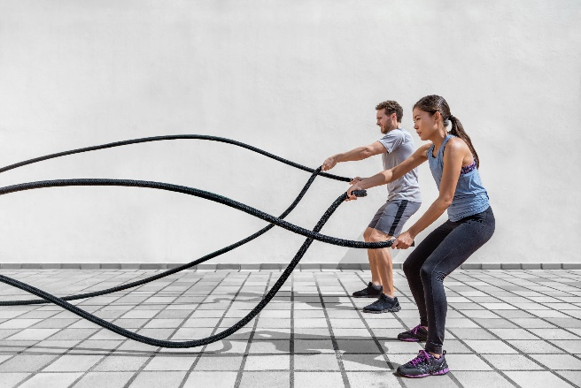
Learning
Outcomes
1.2.a. Components of fitness
By the end of this topic you should …
Know the following components of fitness
  Cardiovascular endurance / stamina
  Muscular endurance
  Speed
  Strength
  Power
  Flexibility
  Agility
  Balance
  Co-ordination
  Reaction time
For each component you should ……………
Know the definition
Be able to apply practical examples where the component is particularly important in physical activity and sport
Know suitable tests for the component
Be able to collect data when both testing and training these components of fitness

Slide 3
What are components of fitness?
TASK: in groups of 3 match the ‘component of fitness’ with it’s definition using the task cards on your table.
Cardiovascular
Endurance
SPEED
Strength
agility
Reaction time
The ability to move the body or body parts quickly
The maximum force a muscle or group of muscles can apply against a resistance
The ability to change direction at speed
The time taken to respond to a stimulus
The ability to continuously exercise without tiring
Muscular endurance
Balance
Co-ordination
POWER
flexibility
The ability to maintain equilibrium, whether stationary or moving
The ability to use two or more body parts together
The ability of a muscle or muscle group to repeatedly contract or keep going without tiring
Strength x speed (maximal force performed at speed)
The range of movement of a joint

Slide 4
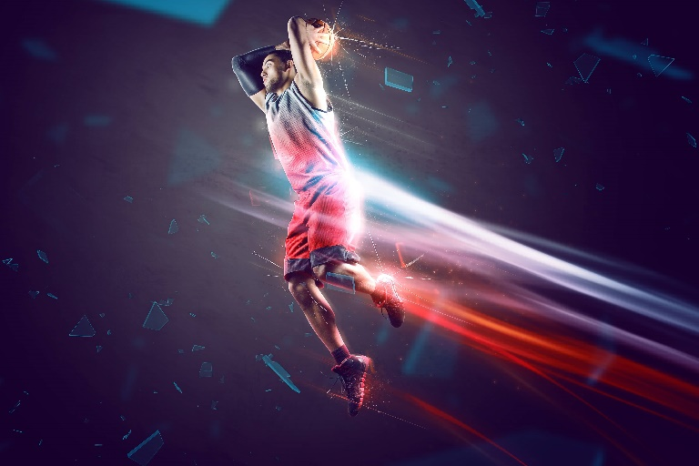
How can we easily remember these components of fitness?
What about an Acronym?
CAN
RETIRED
MEGA
SPORTS
STARS
PLAY
FOR
AMERICAN
BASKETBALL
CLUBS
Cardiovascular endurance
Reaction Time
Muscular Endurance
Strength
Speed
Power
Flexibility
Agility
Balance
Co-ordination
TASK: Come up with your own Acronym!

Slide 5
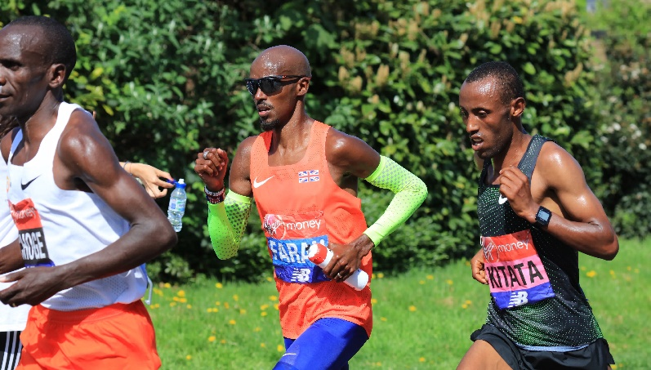
Who would use these components of fitness & why?
Cardiovascular Endurance/stamina:
Who?
Long distance runners/cyclists.
Why?
Good Cardiovascular endurance allows the athlete to exercise the entire body for long periods of time.
Tests?
12 minute Cooper run.
Multi Stage Fitness Test
DEFINITION:
Cardiovascular endurance is the ability to continuously exercise without tiring.
The more oxygen that can be transported around the body the longer muscles can utilise or use this oxygen.
The level of endurance fitness is indicated by an individual’s VO2 Max (the maximum amount of oxygen an individual can take in and use in one minute)
TASK: Come up with your own Sporting Example for Cardio Vascular Endurance/Stamina

Slide 6
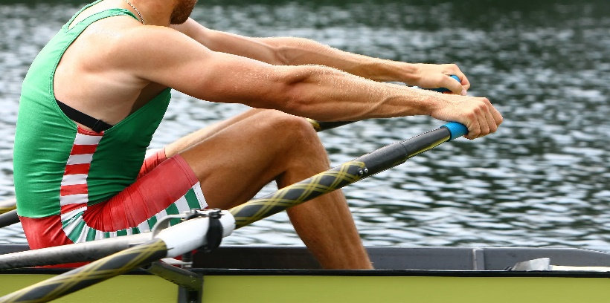
Who would use these components of fitness & why?
Muscular endurance:
Who?
Rowers.
Why?
Good Muscular Endurance allows the athlete to keep moving his or her voluntary muscles many times without getting tired.
Tests?
Press Up test
Sit Up test
DEFINITION:
Muscular endurance is the ability of the muscle or muscle groups in the body to repeatedly contract or keep going with without rest.
Activities such as swimming or running can enlarge slow twitch fibres, which gives greater potential for energy production.
The onset of fatigue is delayed (you get tired less quickly) because of higher maximum oxygen uptake (VO2Max).
By Exercising the size and number of mitochondria in muscles are increased.
Also with exercise there is an increase in myoglobin content within the muscle cell.
TASK: Come up with your own Sporting Example for Muscular Endurance

Slide 7
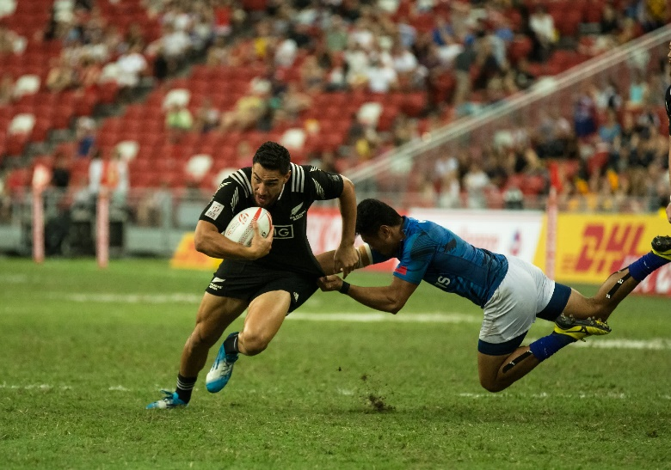
Who would use these components of fitness & why?
Speed:
Who?
Games players.
Example - Rugby players.
When?
For attackers to outrun defenders in the sprint to the line.
Or
For defenders to catch attackers to make tackles.
Or
Make quick passes with the ball.
Test?
30 metre sprint test
DEFINITION:
Speed is the ability to move all or part of the body quickly.
Genetics influence how quick you are, but training can improve your rate or speed of movement.
The amount of fast-twitch muscle fibres also influences speed.
TASK: Come up with your own Sporting Example for SPEED

Slide 8
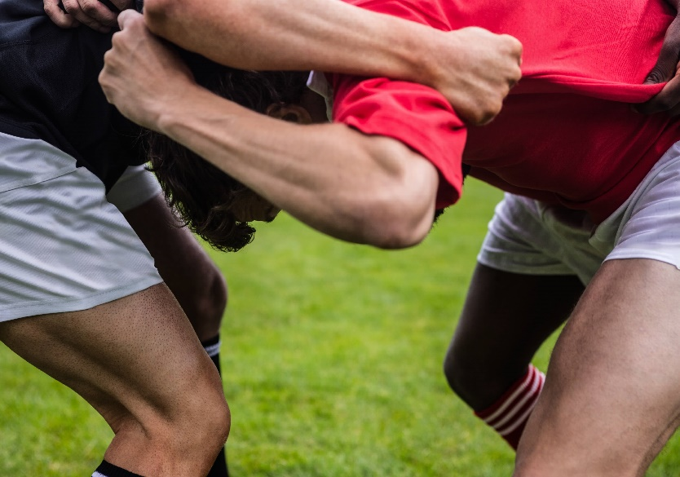
Who would use these components of fitness & why?
Strength:
Who?
Rugby players
Why?
Helps props hold up the scrum safely.
Tests?
1 Rep Max test
Hand grip test
DEFINITION:
Strength is the amount of force a muscle can exert against a resistance.
The amount of force that can be exerted by a muscle depends on the size and number of the muscles involved, as well as the type of muscle fibres used.
TASK: Come up with your own Sporting Example for STRENGTH

Slide 9
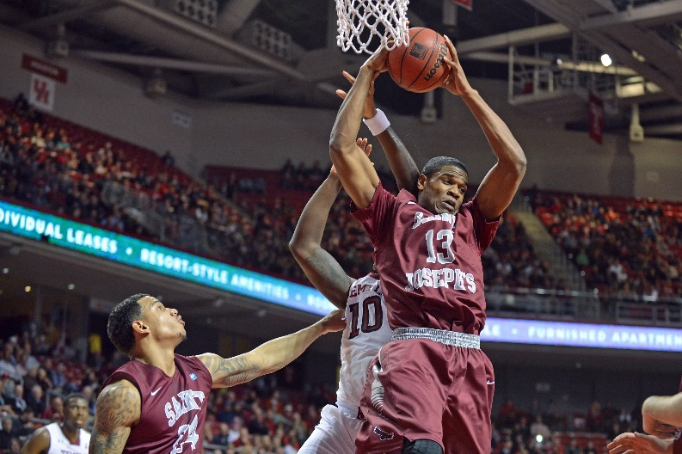
Who would use these components of fitness & why?
Power:
Who?
Basketball players.
Throwers in athletic events
Why?
Good Power will allow the basketball player to jump high to secure a rebound.
And
A javelin thrower to throw the javelin further or the tennis player fire a shot down court making it harder for his opponent to return it.
Tests?
Standing broad jump
Standing vertical jump
DEFINITION:
Power is the ability to perform strength based movements quickly
Power is an important component of fitness that is used in many dynamic sports activities
TASK: Come up with your own Sporting Example for POWER

Slide 10
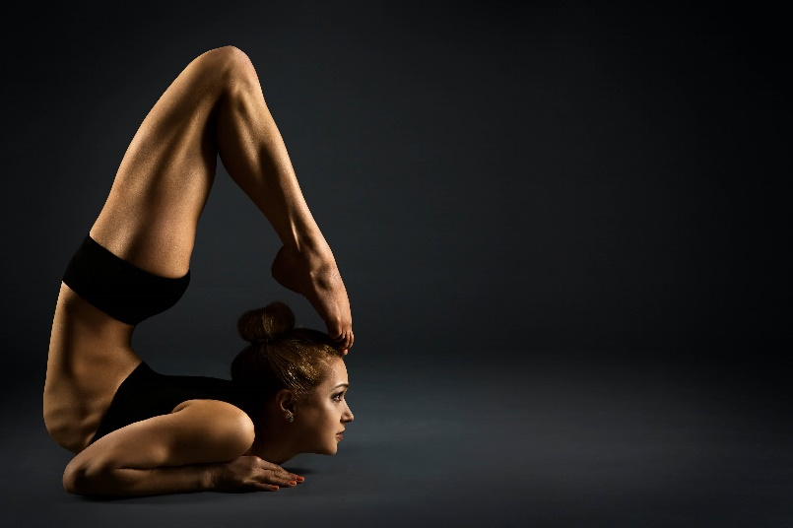
Who would use these components of fitness & why?
Flexibility:
Who?
Gymnasts.
Why?
Good Flexibility allows the athlete to increase their range of movement possible about a joint, and thereby stretch further and perform more complex moves and routines.
Tests?
Sit and reach test
DEFINITION:
Flexibility is the amount or range of movement that you have around a joint.
If we are flexible we are less likely to suffer from soft tissue / muscular injury.
TASK: Come up with your own Sporting Example for FLEXIBILITY

Slide 11
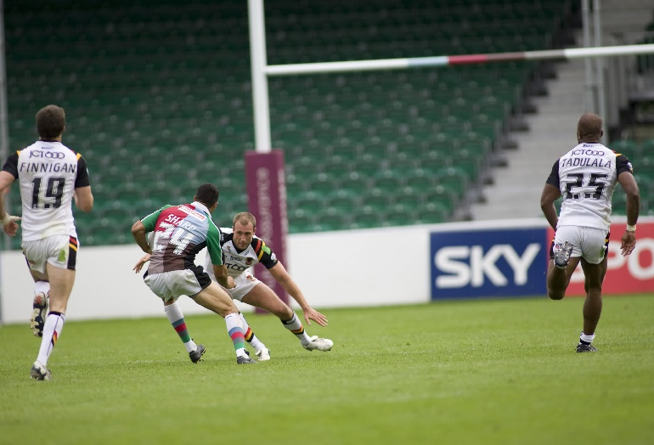
Who would use these components of fitness & why?
Agility:
Who?
Rugby Players/ Hockey players
Why?
Being able to change direction quickly (dodging) will allow attackers to evade a tackling player.
Test?
Illinois agility test
DEFINITION:
Agility is how quickly you can change direction under control and maintaining speed, balance and power.
There are THREE main components of Agility:
  Core Strength
  Balance
  Flexibility
TASK: Come up with your own Sporting Example for AGILITY

Slide 12
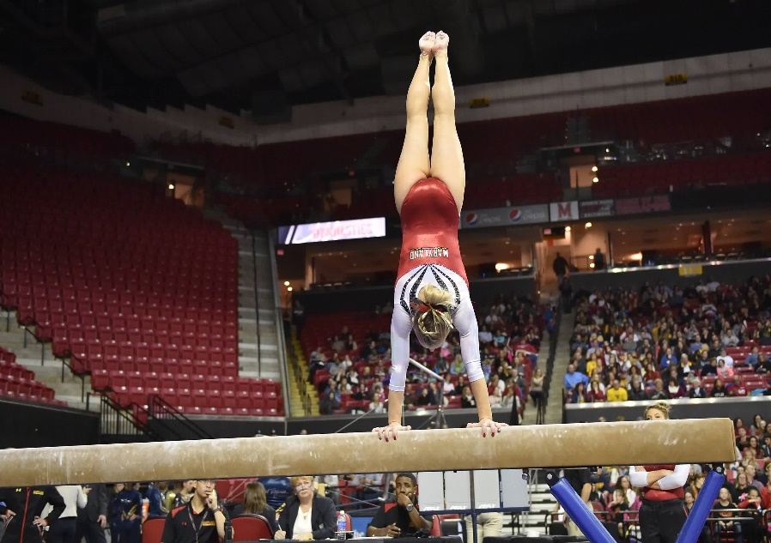
Who would use these components of fitness & why?
Balance:
Who?
Dancer / Gymnast
Why?
both need balance to hold and perform complex routines with control without falling over.
Tests?
Stork stand test
DEFINITION:
Balance is the ability to maintain equilibrium, whether stationary or moving.
TASK: Come up with your own Sporting Example for Balance

Slide 13
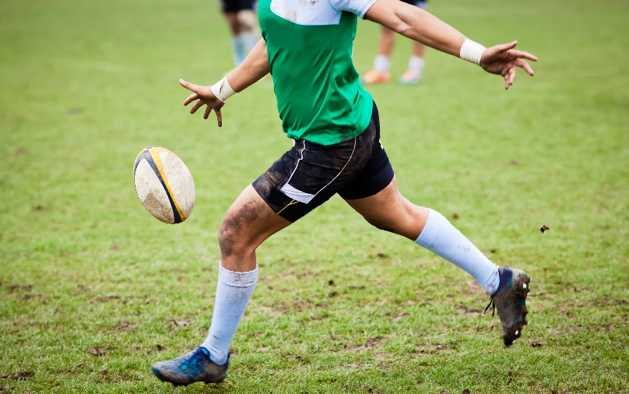
Who would use these components of fitness & why?
Co-ordination:
Who?
Rugby player taking a drop kick.
Server in badminton.
Why?
Both need co-ordination to be able to move different body parts at the same time and get the ball where they want it to go.
Test?
‘Wall throw test’.
DEFINITION:
Co-ordination is the ability to move different limbs at different times or do more than one task effectively at the same time.
TASK: Come up with your own Sporting Example for Co-ordination

Slide 14
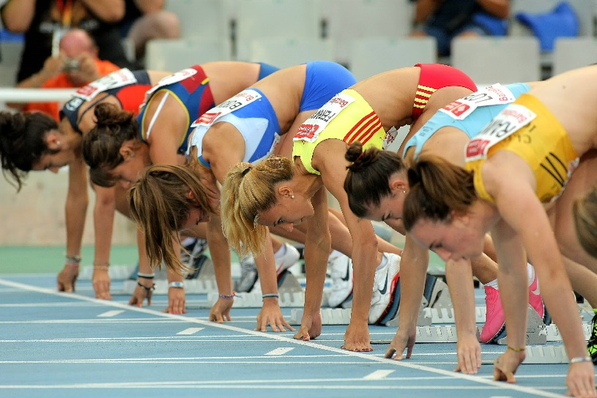
Who would use these components of fitness & why?
Reaction Time:
Who?
Sprinters / Goal Keepers.
Why?
Being able to react to the starter gun will give s sprinter a good start
Or
Improve a goal keepers chances of saving the shot on goal.
Tests?
Reaction time ruler test
DEFINITION:
Reaction Time is the time is take for you to initiate an action or movement in response to a stimuli.
Reaction Time: is the time between the onset of the stimulus and the initiation of the response
Movement Time: is the time it takes to move
Response Time: is the time between the onset of the stimulus to the completion of the movement.
TASK: Come up with your own Sporting Example for REACTION TIME

Slide 15
How can we test these components of fitness?
TASK: can you match these fitness tests to the appropriate component of fitness?
Multi Stage Fitness Test
Sit and Reach Test
Wall throw test
12 min Cooper Run Test
CV ENDURANCE
FLEXIBILITY
CO-ORDINATION
Press Up Test
CV ENDURANCE
Sit Up Test
MUSCULAR
ENDURANCE
MUSCULAR
ENDURANCE
Standing Stork Test
Illinois Agility test
BALANCE
AGILITY
Hand Grip
Test
Vertical Jump Test
30m Sprint Test
Standing Broad Jump Test
Ruler Drop Test
STRENGTH
POWER
SPEED
POWER
REACTION TIME

Slide 16
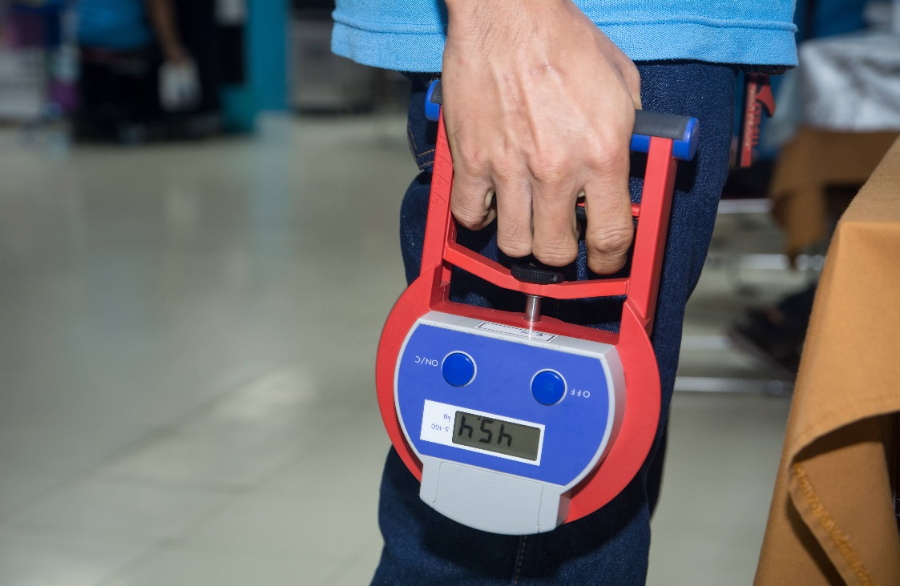
NOTE:
You need to know how to perform all these tests!

Slide 17
OCR Resources: the small print
OCR’s resources are provided to support the delivery of OCR qualifications, but in no way constitute an endorsed teaching method that is required by the Board, and the decision to use them lies with the individual teacher. Whilst every effort is made to ensure the accuracy of the content, OCR cannot be held responsible for any errors or omissions within these resources.
Our documents are updated over time. Whilst every effort is made to check all documents, there may be contradictions between published support and the specification, therefore please use the information on the latest specification at all times. Where changes are made to specifications these will be indicated within the document, there will be a new version number indicated, and a summary of the changes. If you do notice a discrepancy between the specification and a resource please contact us at:
resources.feedback@ocr.org.uk.
© OCR 2018 - This resource may be freely copied and distributed, as long as the OCR logo and this message remain intact and OCR is acknowledged as the originator of this work. OCR acknowledges the use of the following content:
Please get in touch if you want to discuss the accessibility of resources we offer to support delivery of our qualifications: resources.feedback@ocr.org.uk
2 > Fitness people exercising with battle ropes at gym / Maridav / Shutterstock.com 4 > Basketball / lassedesignen / Shutterstock.com 5 > Mo Farah / Chris Mole / Shutterstock.com / ED 6 > Athlete rower at the start / videoTD / Shutterstock.com 7 > Rugby game / Mai Groves / Shutterstock.com / ED 8 > Rugby players doing a scrum at the park / wavebreakmedia / Shutterstock.com 9 > Big 5 basketball game / Aspen Photo / Shutterstock.com / ED | 10 > Yoga Backbend Gymnastics / Inara Prusakova / Shutterstock.com 11 > Rugby league match / Mitch Gunn / Shutterstock.com / ED 12 > Gymnast competes on the balance beam / Aspen Photo / Shutterstock.com / ED 13 > Rugby player preparing to kick the oval ball during game / Melinda Nagy / Shutterstock.com 14 > Athletes ready on the start of 100m event / Maxisport / Shutterstock.com / ED 16 > DIGITAL HAND GRIP DYNAMOMETER / Watchares Hansawek / Shutterstock.com

