Slide 1

Applied Anatomy and Physiology

Slide 2

Learning
Outcomes
1.1.e. Effects of exercise on body systems
By the end of this topic you should be able to …
Understand the short term effects of exercise
Apply the effects to examples from physical activity / sport
Collect and use data relating to short-term effects of exercise
Understand the long-term effects of exercise
Apply the effects to examples from physical activity / sport
Collect and use data relating to long-term effects of exercise

Slide 3
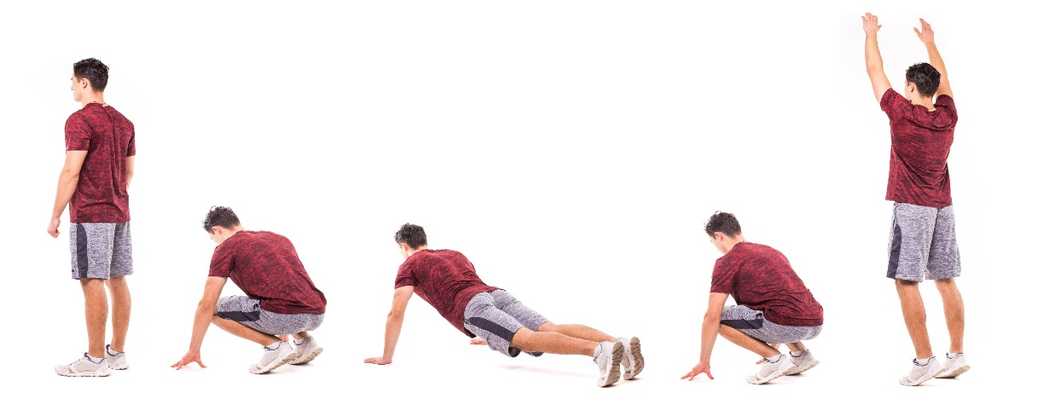

Effects of exercise on body systems
TASK: I need someone who thinks they’re fit and able!
I need that person to perform as many squat thrusts (aka Burpees)
as possible in 1 minute
So what did we see happen?

Slide 4
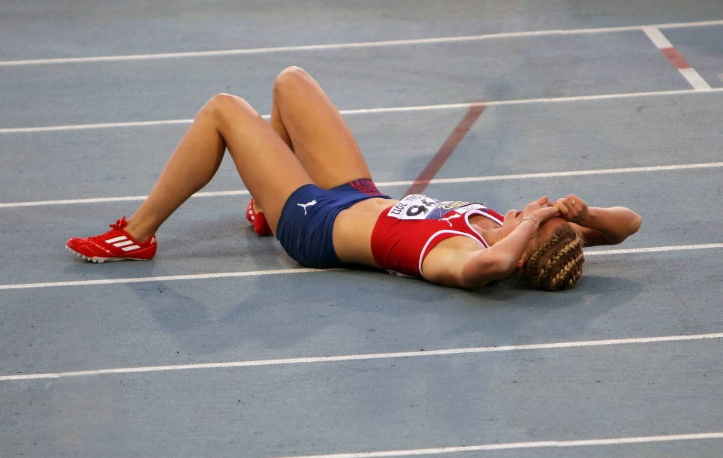
Effects of exercise on body systems
Short term effects of exercise - Muscles
The short term effects of exercise on the muscles:
Working muscles produce heat therefore increasing muscle temperature.
Increased muscle fatigue due to lactic acid production.
Blood is re-distributed to working muscles in an attempt to provide more oxygen to these working areas (Blood / Vascular shunting).

Slide 5
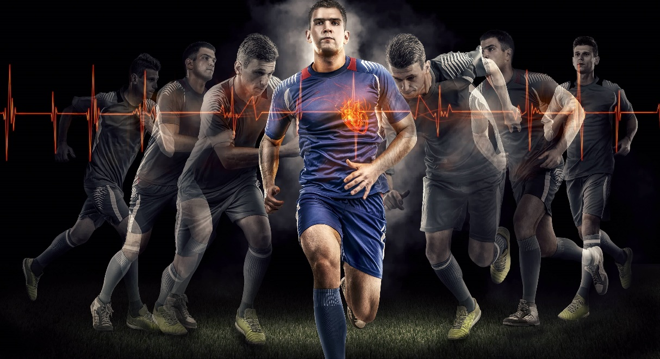
Effects of exercise on body systems
Short term effects of exercise – Cardiovascular system
The short term effects of exercise on the cardiovascular system:
Increase in heart rate
Increase in stroke volume
Increase in cardiac output

Slide 6
Effects of exercise on body systems
Short term effects of exercise – Cardiovascular system
Increase in heart rate
As we start exercising heart rate increases and beats with greater force.
Heart rate is increase by the body releasing adrenaline – the hormone that signals the heart to pump faster and harder. It also triggers the release of glycogen from the liver.
Exercise makes the body work harder and therefore muscles require more oxygen to continue to work effectively.

Slide 7

Effects of exercise on body systems
Short term effects of exercise – Respiratory system
The short term effects of exercise on the respiratory system:
Increase in respiratory rate
Increase in minute ventilation
Increase in tidal volume

Slide 8
Effects of exercise on body systems
Short term effects of exercise – Respiratory system
Increase in depth and frequency of breathing
Exercise causes an
increase in breathing rate
and
depth of breathing
Breathing rate can increase up to 50 per minute!!

Slide 9
Learning
Outcomes
Effects of exercise on body systems
By the end of this topic you should be able to …
Understand the long-term effects of exercise on:
    Bone density
    Hypertrophy of muscle
    Muscular strength
    Muscular endurance
    Resistance to fatigue
    Hypertrophy of the heart
    Resting heart rate and resting stroke volume
    Cardiac output
    Rate of recovery
    Aerobic capacity
    Respiratory muscles
    Tidal volume and minute volume during exercise
    Capilliarisation
Apply the effects to examples from physical activity / sport
Collect and use data relating to long-term effects of exercise

Slide 10
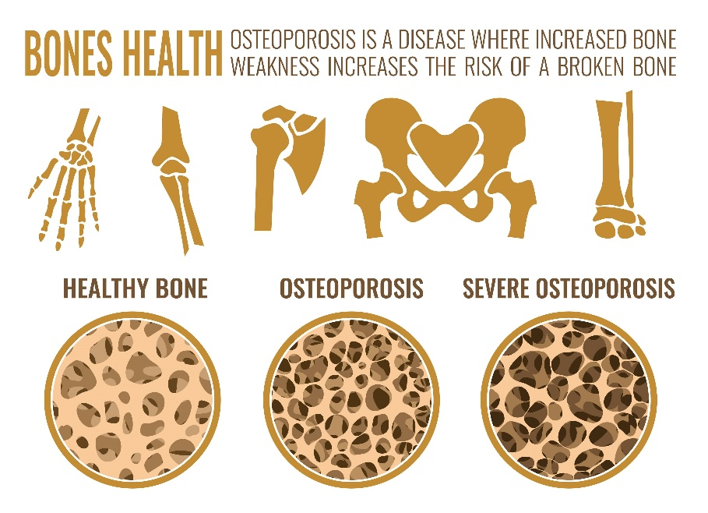
Effects of exercise on body systems
Increased bone density
Regular training will increase bone density & strengthen bone matter helping to reduce the risk of Osteoporosis
Regular weight-bearing exercise can help to maintain bone density and strength.
Weight-bearing exercise can include :
Skipping
Running up and down stairs
Jumping

Slide 11
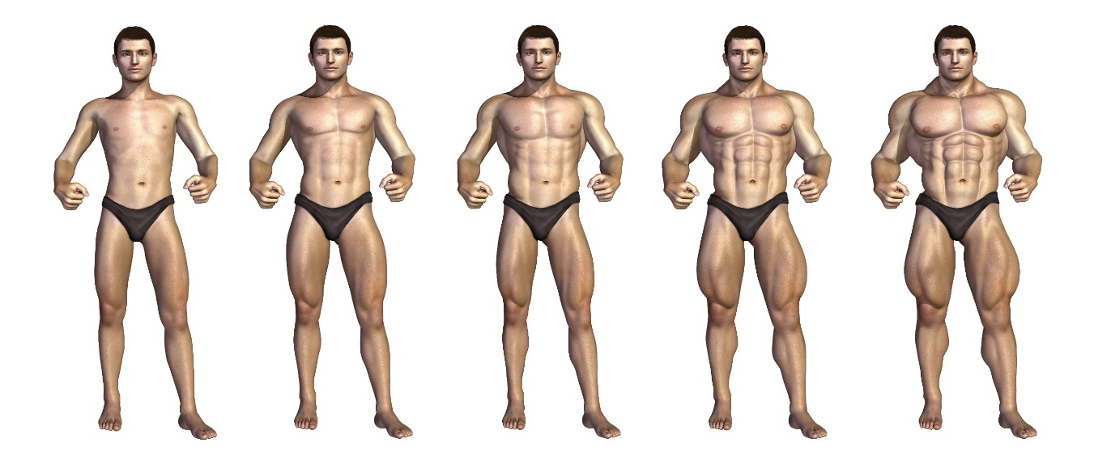
Effects of exercise on body systems
HYPERTROPHY of MUSCLE
HYPERTROPHY is an increase in the size of muscle(s).
Training results in skeletal muscle being damaged as the tiny muscle fibers are pulled apart causing trauma.
With REST and time to RECOVER these muscle fibers are re-built stronger than before.
Muscle hypertrophy will occur when training with heavy weights with low reps, increasing muscle size and strength.
Low weights, many reps will improve muscle tone and stamina.
Tendons, ligaments and posture will also improve.

Slide 12

Effects of exercise on body systems
STRENGTH
Following resistance training there is an increase in the thickness of muscle fibres due to greater muscle protein.
Muscle STRENGTH will therefore be increased along with strength of tendons.

Slide 13
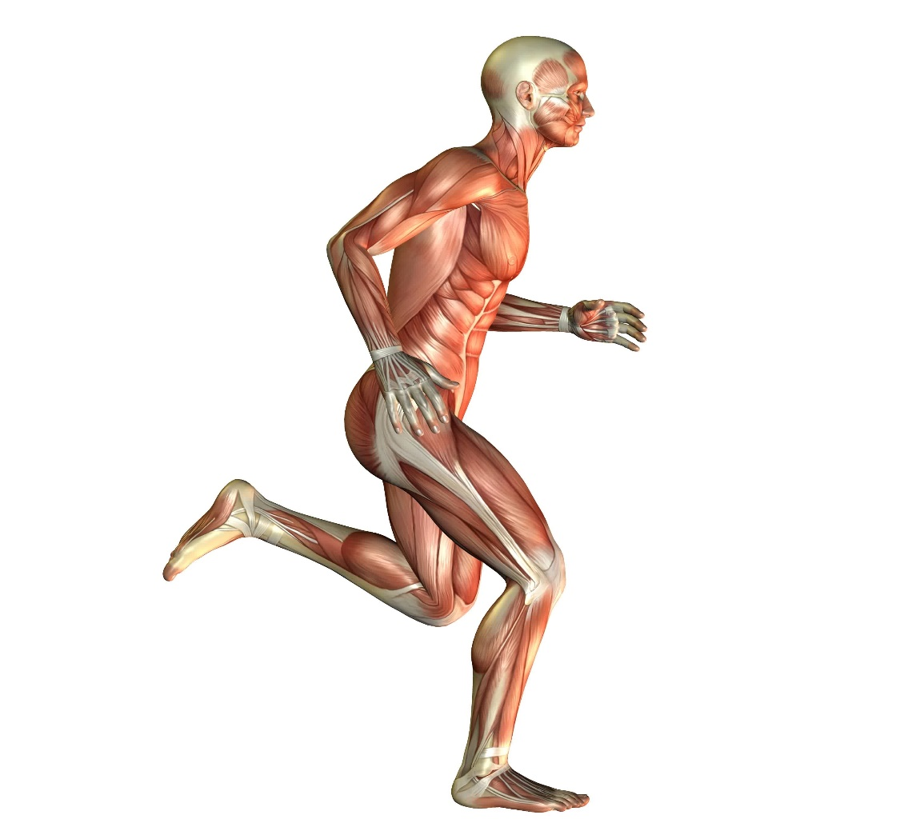
Effects of exercise on body systems
MUSCULAR ENDURANCE
Following endurance (stamina) training, muscular endurance increases.
Slow twitch fibres will get larger by about 20%.
This means that there is greater potential for energy production.

Slide 14
Effects of exercise on body systems
Resistance to Fatigue
Endurance training will also increase the capacity to carry oxygen and the athlete becomes aerobically fitter.

Slide 15
Effects of exercise on body systems
HYPERTROPHY of the HEART
With most training programmes the size of the heart will increase.
This increase in size is known as cardiac hypertrophy.
This will occur particularly with endurance-type exercise or training. The wall of the left ventricle becomes thicker, thus increasing the strength of contractions in the heart.
This increase in contractions will ensure more blood is delivered to the working muscles.
More blood is pumped from the heart per beat of the heart and therefore stroke volume will increase.
Cardiac output will also therefore increase during high or maximal levels of exercise.

Slide 16
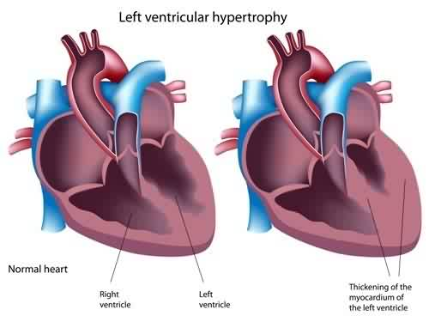
Effects of exercise on body systems
Decreased resting heart rate
and
Increased Stroke Volume
The increased size of the heart means it takes less beats in a minute to supply the body with enough oxygen at rest.
and
Can pump more blood with each pulse (increased STROKE VOLUME).

Slide 17
Effects of exercise on body systems
Increased Cardiac Output
As more blood is pumped from the heart per beat (Increased stroke volume).
Cardiac output will also therefore increase during high or maximal levels of exercise.

Slide 18
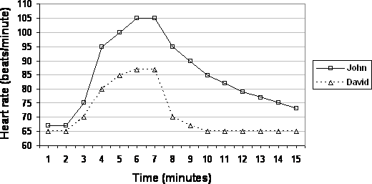
Effects of exercise on body systems
Heart Rate Recovery
Training will result in heart rate recovering quicker after exercise.
Describe what you see from these graphs.
Which athlete is trained and which is one is untrained? (Justify your answer!)

Slide 19
Effects of exercise on body systems
The long-term effects of exercise, or adaptations, on the respiratory system.
There is an increase in capillary density (capillarisation), which increases the efficiency
of oxygen uptake for energy.
There is a slight increase in vital capacity, which means more air can be inspired, and also a slight increase in tidal volume, which means again more oxygen can enter the lungs.
There will also be an increase in Minute Volume, the amount of air inspired or expired in one minute.
There is greater intercostal muscle strength, allowing more air to be breathed in and out, and a reduction in resting respiratory rate, which makes the body more efficient.
The exchange of gases at the alveoli (pulmonary diffusion) becomes more efficient and therefore the body can work harder and longer due to the increased surface area of the alveoli.
An increase in capillarisation again leads to more effective uptake of oxygen and more effective removal of carbon dioxide.

Slide 20
Effects of exercise on body systems
Interpreting data and graphs
The graph below shows Tom’s resting heart rate recorded at each week of his training.
What do you notice?
What is the reason for this trend?

Slide 21
Effects of exercise on body systems
Interpreting data and graphs
The tables below show Freddie’s cardiovascular and respiratory measurement taken at rest and during exercise.
Heart rate (bpm) | Stroke volume (ml) | Breathing rate (number per min) | Muscle temperature
72 | 60 | 18 | Normal
Freddie at REST
Heart rate (bpm) | Stroke volume (ml) | Breathing rate (number per min) | Muscle temperature
156 | 140 | 48 | Hot
Freddie during exercise
Describe what the tables tell you?
Discuss why these changes have taken place?

Slide 22
Effects of exercise on body systems
Apply it!
Short term & long term effects of exercise on the body
Explain to the person next to you 2 short term effects of exercise.
Describe the term hypertrophy (cardiac or muscular)
Explain the long term effects of exercise on the body.
Explain why an athlete might experience a shortage of breath at the start of an intense basketball game.
Notes:
Photos by: LOCOG

Slide 23
OCR Resources: the small print
OCR’s resources are provided to support the delivery of OCR qualifications, but in no way constitute an endorsed teaching method that is required by the Board, and the decision to use them lies with the individual teacher. Whilst every effort is made to ensure the accuracy of the content, OCR cannot be held responsible for any errors or omissions within these resources.
Our documents are updated over time. Whilst every effort is made to check all documents, there may be contradictions between published support and the specification, therefore please use the information on the latest specification at all times. Where changes are made to specifications these will be indicated within the document, there will be a new version number indicated, and a summary of the changes. If you do notice a discrepancy between the specification and a resource please contact us at:
resources.feedback@ocr.org.uk.
© OCR 2018 - This resource may be freely copied and distributed, as long as the OCR logo and this message remain intact and OCR is acknowledged as the originator of this work. OCR acknowledges the use of the following content:
Please get in touch if you want to discuss the accessibility of resources we offer to support delivery of our qualifications: resources.feedback@ocr.org.uk
2 > Portrait of young sports woman / mimagephotography / Shutterstock.com 3 > Burpee young man doing sports exercise / F8 studio / Shutterstock.com 4 > Vilde J. Svortevik / Denis Kuvaev / Shutterstock.com / ED 5 > Soccer players isolated on black background / masisyan / Shutterstock.com 7 > Young sportsman taking breath / Dragon Images / Shutterstock.com | 10 > Osteoporosis stages image / Double Brain / Shutterstock.com 11 > Chart depicting a bodybuilder gaining muscle mass over time / Linda Bucklin / Shutterstock.com 12 > Group with dumbbell weight training equipment on sport gym / Tono Balaguer / Shutterstock.com 13, 14 > Illustration of muscle in a running man / Gehrke / Shutterstock.com 16, 17 > Left ventricular hypertrophy / Alila Medical Media / Shutterstock.com

