Slide 1

Movement Analysis

Slide 2
Learning
Outcomes
1.1.c. Movement Analysis
By the end of this topic you should ………….
Know the three classes of lever and their use in physical activity and sport.
  1st Class: example - Neck
  2nd Class: example – Ankle
  3rd Class: example - Elbow
Know the definition of mechanical advantage
Know the location of planes of movement in the body and their application to physical activity and sport:
  Frontal
  Transverse
  Sagittal
Know the location of axes of rotation in the body and their application to physical activity and sport:
  Frontal
  Transverse
  Longitudinal

Slide 3
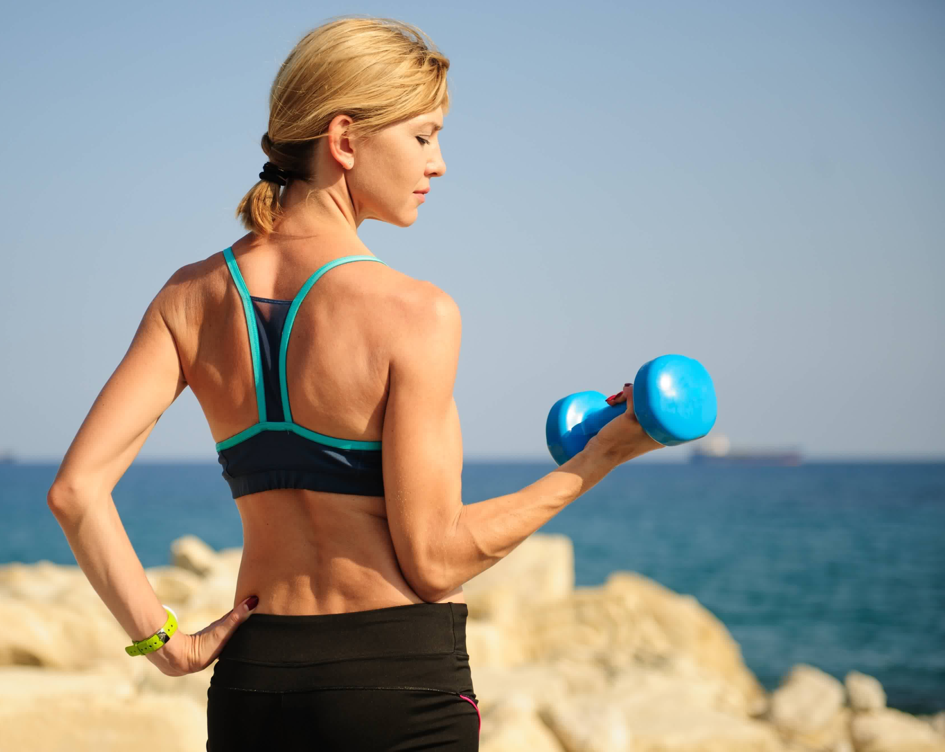
Lever Systems
Many bones and muscles work together to form levers.
Our bones form a rigid structure that turns about a fulcrum (the joint).
Levers are used to make a small amount of force into a much bigger force.
This is known as gaining a Mechanical Advantage.
LOAD
There are 4 parts to a lever:
Lever Arms (Bones)
FULCRUM (Joints)
EFFORT (Muscles provide the effort to move loads e.g. BICEPS)
LOAD (load forces are often the weight of the body parts that are moved or forces needed to lift, push or pull things like weights, balls, throwing implements etc.)
EFFORT
(Biceps)
FULCRUM
(Elbow Joint)

Slide 4
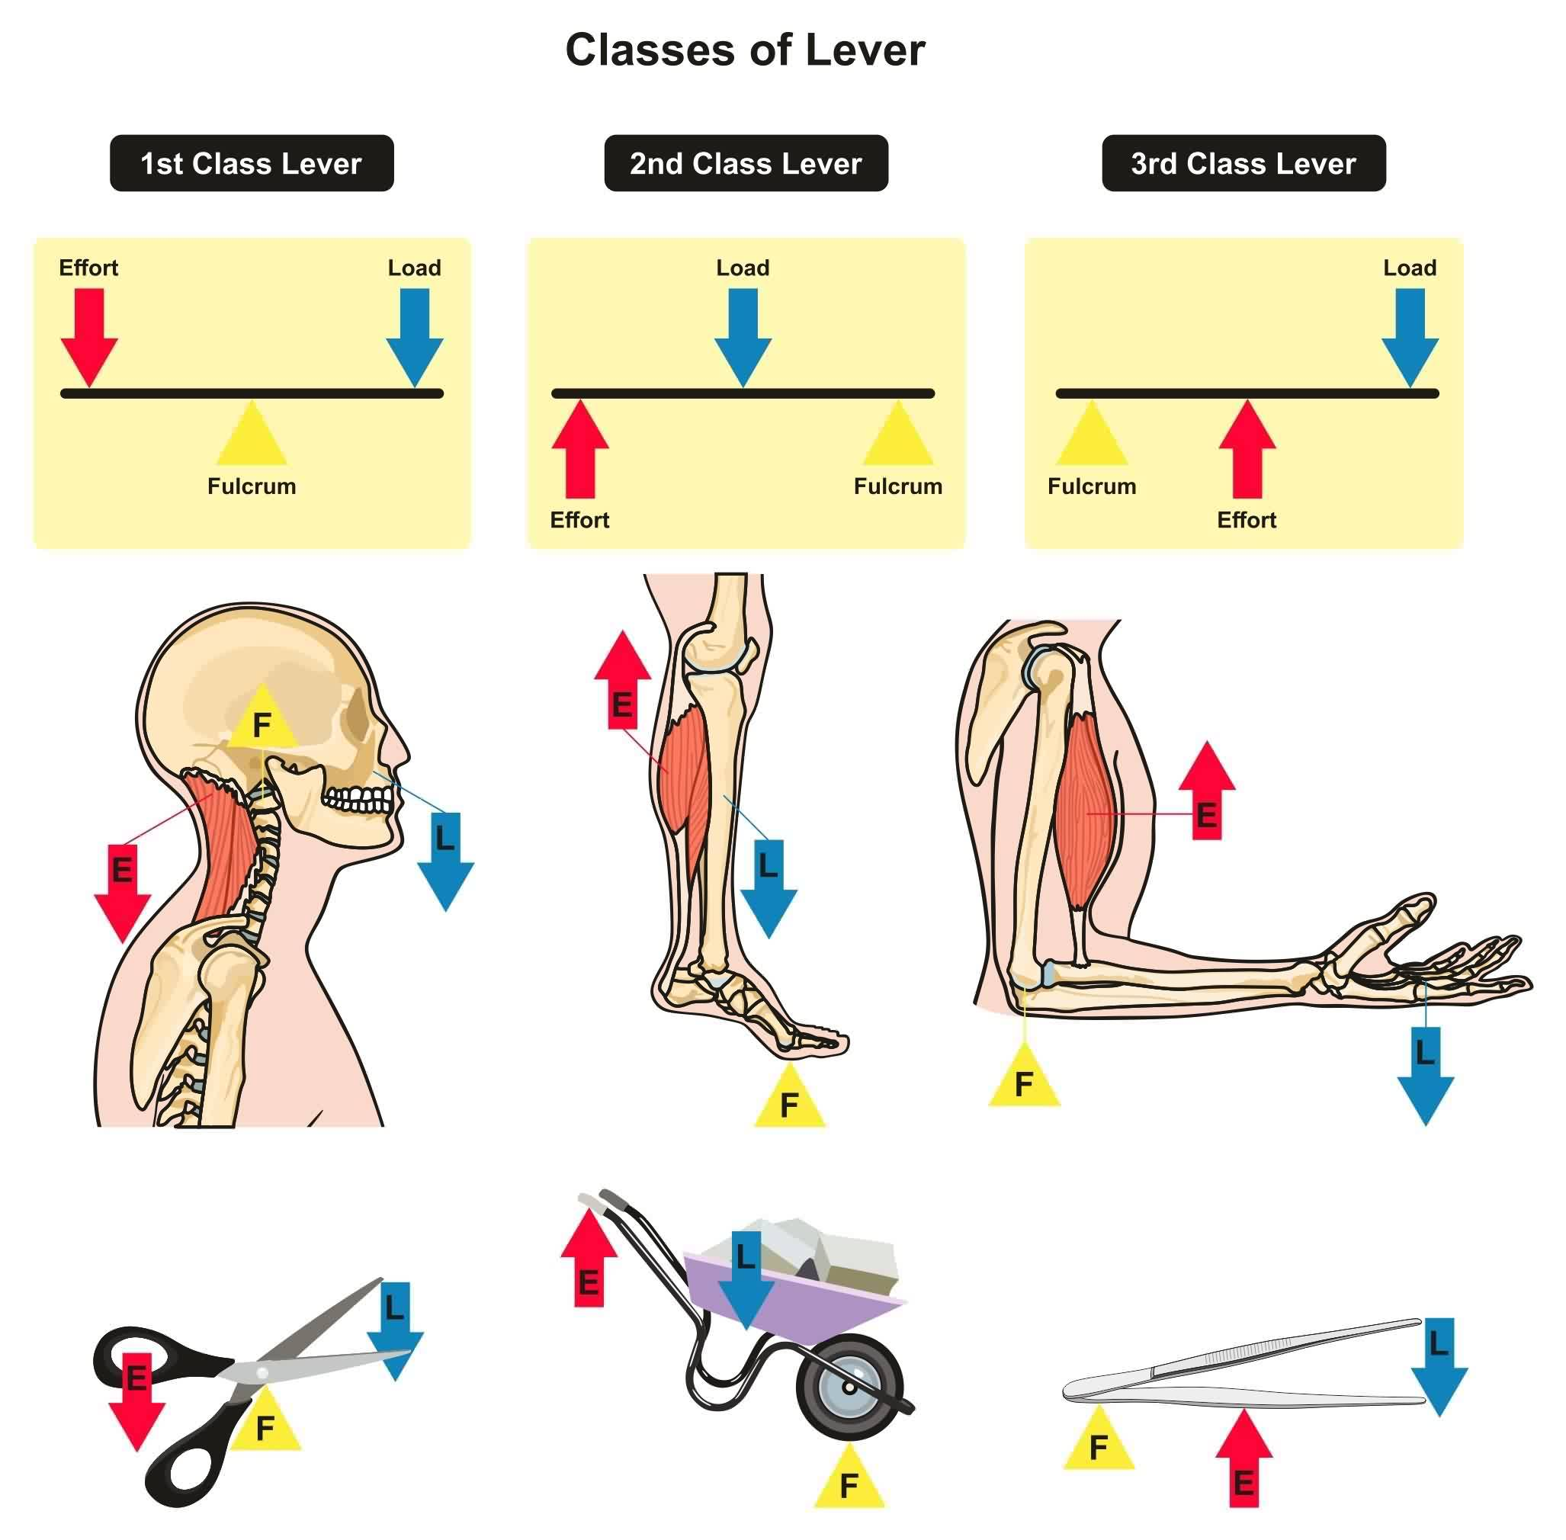
Lever Systems
Let’s Look at the Three Classes of Lever in more detail

Slide 5
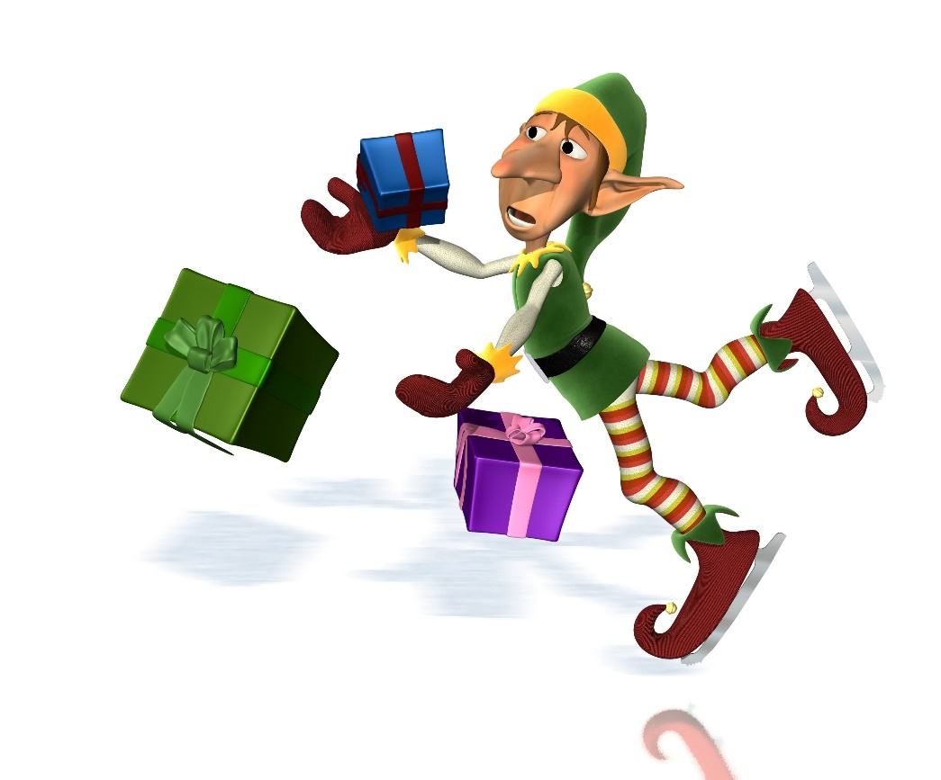
REMEMBER!!
EFL the ELF FELL!
EFL = 1ST CLASS ELF = 2ND CLASS FEL = 3RD CLASS

Slide 6
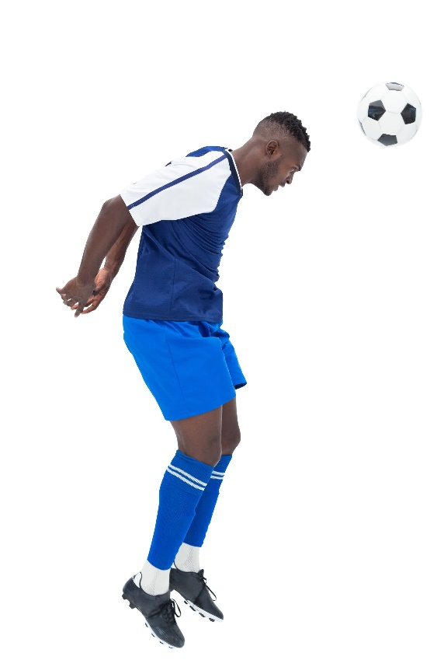
Lever Systems
Class of lever – First Class (EFL)
This is a lever where the Fulcrum (pivot) occurs between the effort and load.
Effort
Lever Arm
Load
Fulcrum / Pivot
Practical example: at the neck – heading a ball in football

Slide 7
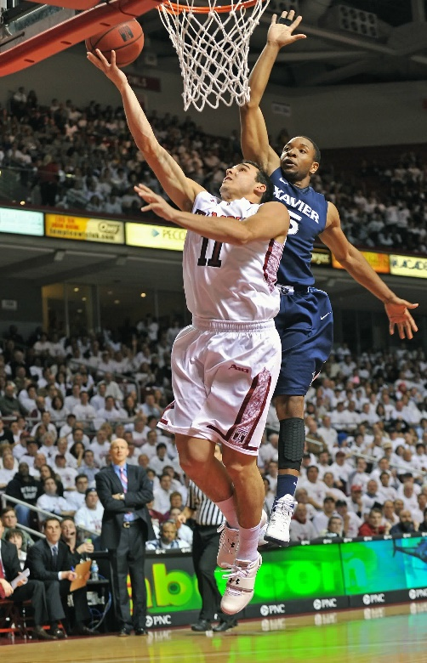
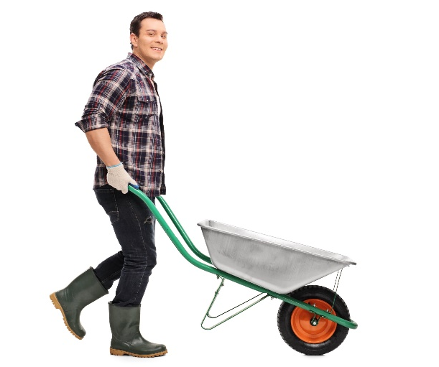
Lever Systems
Class of lever – Second Class (ELF)
This lever occurs when the load is between the effort and the fulcrum.
Effort
Lever Arm
Load
Fulcrum / Pivot
Practical example: at the ankle – taking off a lay up in basketball

Slide 8
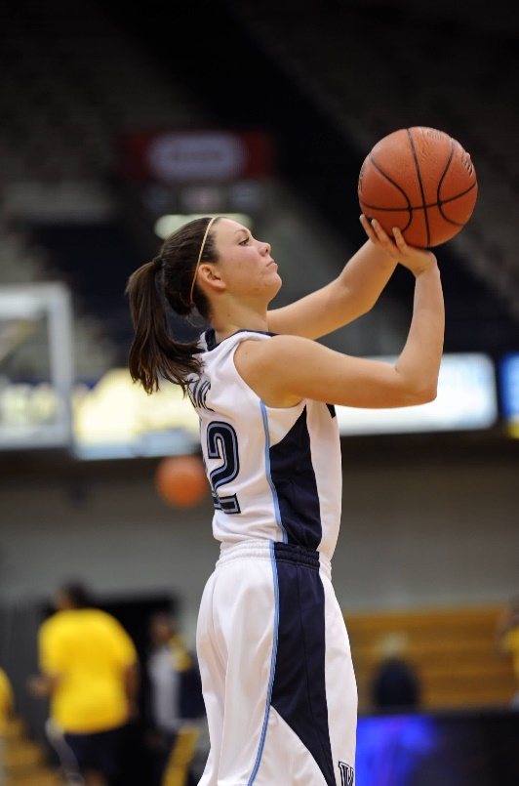
Lever Systems
Class of lever – Third Class (FEL)
This lever occurs when the effort lies between the fulcrum and load.
This is very common in human movement.
Effort
Lever Arm
Load
Fulcrum / Pivot
Practical example: the action of the biceps and the triceps at the elbow joint when shooting a basketball

Slide 9
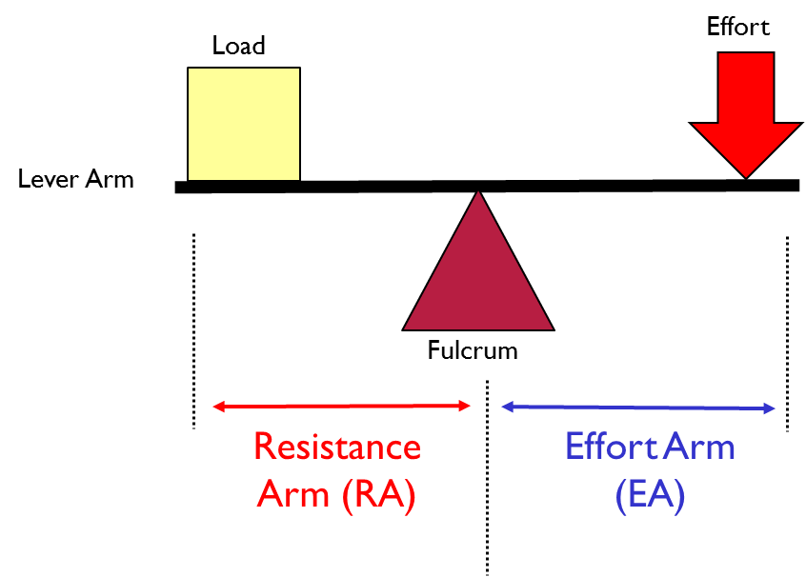
Lever Systems
Mechanical Advantage
Definition:
The relative efficiency of each of the lever systems is called the ‘mechanical advantage’.
TASK: Use the following equipment to explore how high you can propel the eraser.
RULER
ERASER
PENCIL/PEN
What you should find:
The greater the Effort arm the greater the force produced, however the greater the Resistance Arm the faster the movement.
How can the 1st class lever be adjusted to increase or change how high the load can be propelled?

Slide 10
Lever Systems
Mechanical Advantage
Class 1 and class 2 levers both provide mechanical advantage.
This means that they allow you to move a large output load with a small effort.
Definition:
The relative efficiency of each of the lever systems is called the ‘mechanical advantage’.

Slide 11
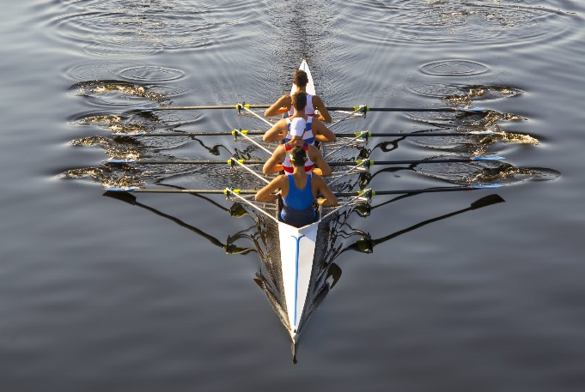
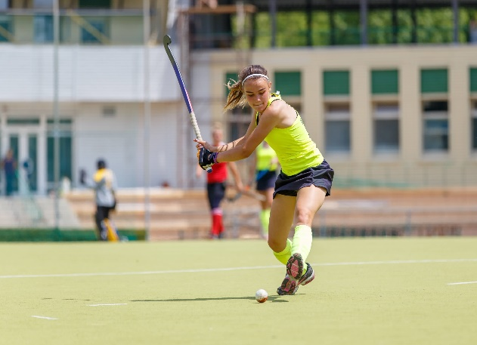
Lever Systems
Mechanical Advantage
The body’s levers can be made even more effective by using rackets, oars, paddles, sticks and bats.
These pieces of equipment increase the length of the resistance arm of the lever. This in turn increases the speed at the end of the lever.

Slide 12
Planes of Movement
Planes and axes of movement
https://www.youtube.com/watch?v=Z7dFWU9J0EU

Slide 13
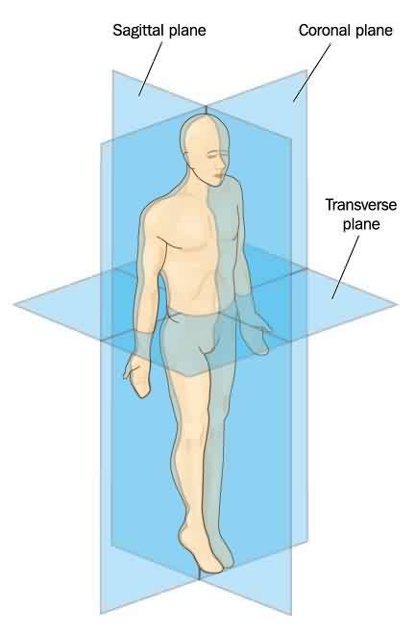
Planes of Movement
Planes of movement
Frontal plane
To help explain movement, the body can be viewed as having a series of imaginary slices/glass panes running through it.
TASK
In groups using the play-doh and card.
Firstly, make 3 human bodies using the play-doh.
Then, use the card to show each of the 3 planes of movement.

Slide 14
Planes of Movement
SAGITTAL Plane
Frontal plane
The sagittal plane is a vertical plane that divides the body into right and left sides.
Practical example of movement through the sagittal plane
running / sit ups / bicep curl / somersault

Slide 15
Planes of Movement
FRONTAL Plane
Frontal plane
The frontal plane is also a vertical plane but this divides the body into front and back.
Practical example of movement through the frontal plane
abduction and adduction of the legs at the hip joint
e.g. performing star jumps type exercises

Slide 16
Planes of Movement
TRANSVERSE Plane
Frontal plane
The transverse plane is a horizontal plane that divides the body into upper and lower halves.
Practical example of movement through the transverse plane
Arm action (circumduction) when bowling in cricket with rotation at the shoulder

Slide 17
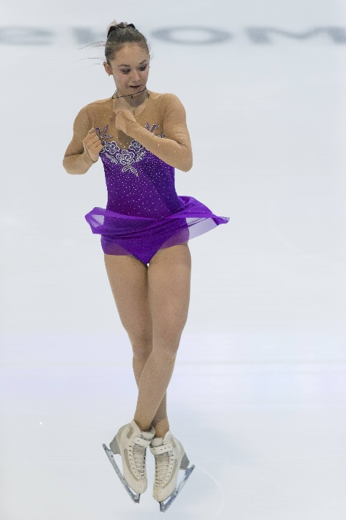
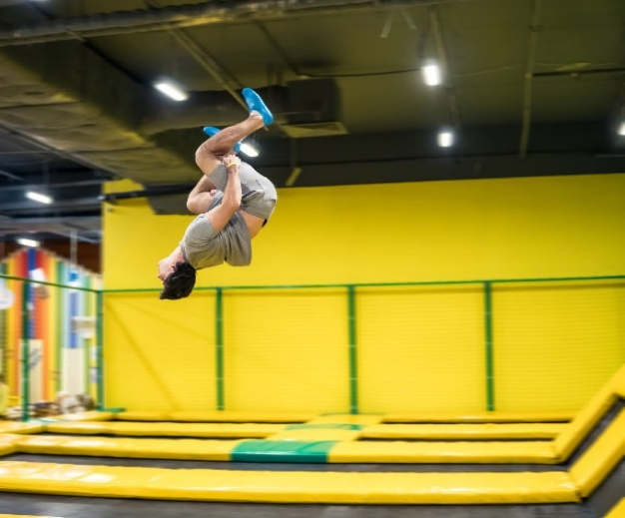
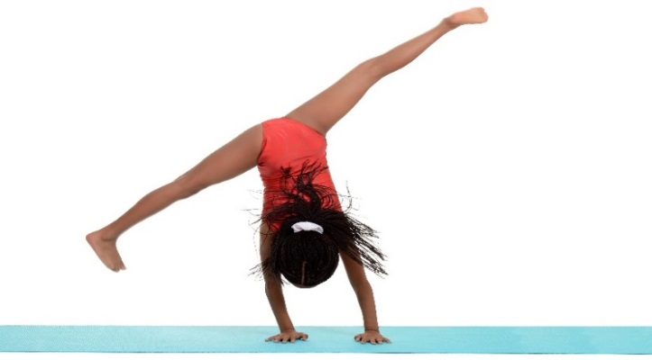
Axes of Rotation
Axes of the body
Axes are like invisible skewers running through the body.
All movements rotate around one of the axes.
Transverse axis
Frontal axis
Longitudinal axis
Practical example: gymnasts will use multiple axes to perform their routines

Slide 18
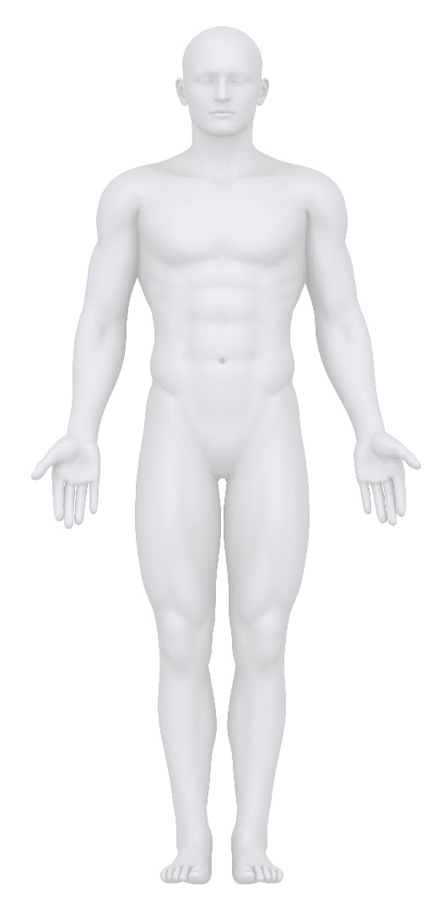
Axes of Rotation
Axes of the body
TASK 1: in groups use the play-doh and cocktail sticks in front of you to show the following….
All movements rotate around one of the axes.
Longitudinal axis
Frontal axis
Transverse axis

Slide 19
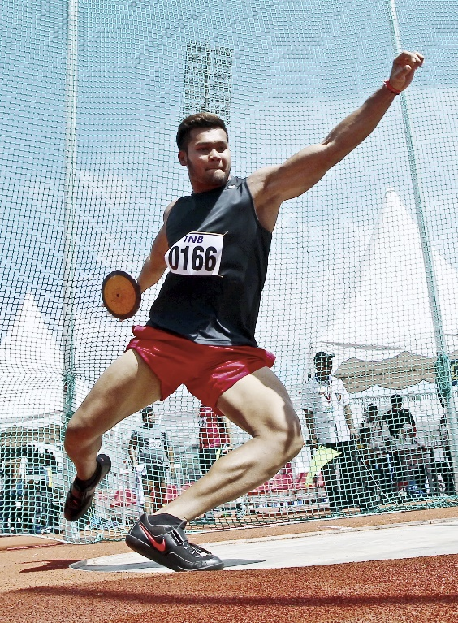
Axes of Rotation
Axes of the body
Longitudinal axis runs through the body vertically from the top to bottom.
TASK:
Move your Play-Doh Figure using the Longitudinal Axis
Practical example: an axel jump in ice skating or a discus throw rotation

Slide 20
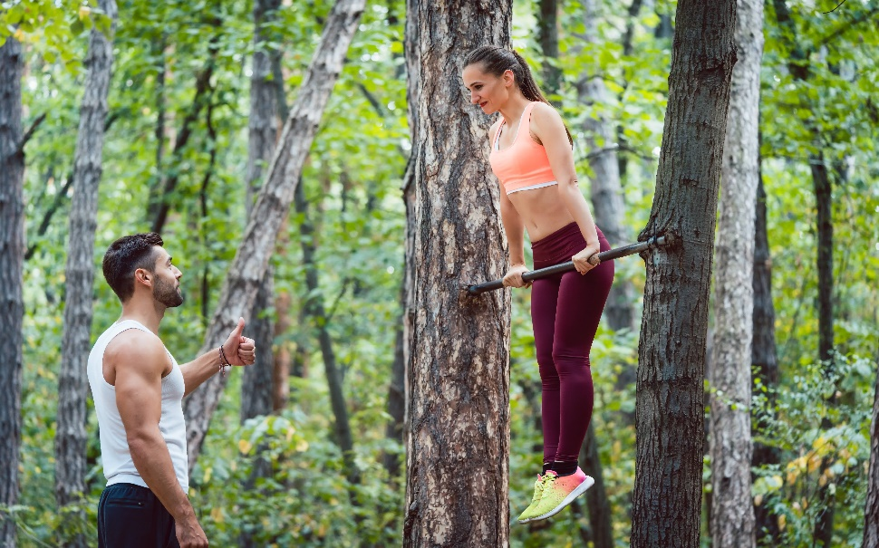
Axes of Rotation
Axes of the body
Transverse axis runs through the body horizontally from the left to right.
TASK: Move your Play-Doh Figure using the Transverse Axis
Practical example: somersault in diving or gymnastics

Slide 21
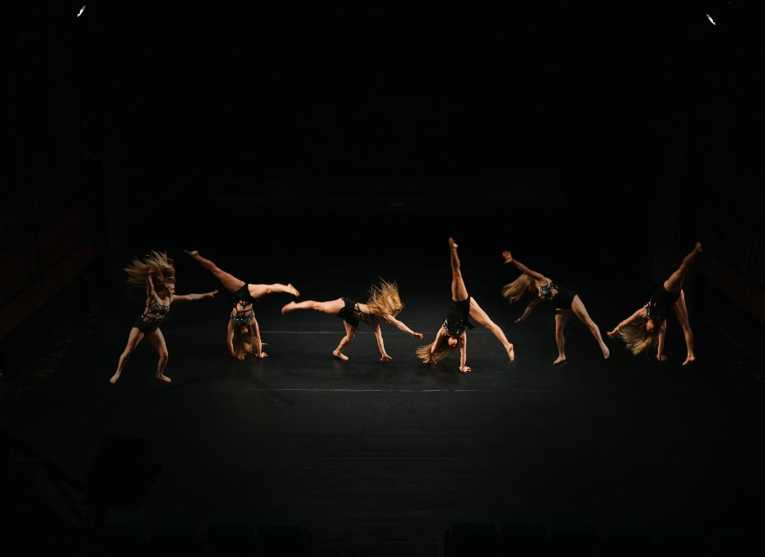
Axes of Rotation
Axes of the body
Frontal axis runs through the body horizontally from the back to front.
TASK: Move your Play-Doh Figure using the Frontal Axis
Practical example: cartwheel in gymnastics

Slide 22
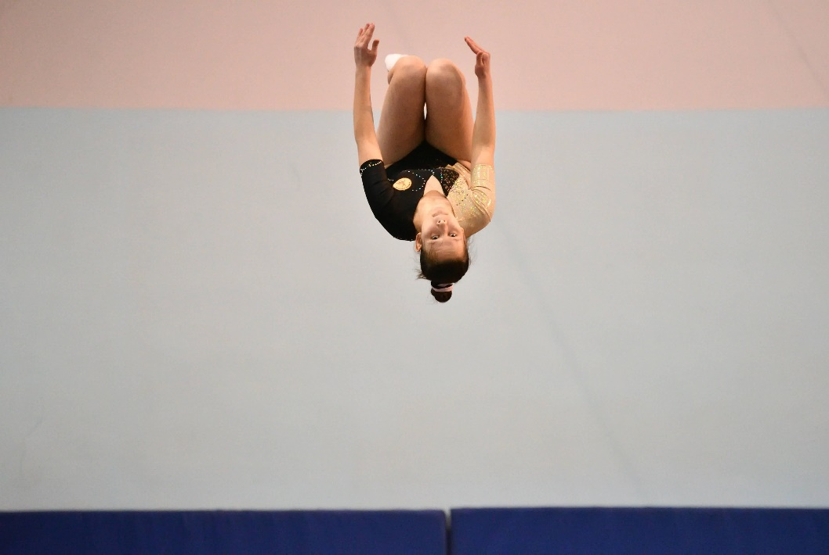
Planes & Axes of Rotation
Planes & Axes of the body combined
Movement in the sagittal plane about the transverse axis allows for front somersaults/forward roll.
Tip to Remember:
Left and right remain left and right
Practical example: somersault

Slide 23

Planes & Axes of Rotation
Planes & Axes of the body combined
Movement in the frontal plane about the frontal axis allows for cartwheels.
Tip to Remember: Front and back remain front and back
Practical example: cartwheel

Slide 24
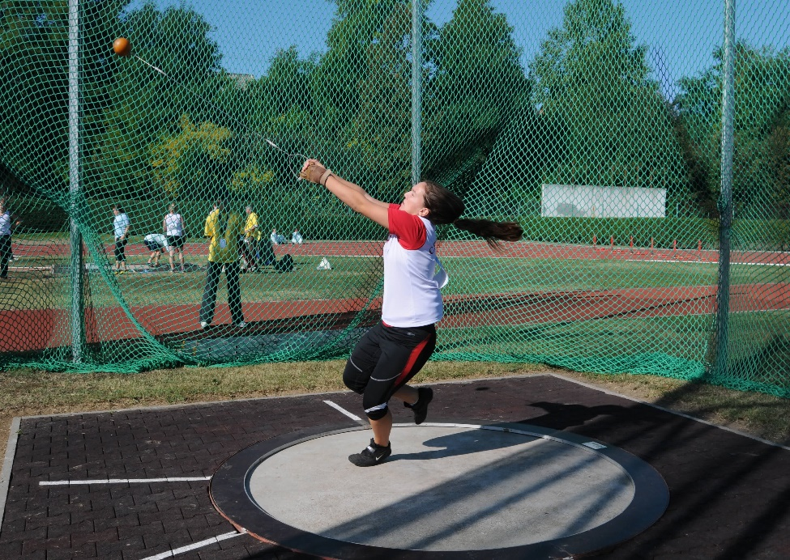
Planes & Axes of Rotation
Planes & Axes of the body combined
Movement in the transverse plane about the longitudinal axis allows for a 360 degree turn.
Tip to Remember:
Top and bottom remain top and bottom
Practical example: hammer throw rotation

Slide 25
Extension Task
Apply it!
Levers and mechanical advantage
Label the following levers components.
Describe the 3 levers in the body (use diagrams to help illustrate your answer)
Explain the term ‘mechanical advantage’
Which class of lever always has a mechanical disadvantage?
Notes:
Photos by: LOCOG

Slide 26
Extension Task
Apply it!
Planes and axes of movement
Name the 3 planes of movement
Describe the 3 axes of movement.
Describe the planes and axes in use for athletes performing a front somersault
Analyse a cartwheel movement using the correct planes and axes in use.
Notes:
Photos by: LOCOG

Slide 27
OCR Resources: the small print
OCR’s resources are provided to support the delivery of OCR qualifications, but in no way constitute an endorsed teaching method that is required by the Board, and the decision to use them lies with the individual teacher. Whilst every effort is made to ensure the accuracy of the content, OCR cannot be held responsible for any errors or omissions within these resources.
Our documents are updated over time. Whilst every effort is made to check all documents, there may be contradictions between published support and the specification, therefore please use the information on the latest specification at all times. Where changes are made to specifications these will be indicated within the document, there will be a new version number indicated, and a summary of the changes. If you do notice a discrepancy between the specification and a resource please contact us at:
resources.feedback@ocr.org.uk.
© OCR 2018 - This resource may be freely copied and distributed, as long as the OCR logo and this message remain intact and OCR is acknowledged as the originator of this work. OCR acknowledges the use of the following content:
Please get in touch if you want to discuss the accessibility of resources we offer to support delivery of our qualifications: resources.feedback@ocr.org.uk
3 > Young atheletic woman / Julia Albul / Shutterstock.com 4 > Classes of lever infographic / udaix / Shutterstock.com 5 > Santa's Elf / Linda Bucklin / Shutterstock.com 6 > Football player / wavebreakmedia / Shutterstock.com 7 > Basketball game / Aspen Photo / Shutterstock.com 7 > Young gardener / Ljupco Smokovski / Shutterstock.com 8 > Women's basketball / Aspen Photo / Shutterstock.com 11 > Rowers / filippo giuliani / Shutterstock.com 11 > Field hockey player / Skumer / Shutterstock.com 13-16 > Anatomical planes / Blamb / Shutterstock.com | 17, 19 > Figure skater / Dmitry Morgan / Shutterstock.com 17 > Girl gymnast doing cartwheel / Michael C. Gray / Shutterstock.com 17 > Trampoline jumper / Igor Kardasov / Shutterstock.com 18 > White male in anatomical position / CLIPAREA l Custom media / Shutterstock.com 19 > Athletes competing in the discus event / Shahjehan / Shutterstock.com 20 > Sporty woman doing fitness exercise / Kzenon / Shutterstock.com 21, 23 > Gymnastics cartwheel cycle / aerogondo2 / Shutterstock.com 22 > Trampoline competition / Vladimir Vasiltvich / Shutterstock.com 24 > Competitor in action / muzsy / Shutterstock.com

