Slide 1
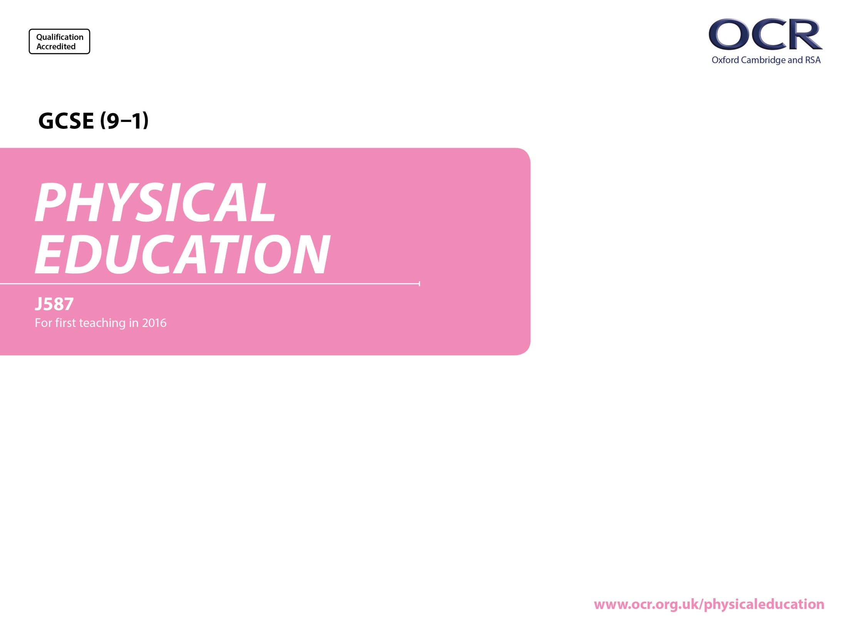
Physical Training

Slide 2
Learning
Outcomes
1.2.c. Preventing injury in physical activity and training
By the end of this topic you should …
Understand how the risk of injury in physical activity and sport can be minimised and be able to apply examples, including:
  Personal protective equipment
  Correct clothing/footwear
  Appropriate level of competition
  Lifting and carrying equipment safely
  Use of warm up and cool down
Know the potential hazards in a range of physical activity and sport settings and be able to apply examples, including:
  Sports hall
  Fitness centre
  Playing field
  Artificial outdoor areas
  Swimming pool

Slide 3
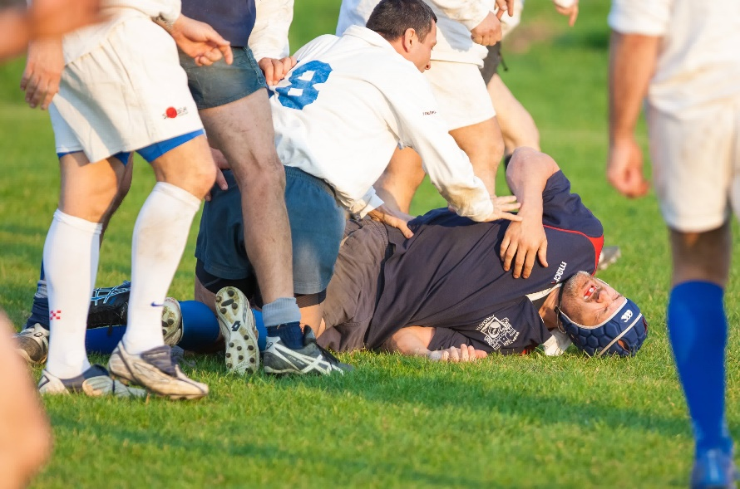
Understand how the risk of injury in physical activity and sport can be minimised
Most, if not all physical activities and sports have some element of risk attached to them, although some activities and sports carry with them higher elements of risk than others.
Methods of reducing risk of injury:
    Use of Personal protective equipment
    Correct clothing/footwear
    Appropriate level of competition
    Lifting and carrying equipment safely
    Use of warm up and cool down

Slide 4
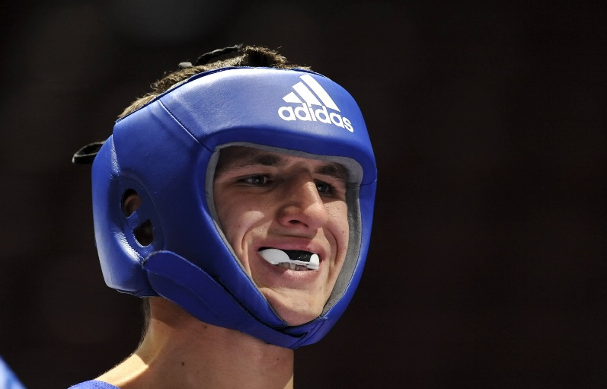
    Use of Personal protective equipment
Understand how the risk of injury in physical activity and sport can be minimised
Risks arising from some hazards can be limited by using Personal Protective Equipment.
Many sports advise using protective equipment others require it’s use in through legislation.
It is as important to NOT wear protective equipment that might injure an opponent as it is to wear protective equipment that will prevent others from injuring you.
TASK: Give an example of one piece of personal protective equipment that reduces risks in the following sports/activities:
Hockey
Rugby
Cricket
Canoeing
Basketball
Water polo
Rock climbing

Slide 5
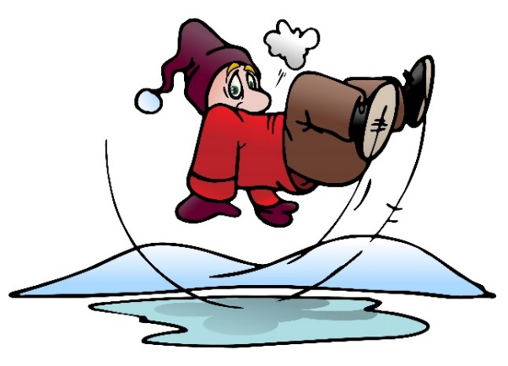
    Correct clothing/footwear
Understand how the risk of injury in physical activity and sport can be minimised
Wearing the correct clothing and footwear for a sport/activity is very important.
Clothing can protect from the weather (sun, heat, cold, rain, ice).
Some activities/sports may have rules preventing the wearing of certain clothes that could be dangerous to self or others
  Zips/Buckles/Straps
  Loose fitting clothes
Correct footwear is one of the most important and common safety features.
  Footwear can help give you stability on the various surfaces you perform on.
  Footwear can protect your feet.
  Footwear might also support the ankle joints etc.
Correct footwear can include:-
  Studded footwear
  Spikes
  Blades (as in skating)
  Ski boots
  Gymnastics slippers
  High jump shoes
Being appropriately dressed can include not wearing jewelry.
TASK: Make a list of the different types of footwear required for the following sports:
(some sports may require more than one type of footwear)
Hockey
Netball
Dance
Gymnastics
Rock climbing
Football
Basketball
Ice skating
Athletics
Cricket
Golf

Slide 6
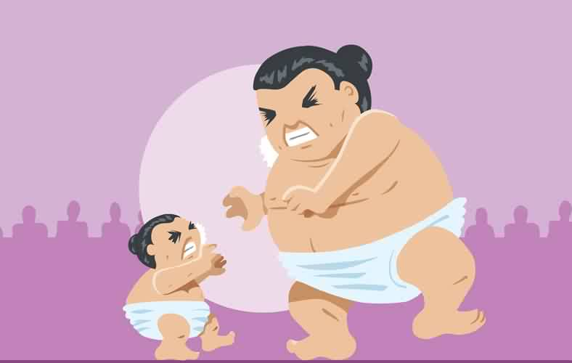
    Appropriate level of competition
Understand how the risk of injury in physical activity and sport can be minimised
Ability / Fitness Level:
  Ensure you are fit to take part in your chosen activity
  Ensure you have an appropriate skill level before taking part in your chosen activity
Weight Categories:
  E.g. Boxing / Martial Arts competitors are matched according to weight as well as ability.
  E.G Boxing: a 7ft 20 stone pro boxer can not safely take on a 5ft 8 stone opponent.
Mixed or Single Sex:
  In most sports men play with and against men and women against women (football / rugby – contact sports!)
  Based on fair competition as men naturally have more muscle than women, this can also be seen as a safety consideration.
Age:
  Children's competitions are based on age as children differ greatly in body size and physical development with each year.
Question
Staff v Schoolchildren matches are banned by many National Governing Bodies of sport.
WHY?
TASK: Can you come up with another sporting example of Appropriate level of competition which is not mentioned above. and explain HOW the risk of injury can be reduced!

Slide 7
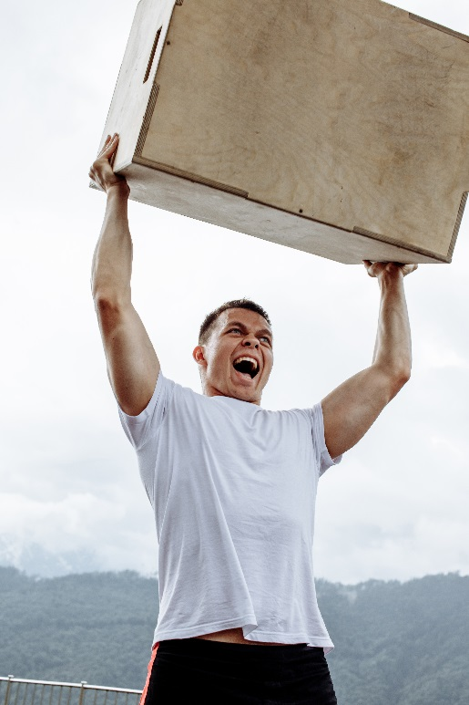
    Lifting and carrying equipment safely
Understand how the risk of injury in physical activity and sport can be minimised
Serious injuries can be caused before the activity even starts by carrying heavy or awkward sporting equipment incorrectly.
Bend at the Knees NOT the back!
How to lift & carry equipment safely…
Keep the load close to your waist for as long as possible keeping the load over your knees
Adopt a stable position (feet should width apart)
Bend your knees and not your back
GET HELP!
Look where you are going when moving and lifting equipment
TASK: Can you come up with a sporting example of lifting and carrying equipment safely
and explain HOW the risk of injury can be reduced!

Slide 8
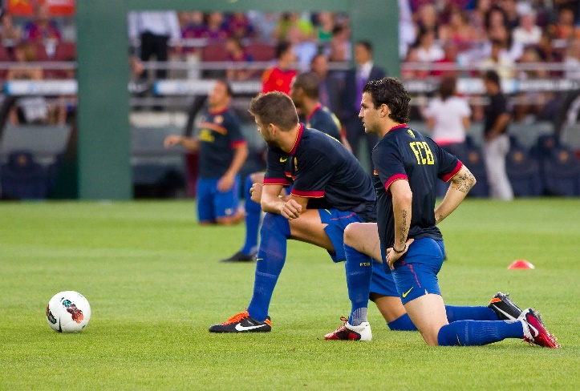
Understand how the risk of injury in physical activity and sport can be minimised
    Use of warm up and cool down
Warming up gradually prepares the body for physical activity and cooling down disperses lactic acid and returns the body to a resting state preventing soreness and aches.

Slide 9
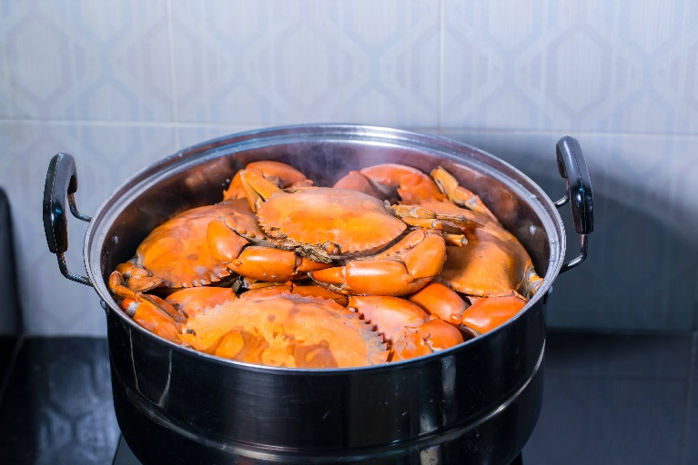
Acronym
Understand how the risk of injury in physical activity and sport can be minimised
    5 Methods of Reducing Risk in Sport
  Personal protective equipment
  Correct clothing/footwear
  Appropriate level of competition
  Lifting and carrying equipment safely
  Warm up and cool down
P - POTTED
C - CRABS
A - ARE
L – LOVELY
W – WARM
TASK: Come up with your own Acronym to remember these 5 methods of reducing risk in sport.

Slide 10
Learning
Outcomes
1.2.c. Preventing injury in physical activity and training
By the end of this topic you should …
  Know potential hazards in a range of physical activity and sport settings and be able to apply examples, including:
  sports hall
  fitness Centre
  playing field
  artificial outdoor areas
  swimming pool

Slide 11
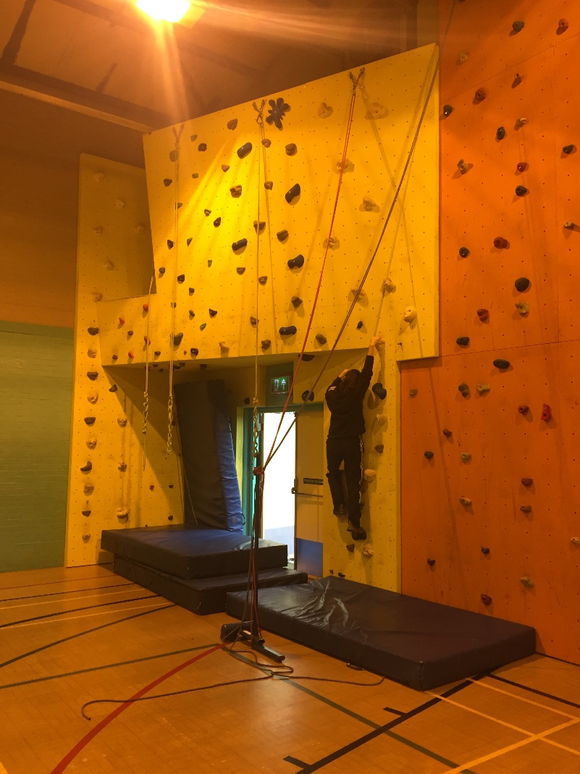
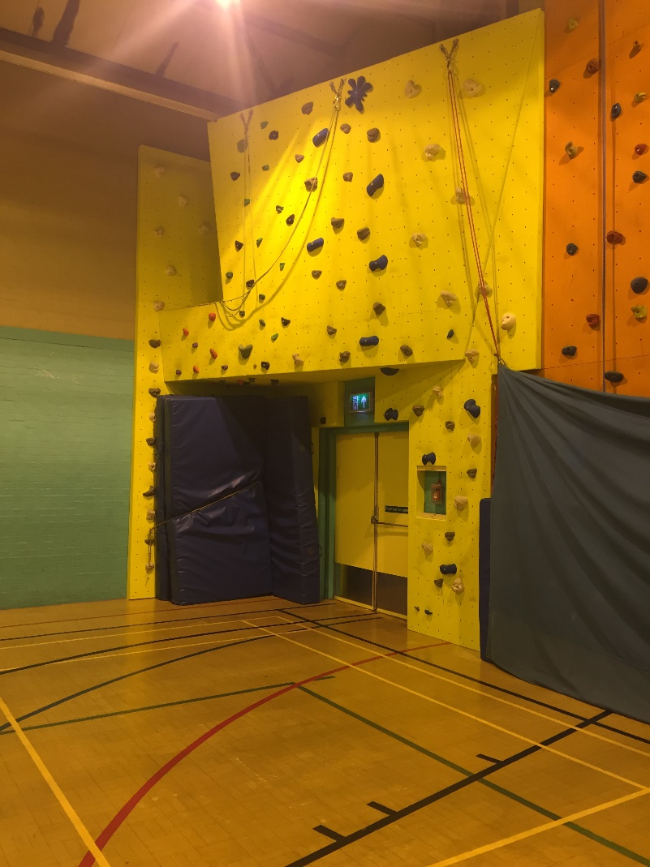
Know potential hazards in a range of physical activity and sport settings and be able to apply examples
    Spot the Difference …
TASK 1: Spot as many risks in the photos as possible and list them.
TASK 2: On the other picture explain how this risk has now been removed or minimised

Slide 12
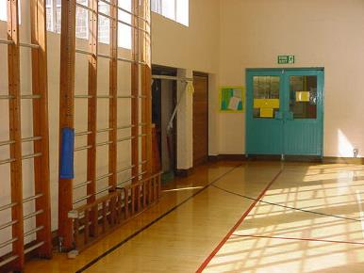
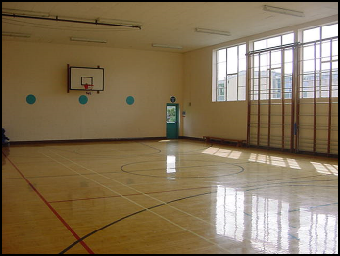
Know potential hazards in a range of physical activity and sport settings and be able to apply examples
HAZARDS IN A GYMNASIUM / SPORTS HALL
What can you see?
Doors opening inwards
Slippery floor – too polished
Hard floor
Apparatus stored at the sides
Equipment left out/ not stored correctly
Wooden floor – splinters
Windows allow glare from sun

Slide 13
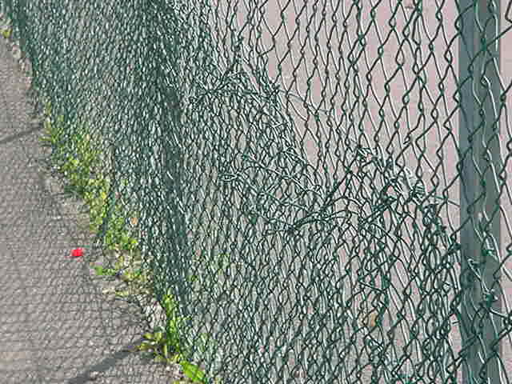
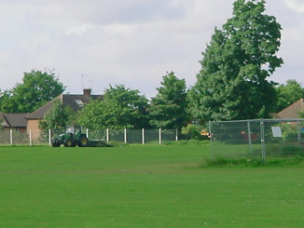
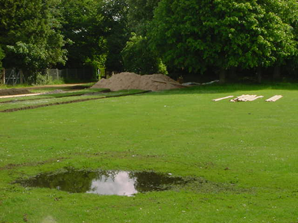
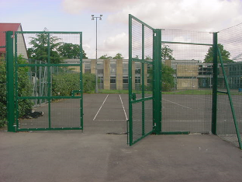
1.2.c. Preventing injury in physical activity and training
OUTDOOR HAZARDS

Slide 14
FORMAL Risk Assessments
TASK: Complete a risk assessment of an area of your choice
Name: | Date: | Sporting/activity area:
Hazard (something that has the potential to cause harm) | Risk (the chance that some one will be harmed) | Measures taken to avoid hazard causing injury/accident
Wet Surface | Slip and hit their head | Ensure all surfaces are inspected prior to use and any wet areas are dried suitably

Slide 15
OCR Resources: the small print
OCR’s resources are provided to support the delivery of OCR qualifications, but in no way constitute an endorsed teaching method that is required by the Board, and the decision to use them lies with the individual teacher. Whilst every effort is made to ensure the accuracy of the content, OCR cannot be held responsible for any errors or omissions within these resources.
Our documents are updated over time. Whilst every effort is made to check all documents, there may be contradictions between published support and the specification, therefore please use the information on the latest specification at all times. Where changes are made to specifications these will be indicated within the document, there will be a new version number indicated, and a summary of the changes. If you do notice a discrepancy between the specification and a resource please contact us at:
resources.feedback@ocr.org.uk.
© OCR 2018 - This resource may be freely copied and distributed, as long as the OCR logo and this message remain intact and OCR is acknowledged as the originator of this work. OCR acknowledges the use of the following content:
Please get in touch if you want to discuss the accessibility of resources we offer to support delivery of our qualifications: resources.feedback@ocr.org.uk
3 > Friendly rugby match / Ivica Drusany / Shutterstock.com / ED 4 > Amateur boxer wearing blue helmet and gum shield / Paolo Bona / Shutterstock.com / ED 5 > Illustration of a man slip on ice pool background / onime / Shutterstock.com / ED | 6 > Big and tiny Sumo wrestler / Danomyte / Shutterstock.com 8 > Cesc Fabregas (R) warms-up before the Gamper Trophy final match / Natursports / Shutterstock.com / ED 9 > Steamed crab in pot / kckate16 / Shutterstock.com

