Slide 1

Socio-cultural influences

Slide 2
Learning
Outcomes
2.1.a. Engagement patterns of different social groups in physical activities and sports
By the end of this topic you should …
Be familiar with current trends in participation in physical activity and sport:
  Using different sources (such as Sport England, NGB’s and Department of Culture Media and Sport)
  Of different social groups
  In different physical activities and sports.

Slide 3
Current trends in participation
Priority/target groups are groups of people who have been identified as either not, or in danger of not, participating in sport or physical activity as much as they should.
‘Creating sporting habits for life’
Sport England Priority/Target Group (14-16 year olds)
30 minutes sustained exercise per week.
Sport England Priority/Target Group (16-25 year olds)
Since 2005/06 the number of 16-25 year olds participating in sport has increased (3.64 million to 3.83 million).
55.5% of 16-25year olds participate in sport once a week for 30 minutes or more.
Sport England Priority/Target Group (26 year olds plus)
32.4% of adults 26 years or older participate in sport once a week for 30 minutes or more.
40.1% of men and 30.5% of women participate in moderate intensity level sport at least once a week.
Priority/target groups
Source: Sport England – Active People Survey 10 2015/16

Slide 4
Current trends in participation
Other important data
In 2013 42% of 5-16 year olds main method of getting to school was walking.
34% were driven to school.
2% cycled.
In 2013 81.6% of 5-15 year olds reported that they had done some form of competitive sport in the last 12 months.
78% had taken part in a competitive sport in school, 38% outside of school.
Priority/target groups
Source: Public Health England - child physical activity data factsheet 2014
Source: Department for Education – Evidence on physical education in schools 2013

Slide 5
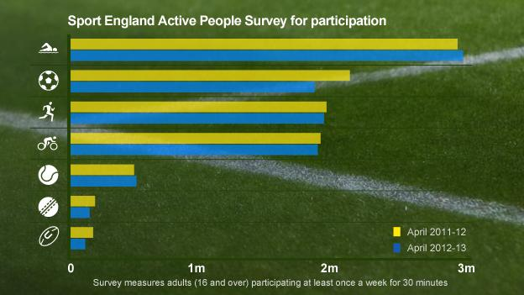
Current trends in participation
Strategies to improve participation in sport
Task: What does this graph tell you about sporting trends in the UK?
What are the three most popular sports in the UK?
Has this changed at any point?
Which sports have grown in popularity?
Which Sports have seen the largest drop in participation?
Why might this be?
Source: Sport England – Active People Survey 2013

Slide 6
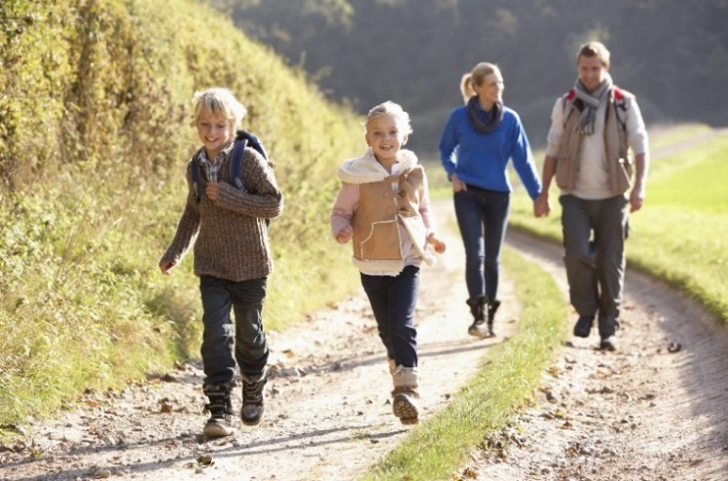
Current trends in participation
Popular sports/activities
Most popular adult activities in the UK in 2017
Walking | 19.2 million
Keep fit/yoga (including aerobics and dance exercises) | 13.4 million
Swimming | 4.5 million
Cycling | 6.2 million
Racket sports (tennis, badminton, and squash) | 2.2 million
Source: Sport England – Active Lives Adult Survey 2017/18

Slide 7
Current trends in participation
The rate of participation among people aged 16 and over is greater in those from higher socio-economic groups (more money) than those from lower socio-economic groups( less money).
Socio-economic groups
Proportion of adults who take part in at least one sport or physical activity
Higher socio-economic groups | Manual and unemployed socio-economic
71% | 54%
Source: Sport England – Active Lives Adult Survey 2017/18

Slide 8
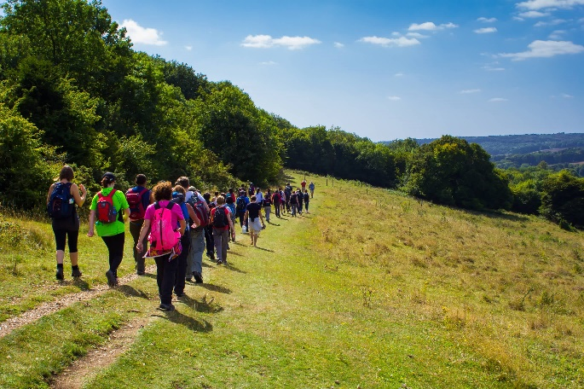
Current trends in participation
Participation by gender
Participate in sport activities
Men | Women
65% | 60%
Participate in organised competition
Men | Women
40% | 14%
Source: Sport England – Active Lives Adult Survey 2017/18

Slide 9
Current trends in participation
The proportion of adults taking part in at least one sport or physical activity decreases with age (except for walking)
Participation by age
Proportion of adults who take part in at least one sport or physical activity (including walking)
16-24 year olds | 65-74 years
84% | 83%
Proportion of adults who take part in at least one sport or physical activity (excluding walking)
16-19 year olds | 70+ years
55% | 19%
Source: Sport England – Active Lives Adult Survey 2015/16

Slide 10
Current trends in participation
Gender
Data, analysis and evaluation
The table below shows the difference between female and male football clubs and registered players.
2012
Gender | Plays football as a member of a sports club | Takes part in organised competition
Female | 13.4% | 14.7%
Male | 19.5% | 27.9%
Source: Women's football fact sheet October 2012

Slide 11
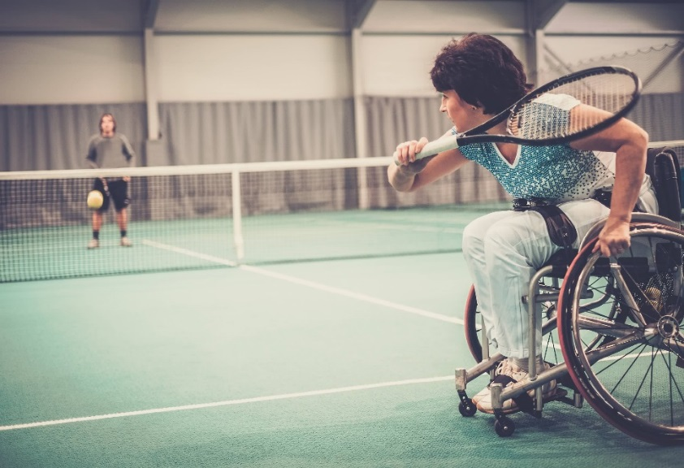
Current trends in participation
Disability
Proportion of adults with a long term limiting illness or disability that played sport once a week
2015/16 | 2017/18
60.9% | 61.8% *
* compared to 81.6% without a disability.
Source: Sport England – Active Lives Adult Survey 2015/16 and 2017/18

Slide 12
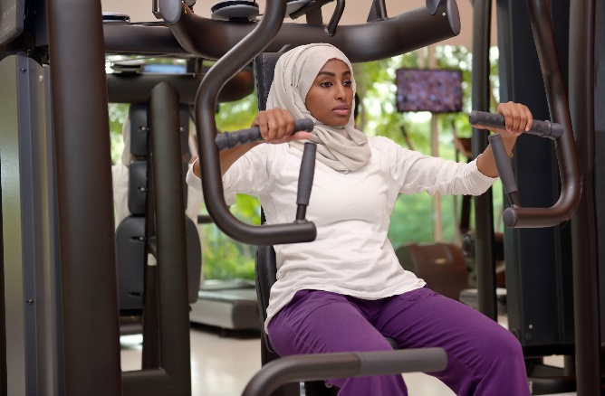
Current trends in participation
Ethnicity
Proportion of adults who play sports once a week
 | 2017/2018
Black and other minority ethnic groups | 57%
White British groups | 63%
Among women, those from white backgrounds are more likely to take part in sport compared to those from Chinese, black and other ethnic backgrounds.
Source: Sport England – Active Lives Adult Survey 2017/18

Slide 13
Current trends in participation
Activity levels are highest for people from mixed ethnicity - 71%
White British background is at 63%.
The lowest are for people from South Asian – 55%.
In basketball and cricket, more than a third are from a non-white background.
Badminton and football also have a higher than average proportion of players from a non-white background.
Non-white players make up a comparatively small share of cyclists and golfers.
In sport in general
Source: Sport England – Active Lives Adult Survey 2017/18

Slide 14
Learning
Outcomes
2.1.a. Engagement patterns of different social groups in physical activities and sports
By the end of this topic you should…
Understand how different factors can affect participation, including:
  Age
  Gender
  Ethnicity
  Religion
  Culture
  Family
  Education
  Time
  Work Commitments
  Cost
  Disposable income
  Disability
  Opportunity
  Access
  Discrimination
  Environment / climate, media coverage, role models
Understand Strategies which can be used to improve participation:
  Promotion
  Provision
  access
  Be able to apply examples from physical activity / sport to participation issues.

Slide 15
Factors affecting participation in physical activity and sport
Age
Percentage of participants taking part at least twice a month by age
16-34 years old | 35-54 years old
81.5% | 78.4%
Source: Sport England – Active Lives Adult Survey 2017/18
TASK: In pairs discuss what conclusions can we draw from this?

Slide 16
Factors affecting participation in physical activity and sport
Age
Average life expectancy has risen, so more and more people could participate.
There is an increase in the number of teams for older people (veterans teams).
Sport is often perceived as a ‘young person’s activity’.
Some older people lack confidence to participate.
Some older people’s participation may be affected by medical conditions or illness.
Some activities have age restrictions
  minimum age for London Marathon is 18 years
  minimum age is for Olympic snowboarding is 15 years
  Some fitness gyms have a minimum age restriction.
Some NGBs have regulations that restrict the age gap between players (2 years etc.)
  In rugby players Under 12 years of age cannot ‘play up’.
Many NGBs have developed adaptations of their sport that are suitable for older people
  Walking netball, walking basketball and walking football are examples.

Slide 17
Factors affecting participation in physical activity and sport
Gender
Let’s look at some statistics for females and male football players
Gender | Member of a registered team/club
Female | 13.4%
Male | 19.5%
Gender | Plays at least once a week
Female | 0.6%
Male | 9.8%
Gender | Receives coaching/tuition in football
Female | 13.8%
Male | 11.8%
Source: Women's football fact sheet October 2012
TASK: What patterns do you notice in the data tables above?

Slide 18
Factors affecting participation in physical activity and sport
Gender
Barriers to women playing sport are…
TASK: Make a list of barriers to women participating in sport
How many of these did you get?
Lack of time and childcare
Lack of self confidence
Personal safety
Parental and adult influence
Male dominated culture of sport
Funding
Body image
Lack of media exposure
Lack of role models
Sexism

Slide 19
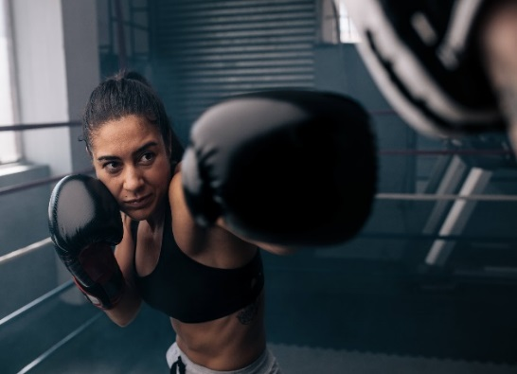
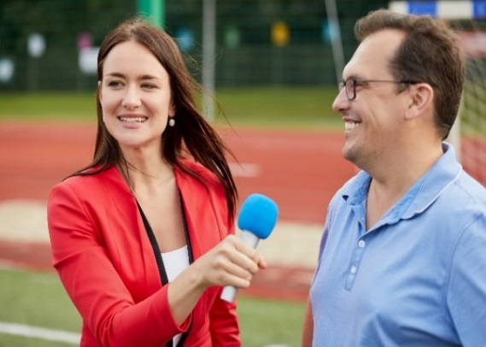
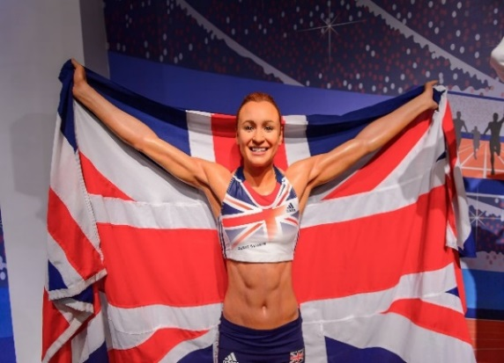
Factors affecting participation in physical activity and sport
Gender
Women’s opportunities at elite level are growing all the time. With an increase in the women's sport profile, sponsorship and financial gain is becoming more readily available.
Many female sports have seen a rise in media coverage and ultimately popularity.
Opportunities for female officials and management roles within teams have grown too and there are a great deal more female presenters on TV.
TASK: Which women’s sports have seen an increase in coverage?

Slide 20
Factors affecting participation in physical activity and sport
Gender
Applying examples from physical activity / sport to participation issues
The tables below show a summary of girls and boys who play sport in or outside school
5 to 10 year olds
Gender | 2012 | 2013 | 2014 | 2015
Girls | 76.4% | 80.1% | 77.2% | 78.6%
Boys | 85.1% | 87.8% | 84.8% | 88.3%
11 to 15 year olds
Gender | 2012 | 2013 | 2014 | 2015
Girls | 92.5% | 94.9% | 93.1% | 95.5%
Boys | 97.2% | 98.5% | 96.7% | 96.0%
Source: Taking part 2015/16 Annual Child Report
TASK: What patterns do you notice in the data table above?

Slide 21
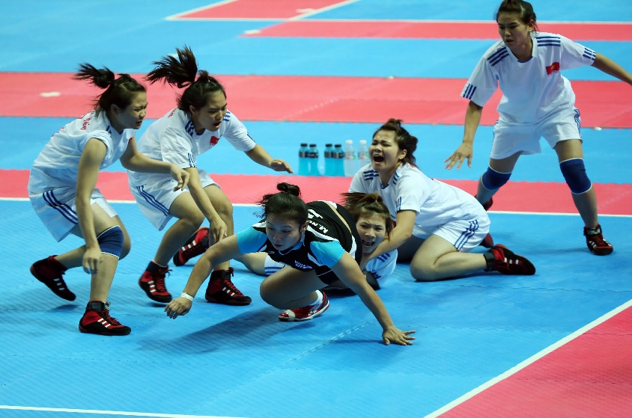
Factors affecting participation in physical activity and sport
Ethnicity, culture and religion
The number of both black and minority ethnic and white British adults playing sport is increasing. Taking up a sport or activity may be influenced by ethnic background e.g. cricket is very popular within Asian countries.
TASK: Which country, culture and/or religion would you associate with the following sports?
Hockey
Cricket
Kabaddi
Basketball
Volleyball
Aussie rules football
Hurling
Curling
TASK: Explain why you think there are less black tennis players/golfers than footballers?

Slide 22
Factors affecting participation in physical activity and sport
Ethnicity, culture and religion
Applying examples from physical activity / sport to participation issues
The tables below show a summary of ethnicity participation over 3 years
Black and ethnic minority groups
2015/16 | 2016/17 | 2017/18
71.6% | 70.4% | 71.4%
White British groups
2015/16 | 2016/17 | 2017/18
78.4% | 78.5% | 78.9%
Source: Sport England – Active Lives Adult Survey 2017/18
TASK: What patterns do you notice in the data table above?

Slide 23
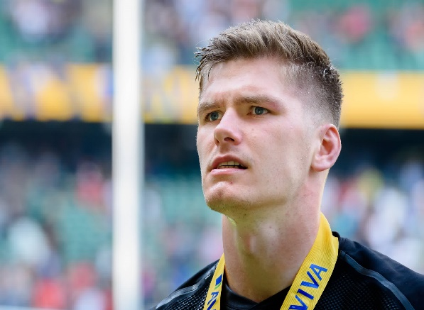
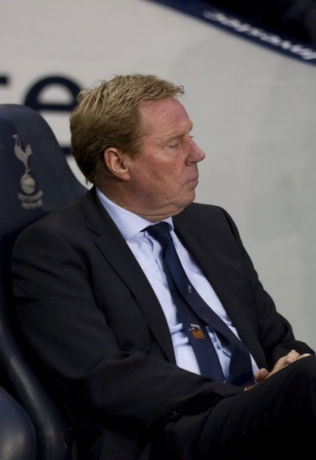
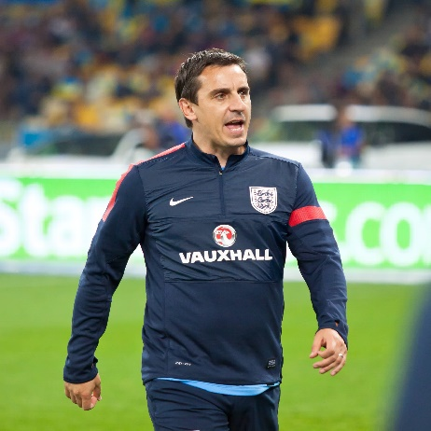
Factors affecting participation in physical activity and sport
Family
You are more likely to participate in sport if your parents do.
You are less likely to participate if there is little interest shown by your family.
Family support is crucial:
Transport
Equipment/kit costs
Membership/match fees
Teaching sporting etiquette/sportsmanship
Negative influences might include:
Poor sportsmanship/deviance
Unrealistic expectations
Placing undue pressures on children
Keeping children away from peers to gain higher levels of competitions.
Andy Farrell
Owen Farrell
Harry Redknapp
Jamie Redknapp
Frank Lampard snr
Frank Lampard jnr
All one family!
Tracey Neville
Gary Neville
Phil Neville
TASKS
Are there any ‘sporting families’ at your school?
Explain how your family may have affected your involvement in your chosen sport…

Slide 24
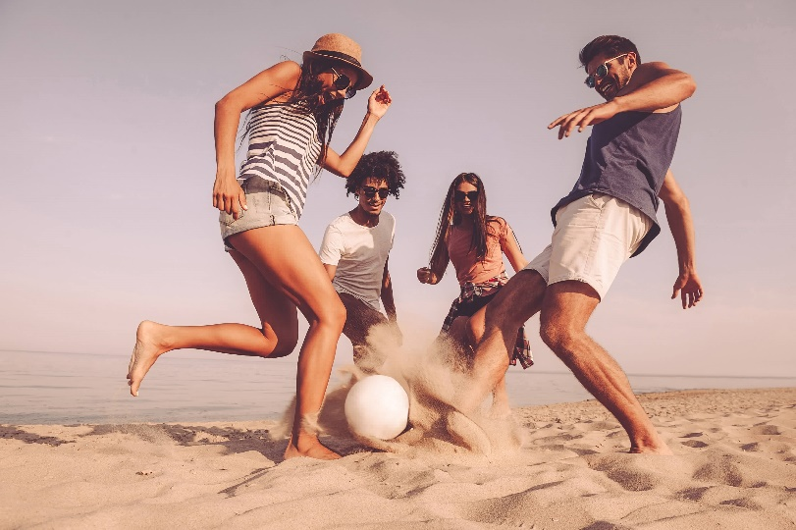
Factors affecting participation in physical activity and sport
Friends and peers can greatly influence you.
They can influence whether you participate or reject physical activity, instead persuading you to go to the cinema, smoke, drink, alcohol, take drugs, etc.
They can influence what sport or physical activity you take up, asking you to attend a pilates class with them.
They can influence whether you continue participating in later life, giving you a lift to a swimming pool or booking a health spa weekend for you both.
Falling out with a friend or the peer group can make you change your interests in sport or stop altogether.
Peer pressure makes you want to do what others do or don’t do.
It is very powerful in relation to children’s attitudes.
Friends/Peers
When you participate in sport or physical activity who do you participate with?

Slide 25
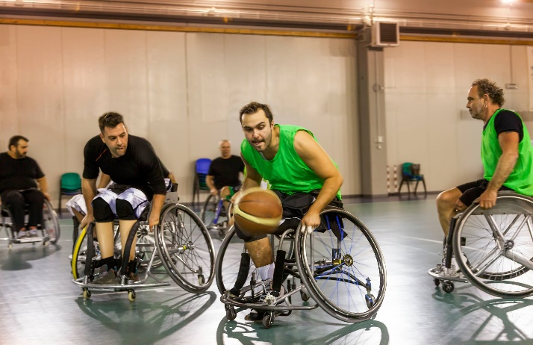
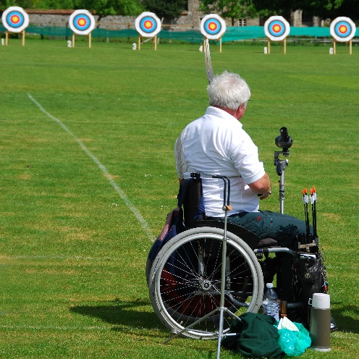
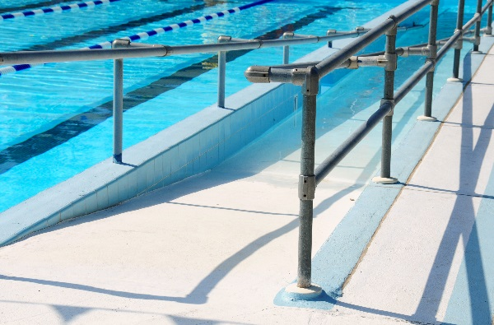
Factors affecting participation in physical activity and sport
Sport is encouraged to all regardless of disability.
Performers with disabilities often compete against similar groups or can be mixed with able-bodied performers.
More disabled people are taking part in sport – 17% in 2015 are playing sport regularly, up from around 15% in 2005/06.
Participation rates have increased since 2012 London Paralympic Games, but overall those with a disability show a comparatively low percentage in participation.
This may be due to the lack of adapted equipment, access, clubs, discrimination and/or a lack of confidence.
Disability

Slide 26
Factors affecting participation in physical activity and sport
Disability
 | Participants with disabilities | Able bodied participants
2005/2006 | 15.1% | 37.8%
2006/2007 | 16.7% | 39.3%
2007/2008 | 16.2% | 39.2%
2008/2009 | 16.3% | 38.9%
2009/2010 | 17.7% | 37.7%
2010/2011 | 18.3% | 39.4%
2011/2012 | 18.5% | 39.2%
Exam question (3 marks)
Assess the trends in participation in sport from 2005/2006 until 2011/2012.

Slide 27
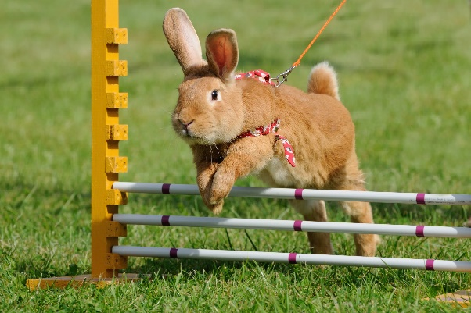
Factors affecting participation in physical activity and sport
Reasons for participation in sport and physical activity
TASK: Identify 3 reasons for taking part in sport
There are 5 reasons for participation in physical activity and sport:
Media coverage
Environment and climate
Time
Resources
Role models
Can you create an acronym to remember these?
Example:
M - My
E - Elephant
T - Trains
R - Racing
R - Rabbits

Slide 28
Reasons people get involved in sport
Media coverage
TASK: Discuss the importance/influence of media on sport today and come up with an example of how media coverage affects participation rates in a certain sport
Other possible reasons people do not get involved in sport (barriers to participation)
Media coverage – some sports get a great deal more media coverage than others which makes them more popular e.g. football vs hockey
Male sport still dominates although there is much more interest in women’s sport in recent years due to increased success e.g. GB women’s football reaching the quarter final of the 2012 Olympic Games
The media can stimulate participation in sports e.g. huge increase in tennis participation during Wimbledon as people watch it on TV and want to participate themselves
Our interest is especially increased when the media highlights the success of UK sports people e.g. lots of interest in cycling after the success in the 2012 Olympic Games when 6 world track records were achieved.

Slide 29
Reasons people get involved in sport
Media coverage
In the News In the year that Andy Murray won Wimbledon (2013) there was a FALL in the number of people who played tennis at least once a week. Sport England’s Active People Survey found that 406,000 people played in the year 2013 – a fall of 39,000 on the previous 12 month period. (PE second edition by J. Honeybourne)
Tennis example – why did this happen?

Slide 30
Reasons people get involved in sport
Media coverage
Extension task: to be prepared for the exam it’s helpful if you learn a summary of how the media can affect participation in sport.
Create a list of both the positive and negative affects of the media on participation in sport.
Positive affects of media on sport | Negative affects of media on sport

Slide 31
Reasons people get involved in sport
POSITIVE aspects of the Media
promotes or encourages sport and exercise, and increases interest through sports coverage promotes healthy living can motivate through role models promotional campaigns or public service broadcasting or through advertising provide a wide variety of sports, including minority and novel sports will create funds and sponsorship that can be used to encourage activity gives information about healthy lifestyles and fitness, e.g. via the internet or new training methods.

Slide 32
Reasons people get involved in sport
NEGATIVE aspects of the Media
may encourage or reinforce unhealthy or inactive lifestyle may show negative role models too much passive watching and listening to media discourages activity, causing the 'couch potato' syndrome minority sports (those in which few people participate) are often under-represented women's sports are under-represented or misrepresented disability sport is under-represented or misrepresented older performers are often under-represented can make people feel inadequate by not having the ability or skill or the 'sporty' body image might show the dangers of participation or (high) risk of injury that might put people off participation.

Slide 33
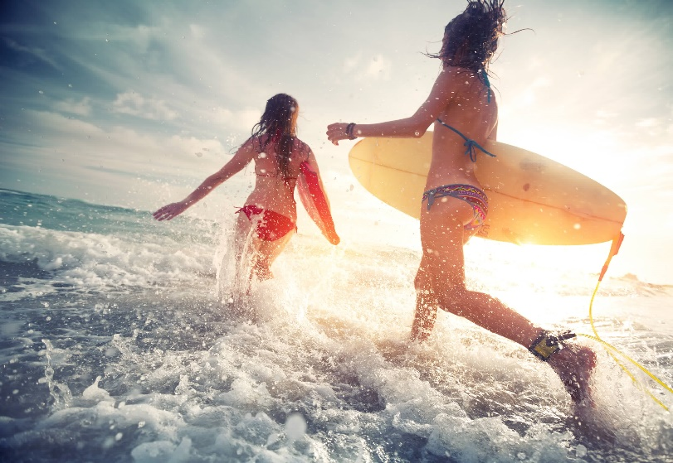
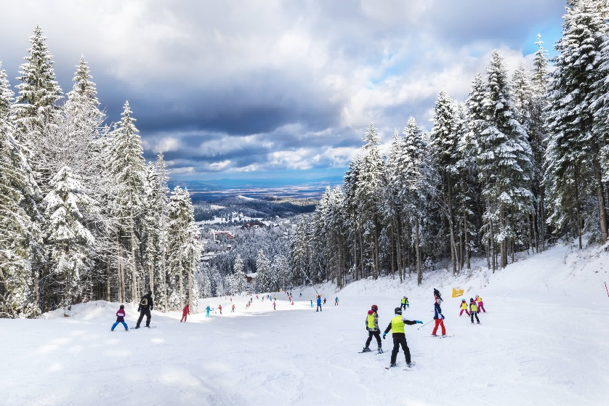
Reasons people get involved in sport
Environment and climate – this can dictate which sports/activities people take part in e.g. if you live in an area that receives regular snow and has hills, then you are more likely to ski than someone who doesn’t.
Environment and climate

Slide 34
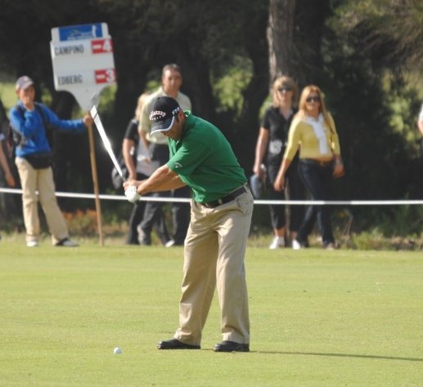
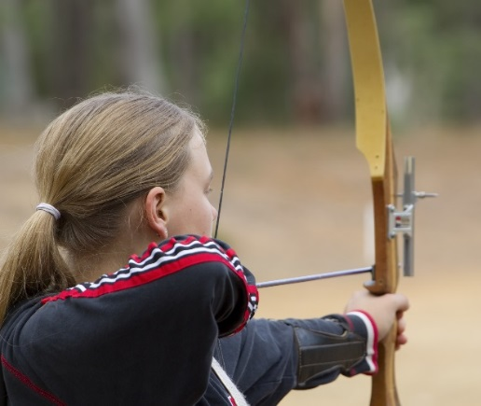
Reasons people get involved in sport
Cost / disposable income
Cost
Some activities/equipment/kit are too costly for everyone to be able to participate.
Examples
You need access to horses for:
polo
show jumping
point to point.
Kit can be expensive for:
ice hockey
golf
Archery.
Memberships can be expensive for
private golf clubs.

Slide 35
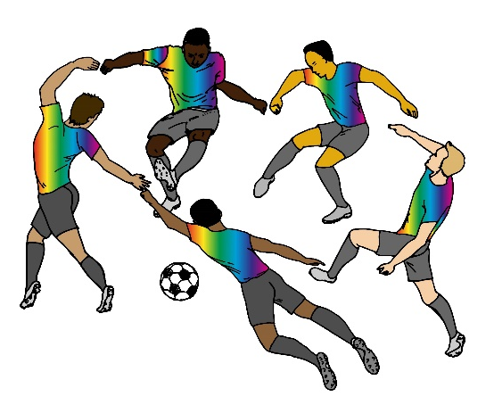
Reasons people get involved in sport
Discrimination
Discrimination may prevent certain people from participating in a sports activity, due to:
Race/colour:
in some countries certain ethnic minorities are prevented from joining clubs.
Gender:
golf clubs not allowing women to participate at certain times or not at all
leisure centres having female only fitness classes.
Disability:
people with disabilities not being allowed to join certain clubs.
Age:
clubs making an upper age limit for membership to prevent
older people joining.

Slide 36

Reasons people get involved in sport
Work commitments can get in the way of finding enough time for sport.
Travel time to and from work may reduce time available for participating.
Family commitments may reduce the time available for parents to participate.
TIME

Slide 37
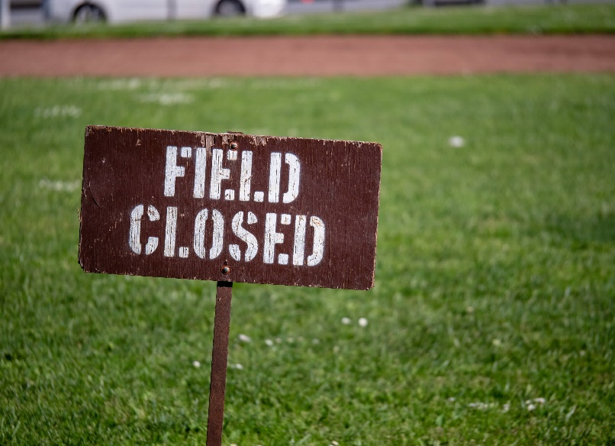
Reasons people get involved in sport
You may not have appropriate sports clubs or facilities near you which may prevent you from participating.
Some local authorities provide transport to help increase participation e.g. buses to leisure centres for elderly people.
Opportunity / Access

Slide 38
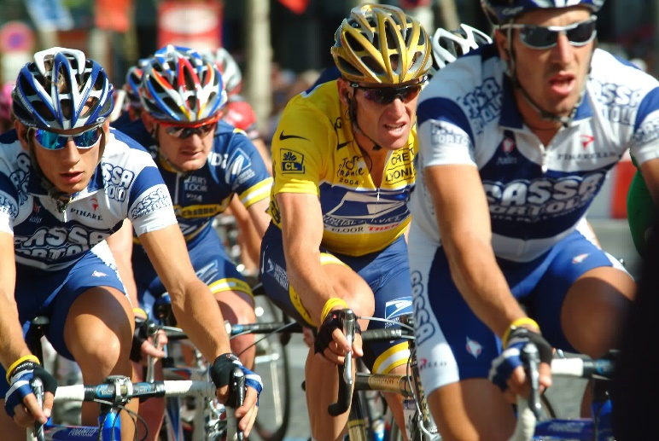
Reasons people get involved in sport
Role models
Like parents, other significant others can influence whether you participate in sport.
These may include:
High level performers you have seen or read about in the media
Players in an older team at your club
PE teachers
Sports coaches who visit your school to coach specific sports activities.
The behaviour/actions of some role models might be negative, which can cause problems if their followers copy their negative behaviours when they participate.
TASK: Make a list of sporting role models.
Indicate if they are positive or negative.
Explain the reasons for your choices.

Slide 39
Strategies to get people involved in sport
The three important factors that can deliver successful strategies for improving participation are:
Promotion or convincing people they should take up sport
Provision of facilities, equipment, coaching etc.
Access or giving people opportunity to participate by making it easier for them to engage in sport.
Promotion, provision and access

Slide 40
Strategies to get people involved in sport
More information/education on the benefits of regular sports participation
e.g. TV advertising to show benefits of regular exercise or e.g. This Girl Can/advertising local clubs on the radio or Change 4 Life.
Regular opportunities for coaching/instructing to enable more frequent participation e.g. fitness instructors available across the working day and evening.
More facilities available for regular participation e.g. ensuring that each community is served by a leisure centre.
Facilities available for longer during the day to enable regular participation e.g. local swimming baths open early morning and close late evening.
Information, opportunities, facilities and availability

Slide 41
Strategies to get people involved in sport
More accessible facilities or more localised facilities or better transport arrangements to access facilities e.g. facilities have wheelchair ramps or a (free) local bus service is provided.
Cheaper facilities for sport or concessions for more adults to be involved e.g. the local leisure centres give concessions for the elderly or give cut price admission for regular users.
Introduction of adapted games e.g. walking football, walking basketball, touch rugby for adults.
Activities/sessions for adults only or age-group sessions e.g. adult/40 plus/50 plus fitness classes.
Provision for childcare e.g. gyms that provide childcare/nursery/playgroup/youth group so that parents can exercise.
Facilities, adaption and childcare

Slide 42
Participation rates
Extension task
Engagement patterns of different social groups
Name and describe 2 social groups that might engage in physical activity.
Explain how role models and media coverage might affect girls and boys taking part in physical activity?
How might the cost or amount of disposable income affect the type of activity an individual could choose to do?
Why might disability affect participation rates in sport?
Notes:
Photos by: LOCOG

Slide 43
OCR Resources: the small print
OCR’s resources are provided to support the delivery of OCR qualifications, but in no way constitute an endorsed teaching method that is required by the Board, and the decision to use them lies with the individual teacher. Whilst every effort is made to ensure the accuracy of the content, OCR cannot be held responsible for any errors or omissions within these resources.
Our documents are updated over time. Whilst every effort is made to check all documents, there may be contradictions between published support and the specification, therefore please use the information on the latest specification at all times. Where changes are made to specifications these will be indicated within the document, there will be a new version number indicated, and a summary of the changes. If you do notice a discrepancy between the specification and a resource please contact us at:
resources.feedback@ocr.org.uk.
© OCR 2018 - This resource may be freely copied and distributed, as long as the OCR logo and this message remain intact and OCR is acknowledged as the originator of this work. OCR acknowledges the use of the following content:
Please get in touch if you want to discuss the accessibility of resources we offer to support delivery of our qualifications: resources.feedback@ocr.org.uk
5 > Young family walking in park / Monkey Business Images / Shutterstock.com 6 > A large group of people hiking the Chiltern Hills during a bright summer day / mikecphoto / Shutterstock.com / ED 8 > Disabled mature woman on wheelchair playing tennis on tennis court / Nejron Photo / Shutterstock.com 9 > Young arab muslim woman working out in a Gym Dubai UAE / Naufal MQ / Shutterstock.com 16 > Boxer practicing her punches at a boxing studio / Jacob Lund / Shutterstock.com 16 > Young female journalist interviews man focus on woman / Pavel L Photo and Video / Shutterstock.com 16 > British athlete Jessica Ennis-Hill Madame Tussauds wax museum / Anton_Ivanov / Shutterstock.com / ED 18 > Nuchanart Maiwan kabaddi player from Thailand participates in an Asian Indoor and Martial Arts Games / Pal2iyawit / Shutterstock.com / ED 21 > Owen Farrell of Saracens / takaimages / Shutterstock.com / ED 21 > Tottenham's manager Harry Redknapp / Mitch Gunn / Shutterstock.com / ED 21 > Gary Neville assistant manager for the England national football team / katatonia82 / Shutterstock.com / ED | 22 > Fun time with friends / g-stockstudio / Shutterstock.com 23 > Disabled sport men in action while playing indoor basketball at a basketball court / marino bocelli / Shutterstock.com 25 > Rabbit / anetapics / Shutterstock.com 26 > British newspaper front pages reporting on England's World Cup / Lenscap Photography / Shutterstock.com / ED 31 > Group of young children learning to practice skiing / Cristian Balate / Shutterstock.com 31 > Two young ladies surfers running into the sea with surf boards / Dudarev Mikhail / Shutterstock.com 33 > Drawing of football players / Povsydu / Shutterstock.com 34 > Tired woman hiding face behind clock at table in office / Pixel-Shot / Shutterstock.com 35 > Field closed sign blocking access to a field in a park outside / David Tran Photo / Shutterstock.com 36 > Lance Armstrong on Champs Elysees in Paris 2004 / Marc Pagani Photography / Shutterstock.com / ED

