Slide 1

Socio-cultural issues and sports psychology

Slide 2
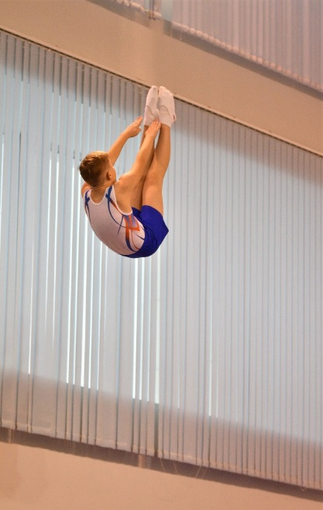
2.2 Sports psychology
By the end of this topic you should ……
Know the definition of motor skills
Understand and be able to apply examples of the characteristics of skillful movement:
  efficiency
  pre-determined
  coordinated
  fluent
  aesthetic.
Know 2 continua used in the classification of skills, including:
  simple to complex skills (difficulty continuum)
  open to closed skills (environmental continuum).
Be able to apply practical examples of skills for each continuum along with justification for their placement on both continua.
Learning
Outcomes

Slide 3
Characteristics of skilful movement
A skilful movement can be defined as:
‘A skilled movement is one in which a predetermined objective is accomplished with maximum efficiency with a minimum outlay of energy.’
OCR GCSE (9-1) PE Second Edition – John Honeybourne 2016
Motor skill
An action or task that has a target or goal and that requires voluntary body and/or limb movement to achieve this goal.

Slide 4
Characteristics of skilful movement
Task: watch the YouTube clip. Do you think the juggler:
planned this routine
tried to make it look good
has good co-ordination
made the routine flow
makes his movements look easy/efficient?
Explain your answers.
Juggler on YouTube
https://www.youtube.com/watch?v=5uaBBl3gXRs
Now let’s apply your answers to the sport and physical activities on the syllabus

Slide 5
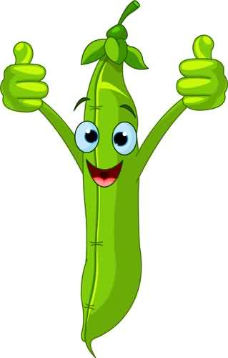
Characteristics of skilful movement
Skilful movement (the characteristics of skill) consist of:
Pre-determined - A player will perform skills having already planned them e.g. a skilled footballer will know where they are going to kick the ball before taking a penalty
Efficiency – A skilled player is able to perform the task without any wasted energy e.g. a swimmer gliding through water, not fighting it
Aesthetic - They look good. A top-class dance routine is pleasing to watch
Fluent - A skilled player is able to perform the task making it look effortless and movements flow from one to the next e.g. a trampoline routine
Coordination – The skilled performer in volleyball can jump and then ‘spike/smash’ successfully whilst still in the air.
ACRONYM
Remember that brilliant football team
PEA FC

Slide 6

Characteristics of skilful movement
Skill differs from ability in that it is not innate, skills are learnt.
They are developed from ability after a period of practice.
To produce a skilled performance, the player must practice so that the required abilities are enhanced.
What are the characteristics of skilful movement?
Write all of them (with an example) on a post it note and stick them on the board!

Slide 7
Why classify skills?
Classification of skills
For skills to be understood fully and for those who teach or coach these skills it is useful to classify skills because…
Classification makes it clearer about what is required to learn and perform a particular skill
All skills can be placed on a continuum (scale).
There are two continua you need to learn:
  difficulty continuum (simple to complex)
  environmental continuum (open to closed).

Slide 8
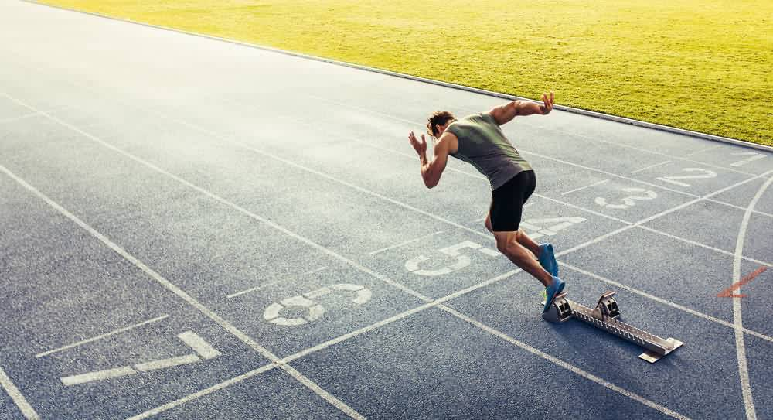
Classification of skills
    Difficulty continuum
Skills can be classified according to the types of judgements and decisions that you have to make to perform the skill.
Simple:
straightforward, with hardly any judgements and decisions to make
can be taught as a whole in a repetitive way
e.g. a sprint start in swimming where there are very few decisions – other than to dive - to be made.
Complex:
  many decisions or judgements to make
  may have to be learned in stages
  e.g. slip catch in cricket, or a pass by a midfield player in hockey who has to make lots of decisions before she passes.
Any sporting action can be placed anywhere on the continuum depending on how simple or complex the skill is
Simple
Complex

Slide 9
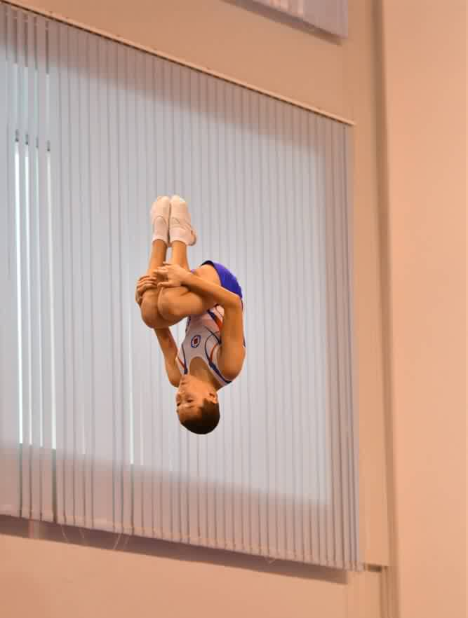
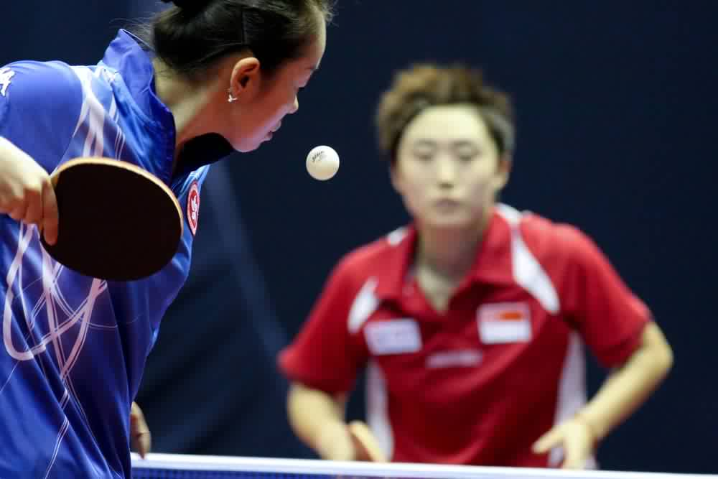
Classification of skills
    Difficulty continuum
Task: where do the skills pictured below belong on this continuum? And why?
Simple
Complex

Slide 10
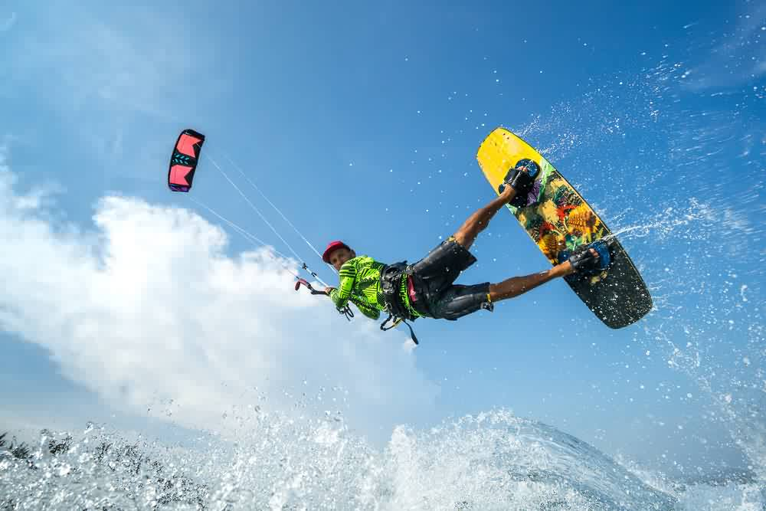
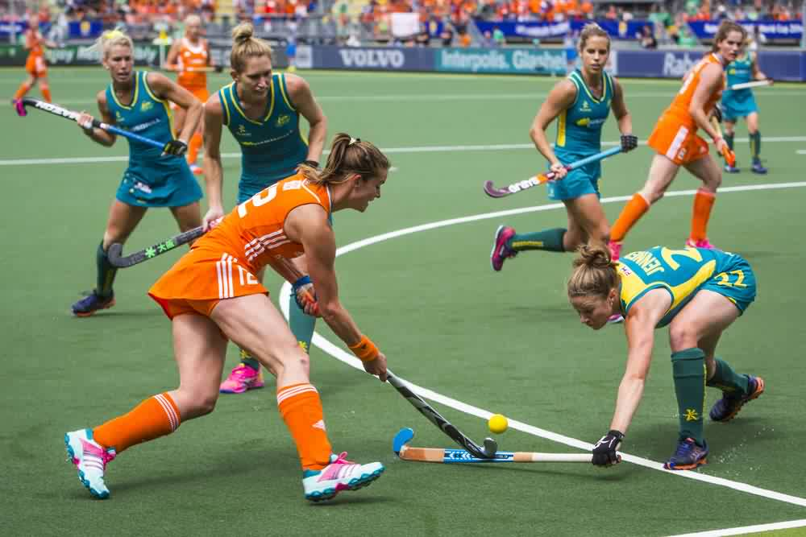
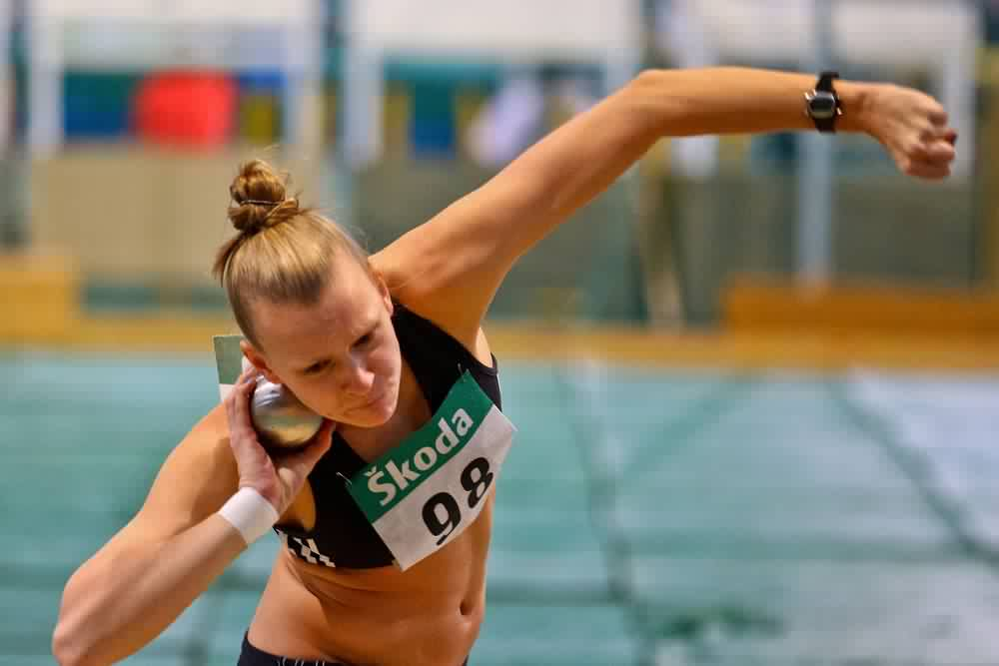
Classification of skills
    Environmental continuum
Open skill : the skill is effected by the environment and requires the performer to make perceptual decisions.
Closed skill : the skill is not affected at all by the environment.
CLOSED
OPEN
Task: where do the skills pictured above belong? Why?

Slide 11
Examiner’s tip
When asked to provide examples of skills/actions that are Open/Closed or Complex/Simple ……… BE SPECIFIC!!
Examples:
Hockey is a complex skill = is vague and gains zero marks.
BUT an attacker in hockey dribbling to beat defenders into the circle, is an example of a complex skill, is more specific and gains marks
Kite surfing is an Open skill = is vague and gains zero marks.
BUT a kite surfer riding a high wave on a windy day is an example of an Open skill, is more specific and gains marks.

Slide 12
Why do we need to classify skills?
There are implications for training and coaching for learning skills in sport
Makes it clearer what is required to learn
If the skill is a closed skill then it is unnecessary to vary the situation.

Slide 13
What are the implications for training and coaching?
If a closed skill was being taught it would need to be repetitive in the same situation as the situation remains fairly constant
If an open skill was being taught then it would need to be learnt in a variety of situations because the performer would need to be able to perform this skill in a variety of circumstances (e.g. keep changing shooting positions and type of shot in a basketball practice)
If a complex skill was being taught it would be taught in stages, to allow the brain to remember each bit
If a simple skill was being taught it would be taught as a whole in a repetitive way to ensure good memory.

Slide 14
Goal setting
By the end of this topic you should …
Understand and be able to apply examples of the use of goal setting:
  for exercise/training adherence
  to motivate performers
  to improve and/or optimise performance.
Understand the SMART principle of goal setting with practical examples.
  (Specific, Measurable, Achievable, Recorded, Timed).
Be able to apply the SMART principle to improve and/or optimize performance.
Learning
Outcomes

Slide 15
Why use Goal Setting?
We use goal setting because it:
motivates performers and keeps them working hard
gives performers a better chance to improve fitness levels
helps to improve/optimise performance
allows progress to be made in your training.
Notes:
Photo by: © plasmastik on Flickr. This image is reproduced under the terms of the Creative Commons License 3.0. http://www.fotopedia.com/items/flickr-3618588891

Slide 16
Why use Goal Setting?
A common way of goal setting is by use of the SMART principle i.e.
Specific
Measurable
Achievable
Recorded
Timed
Note*
A can also represent – Agreed
R can also represent – Realistic
This is not incorrect, however, our syllabus shows them as Achievable and Recorded.
Notes:
Photo by: © plasmastik on Flickr. This image is reproduced under the terms of the Creative Commons License 3.0. http://www.fotopedia.com/items/flickr-3618588891

Slide 17

Applying SMART targets
S | SPECIFIC | The goal must be specific so the performer knows exactly what they aim to achieve. ‘To get better at my sport sometime’ is much too vague.
M | MEASURABLE | You must be able to measure your progress. Example – to improve shot success in basketball by 20% is measurable. Improve concentration can’t be measured.
A | ACHIEVABLE | The goal must be possible for the performer to reach. Example – A sprinter trying to knock 8 seconds off their 100m time would be wasting their time, they need to work in 10ths or 100ths secs.
R | RECORDED | Logging the goal and the progress made will enable the performer to see how close they are getting to their target. It is also motivating to do this. Using a table/graph or spreadsheet are ways of recording the goal & progress.
T | TIMED | The goal must have a definite BEGINNING and END, which gives the performer a time limit in which to achieve the goal. This could be months or a whole season.
Task: make yourself a goal setting target for your sport, using the SMART principle

Slide 18
Applying SMART targets
By setting appropriate goals you can:
take up an activity or activities
achieve more when you participate in physical activities
improve your performance
improve the quality and quantity of your training
increase your motivation to succeed
increase your pride and satisfaction after goal completion.
Goal setting is a very powerful process that can lead to rewards, personal satisfaction and increased motivation levels.
By knowing what you want to achieve, you then know what you need to concentrate on and improve and what distractions to ignore. When you set goals for training in sport, you should try to:
pace yourself - do not try to do too much too soon
give yourself rewards
keep goals realistic
keep a record of your goals
not feel bad if things do not go well - plan your next step for future success.

Slide 19
What has stuck with you?
Apply it!
Use of goal setting and SMART targets
Explain the SMART principle
Why do beginners set more performance related goals than outcome ones?
Using an example describe a good target that is ‘timed’
Why should targets be measurable?
Notes:
Photos by: LOCOG

Slide 20
Mental preparation
By the end of this topic you should…
Know mental preparation techniques and be able to apply practical examples to their use:
  imagery
  mental rehearsal
  selective attention
  positive thinking.
Learning
Outcomes

Slide 21
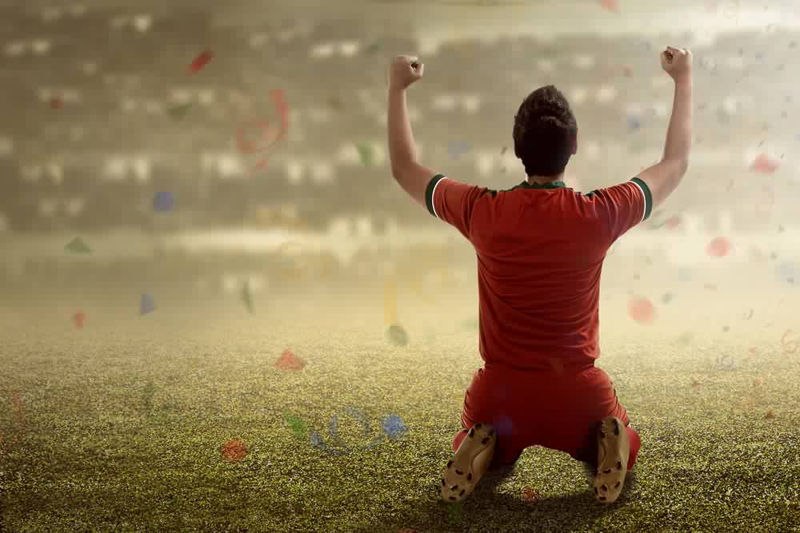
Mental Preparation
    Imagery
Imagery can improve concentration.
The creation of pictures in our minds is imagery.
Many people try to get the feeling of movement or capture an emotional feeling, for example of pleasure or happiness. Imagery can also help with relaxation.
A participant in a physical activity or a performer in sport who feels anxious could go to ‘another place' in their minds to try to calm down.
Many participants report that they use these techniques to cope with stress and anxiety.

Slide 22
Mental Preparation
    Mental Rehearsal
Mental rehearsal can involve both internal and external imagery.
External imagery is when you can picture yourself from outside your body, like watching yourself on film.
For example, a trampolinist may imagine watching themselves before they perform their routine.
Internal imagery is when you imagine yourself doing the activity and can simulate the feelings of the activity.
For example, bobsleigh driver or a high-jump athlete visualising the whole activity of run-up, jump and landing.
Mental rehearsal and imagery can result in the following benefits:
speeds up your reactions to different situations
enables you to concentrate and focus
keeps you calm and helps to control your levels of arousal
can prepare you to react in different ways depending on the opponent or changing circumstances
encourages you to be motivated and positive in your outlook.
Task: how might a gymnast use imagery before a routine?

Slide 23
Mental Preparation
    Mental Rehearsal
………….. is similar to imagery but can be used to:
familiarise the athlete with a competition site, a race course, a complex play pattern or routine
motivate the athlete by recalling images of their goals or of success in a past competition
perfect skills or skill sequences the athlete is learning or refining
reduce negative thoughts by focusing on positive outcomes
set the stage for performance with a complete mental run through of the key elements of their performance.
Examples:
taking and scoring a penalty in football, penalty flick in hockey or free throw in basketball
kicking a conversion in rugby
completing a slalom run in skiing.

Slide 24
Mental Preparation
    Selective Attention
This is the process of focusing on a particular object in the environment for a certain period of time.
Attention is a limited resource, so selective attention allows us to tune out unimportant details and focus on what really matters.
This is especially important right before a vital moment in sport.
When learning or performing skills in sport it is often difficult for the learner/performer to discriminate between information that is relevant and information that is unimportant in the execution of the skill.
A beginner basketball player may pay too much attention to the ball and not watch the movement of the opponent he is supposed to be marking.
It is therefore important that when learning or performing a skill that needs more concentration, the performer concentrates on what is relevant and ignores irrelevant distractions.
This process is called selective attention.

Slide 25
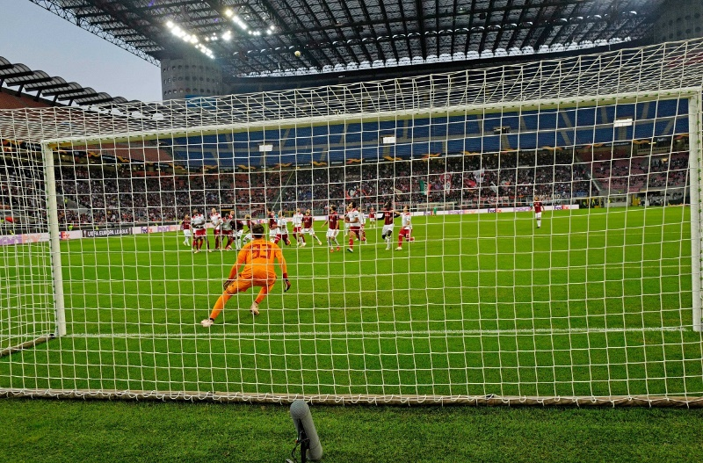
Mental Preparation
    Selective Attention
Task: make a list of ‘information’ that is not helpful when a goalkeeper is trying to save a shot in a football match.
Did you get?
crowd noise – cheering or jeering
stadium floodlights
crowd taking photographs on mobile phones
weather elements e.g. rain, wind, cold
the player shooting – opponent’s top goal scorer
the score
the time of the shot – beginning/middle/end of game.
Perhaps more importantly the focus should be on:
where the ball is
where your own players are
where you are positioned.

Slide 26
How is your Selective Attention?
Selection attention test on YouTube
https://www.youtube.com/watch?v=vJG698U2

Slide 27
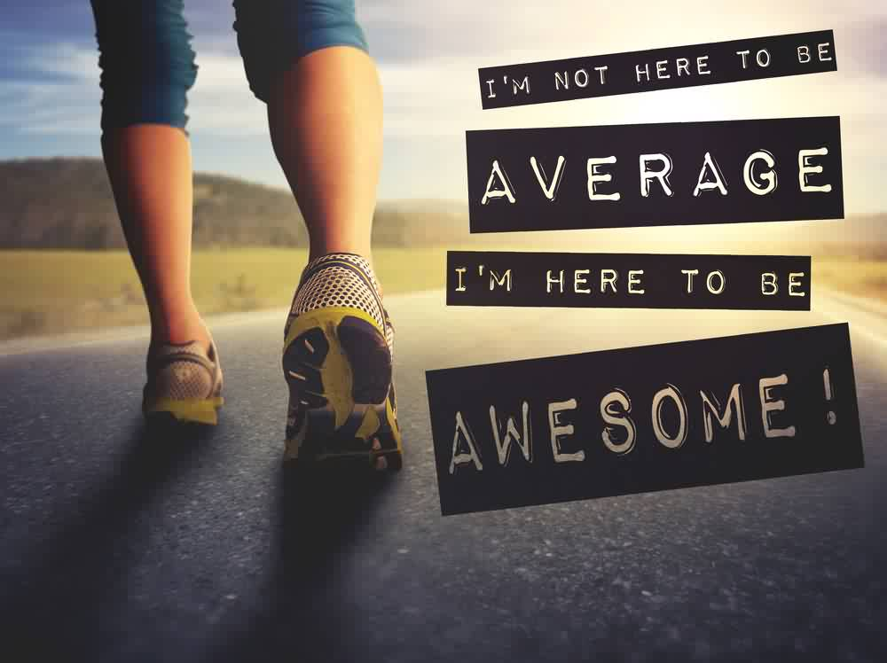
Mental Preparation
    Positive Thinking
…. sometimes called 'self-talk’
Involves the participant in a physical activity or the sports performer being positive about past experiences and performances and future efforts by talking to themselves or thinking through how successful they might be.
This involves recognising that the athlete has started worrying about a performance and refocusing by using positive inner thoughts.
This technique has been shown to help with self-confidence and to raise levels of aspiration.
e.g. netball player tells herself “focus” or a footballer saying
“we can do this”.
There are many ‘motivational quotes on the internet that performers use to enhance positive thinking.

Slide 28
Mental Preparation
    Negative Self Talk
For many would-be participants in physical activities and performers in sport, thinking can be far from positive and often can be negative.
There are five categories of negative thoughts:
worry about performance, e.g. 'I think she is better than me.'
inability to make decisions, e.g. 'Shall I pass, shall I hold, shall I shoot?'
preoccupation with physical feelings, e.g. 'I feel too tired, I'm going to give up and rest.'
thinking about what will happen if they lose, e.g. 'What will my coach say when I lose this point?'
thoughts of not having the ability to do well, e.g. 'I am not good enough; he is better than me.'
Task: for each of the statements above, turn the negative comment into a positive one

Slide 29
What has stuck with you?
Apply it!
Mental preparation for performance
Explain mental rehearsal
What other ways can an athlete prepare for exercise?
Discuss the advantages of mental rehearsal
Why is a warm up a good way of preparing for exercise?

Slide 30
Types of guidance and feedback
By the end of this topic you should…
Understand types of guidance, their advantages and disadvantages, and be able to apply practical examples to their use:
  visual
  verbal
  manual
  mechanical.
Learning
Outcomes

Slide 31
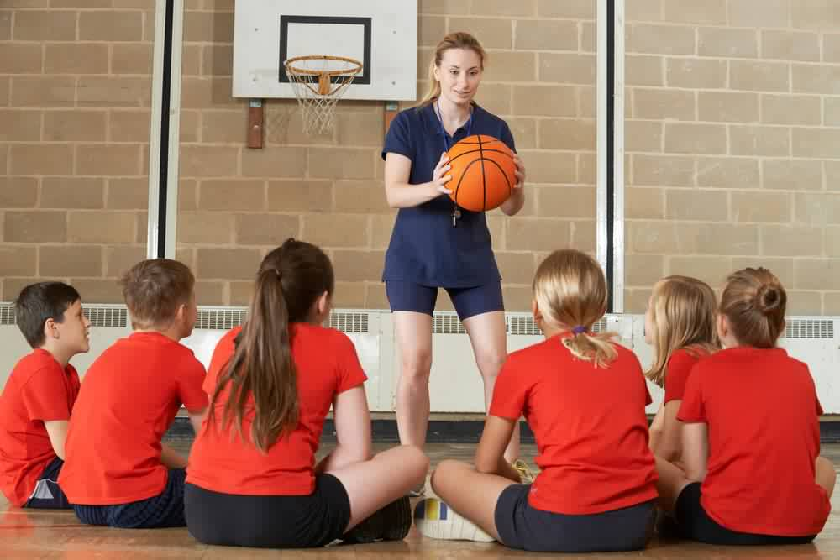
Types of Guidance
When learning any new skills different forms of guidance are required.
Coaches and teachers normally give this support.
Methods of teaching/ guidance include:
visual (seeing)
verbal (hearing)
manual (assistance of movement)
mechanical (use of objects/aids).
Task: discuss – what do you think is meant by these types of guidance?

Slide 32
Visual Guidance
This is often used when a performer is just starting out in the learning process (beginners). Learners can see the whole action and interpret it for themselves.
Forms of visual guidance include:
demonstration
playback of a video clip
observe technique from images or stills.

Slide 33
Visual Guidance
Advantages and disadvantages of visual guidance:
Advantages | Disadvantages
provides learner with a mental image of the skill
draws attention to key points (gives cues)
better for less complex skills where less information needs to be given.
can demotivate learner if it's a highly complex skill as they won’t be able to do it
can overload beginners with information
needs to be accurate and clear otherwise skill can be learnt incorrectly.
Notes:
Clipart: © Clker.com 2012

Slide 34
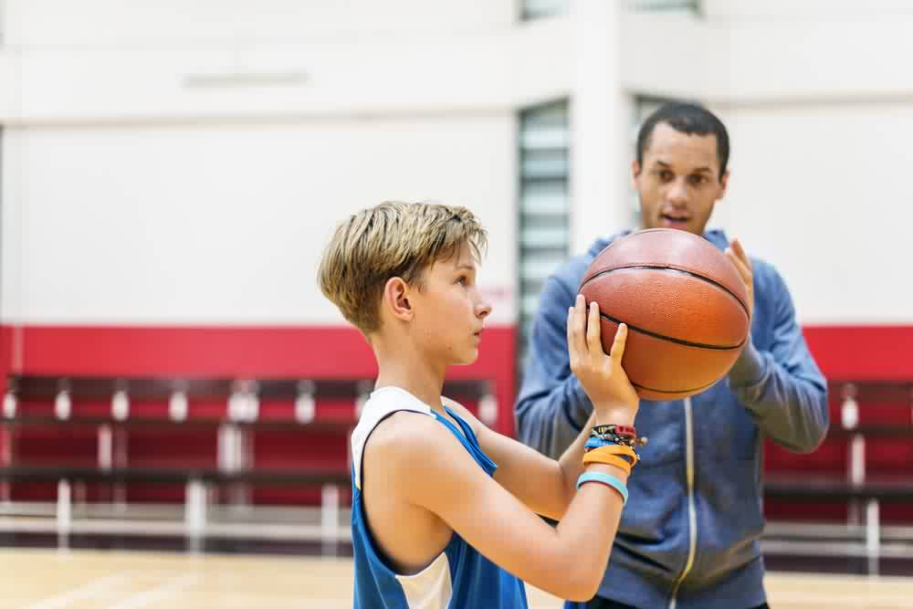
Verbal Guidance
Terminology and phrases associated to certain skills can be made simple and straightforward in a clear verbal explanation.
Example:
spread fingers
square up
focus on back of ring
follow through.

Slide 35
Verbal Guidance
Advantages and disadvantage of verbal guidance:
Advantages | Disadvantages
tactics can be explained
gives technical info/ key points and highlights cues
feedback can be given and immediately.
players must understand the basic
terminology used
overload beginners with information
learners may lose concentration easily.
Notes:
Clipart: © Clker.com 2012

Slide 36
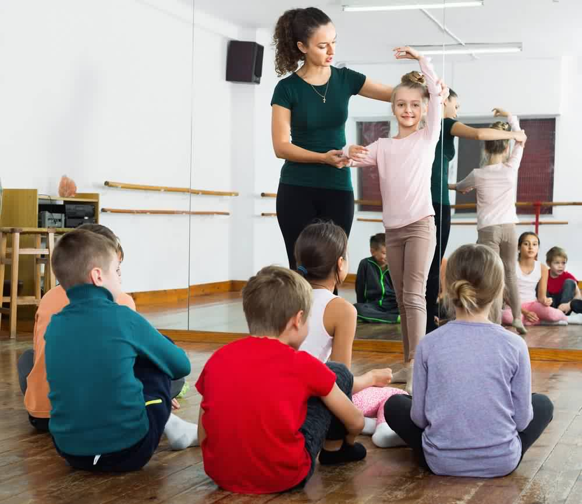
Manual Guidance
This method is used when the skills learnt are dangerous or are complex.
Coaches or teachers will use a ‘hands on’ approach to ensure safety
i.e. gymnastics coach holding the legs of the performer in a handstand.
Task: can you think of other manual guidance uses?
In what other sport may a coach use this method?

Slide 37
Manual Guidance
Advantages and disadvantage of manual guidance:
Advantages | Disadvantages
builds confidence
eliminates danger
gives early feel for whole skill (kinaesthesis).
learner becomes dependent on support and interferes with kinaesthetic awareness
gives false sense of security to performer
takes away true feeling of the skill
can slow down learning of the skill
proximity of coach may be upsetting.
Notes:
Clipart: © Clker.com 2012

Slide 38
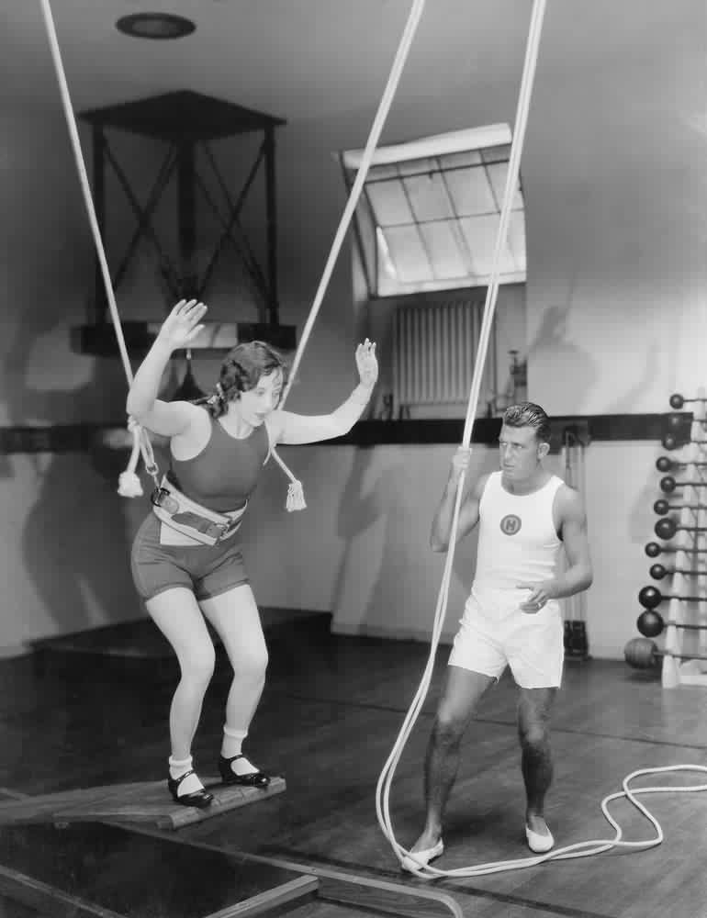
Mechanical Guidance
Mechanical guidance
………involves the use of equipment to help support the learner whilst practising the skill.
i.e. the use of belts in gymnastics and trampolining to help support somersaults.

Slide 39
Types of Guidance
Advantages and disadvantage of mechanical guidance:
Advantages | Disadvantages
promotes confidence and ensures safety for the learner particularly where there is an element of danger in the skill. i.e. rock climbing
builds confidence
eliminates danger
gives early feel for whole skill (kinaesthesis).
learner can become dependent on this form of guidance
the feel of the movement with the guidance is different to the actual movement
the learner does not get an opportunity to correct mistakes in the technique.
Notes:
Clipart: © Clker.com 2012

Slide 40
Types of guidance and feedback
By the end of this topic you should…
Understand types of feedback and be able to apply practical examples to their use:
  intrinsic
  extrinsic
  knowledge of performance
  knowledge of results
  positive
  negative.
Learning
Outcomes

Slide 41
Types of Feedback
Feedback is a vital part of information processing, which can help to provide confidence and motivation for the performer.
Feedback has an important role to play in correcting errors and improving performance.
Task: describe an experience you have had whilst playing sport of both positive and negative feedback.

Slide 42
Types of Feedback
    Intrinsic
This type of feedback happens within the performer.
Information received by the athlete as a direct result of producing a movement through the kinaesthetic senses - feelings from muscles, joints and balance.
The performer knows from the ‘feeling’ they get that the action will be successful.
Michael Jordan – eyes closed free throw on YouTube
https://www.youtube.com/watch?v=_JUjbpL9X7I
Task: how many different sporting examples can you think of where intrinsic feedback happens?

Slide 43
Types of Feedback
    Intrinsic
Basketball player who knows their 3 point shot is going in before the ball gets to the basket.
Rugby penalty kicker who is running back to the half way line – knowing the kick is successful before the ball gets to the posts.
Gymnast who knows their legs are in the correct position whilst performing a handstand.
Trampolinist knowing exactly when to open out from a triple somersault and spot a perfect landing.
Golfer who knows their tee shot is perfect from the feel of their swing.
Tennis player who knows their serve is perfectly placed as it felt good.

Slide 44
Types of Feedback
    Extrinsic
This feedback comes from external sources.
For example from sound or vision.
Practical example – a footballer seeing that their penalty kick was successful as it hits the back of the net.
The following are all examples of extrinsic feedback:
watching a performance back from video
listening to a coaches comments
final score in a game.

Slide 45
Types of Feedback
    Knowledge of Performance
This type of feedback is normally related to External (extrinsic) Feedback, but can be gained through kinaesthetic awareness.
Example:
a gymnast feeling that their legs are not straight whilst performing a handstand. (in this case the gymnast tends to be highly skilled as they can feel if the performance is good).
It provides information about the pattern of movement/technique(s) that is taking place.
Examples include:
A coach telling a prop in a rugby scrum how their technique is incorrect
a basketball coach telling a player that they missed a shot because they didn’t follow through when they released the ball.

Slide 46
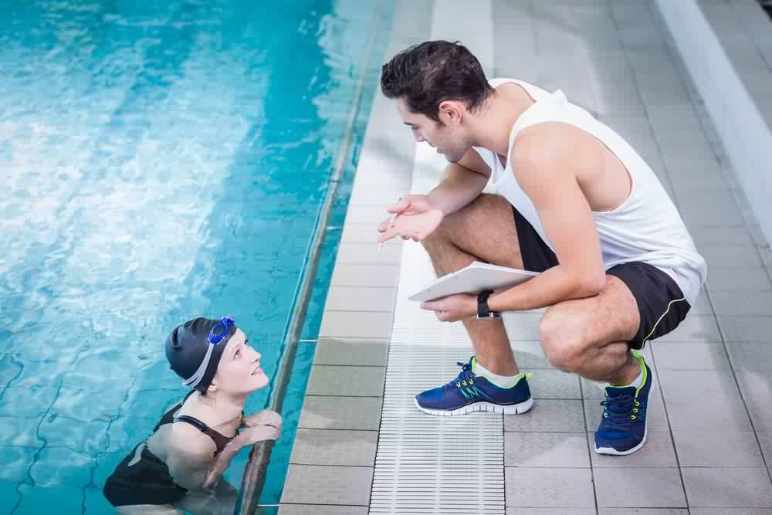
Types of Feedback
    Knowledge of Results
This feedback is External (extrinsic) and can come from the performer themselves or another person (coach, teacher or sometimes a spectator).
It is very important for performers to know the outcome (results) of their actions, otherwise little learning is possible.
Examples:
watching your shot go into the net in a netball match
an announcer telling you how far you have thrown the javelin
seeing your tennis serve touch the top of the net
the crowd cheering when your tee shot lands in an excellent position on the fairway.
Task: give an example of knowledge of results following an action in your chosen sport/activity

Slide 47
Types of Feedback
    Positive & Negative
Beginners will need more positive feedback to encourage and motivate, whereas elite athletes can take negative feedback more constructively.
Some performers are motivated by negative feedback, they like to prove people wrong and so try hard to put the mistake/inaccuracy right.
Other performers are demotivated by negative feedback and will ‘give up’ as they ‘will never be good enough’.
Positive feedback is often more motivating.
Beginners and children enjoy positive feedback.
Positive feedback must be ‘honest’, telling a performer that their actions were good, when they weren’t can lead to problems in the future.

Slide 48
What has stuck with you?
Apply it!
Guidance and feedback on performance
Explain visual guidance
What is the difference between intrinsic and extrinsic feedback?
Discuss the advantages and disadvantages of verbal guidance
Describe the types of feedback and guidance a beginner would need

Slide 49
OCR Resources: the small print
OCR’s resources are provided to support the delivery of OCR qualifications, but in no way constitute an endorsed teaching method that is required by the Board, and the decision to use them lies with the individual teacher. Whilst every effort is made to ensure the accuracy of the content, OCR cannot be held responsible for any errors or omissions within these resources.
Our documents are updated over time. Whilst every effort is made to check all documents, there may be contradictions between published support and the specification, therefore please use the information on the latest specification at all times. Where changes are made to specifications these will be indicated within the document, there will be a new version number indicated, and a summary of the changes. If you do notice a discrepancy between the specification and a resource please contact us at:
resources.feedback@ocr.org.uk.
© OCR 2018 - This resource may be freely copied and distributed, as long as the OCR logo and this message remain intact and OCR is acknowledged as the originator of this work. OCR acknowledges the use of the following content:
Please get in touch if you want to discuss the accessibility of resources we offer to support delivery of our qualifications: resources.feedback@ocr.org.uk
2 > Trampolinist / Vladimir Vasiltvich / Shutterstock.com / ED 5 > Garden_Pea / Pushkin / Shutterstock.com 7 > Sticky_note / Lyudmyla Kharlamova / Shutterstock.com 9, 10 > Sprinter / Jacob Lund / Shutterstock.com 10 > Table_tennis / CHEN WS / Shutterstock.com / ED 10 > Trampolinist / Vladimir Vasiltvich / Shutterstock.com / ED 11 > Shotput / Herbert Kratky / Shutterstock.com / ED 11, 12 > Kite_surfer / Wallenrock / Shutterstock.com 11, 12 > Hockey / Corepics VOF / Shutterstock.com / ED | 18 > Target / Abscent / Shutterstock.com 23 > Footballer / leolintang / Shutterstock.com 27 > Milan vs Olimpiacos / Paolo Bona / Shutterstock.com / ED 29 > Runner / Annette Shaff / Shutterstock.com 33, 34 > School_basketball / SpeedKingz / Shutterstock.com 36 > Young_basketballer / Rawpixel.com / Shutterstock.com 38 > Young_ballet_dancer / Iakov Filimonov / Shutterstock.com 40 > Gymnast / Everett Collection / Shutterstock.com 48 > Swimmer / wavebreakmedia / Shutterstock.com

