Slide 1

Socio-cultural influences

Slide 2
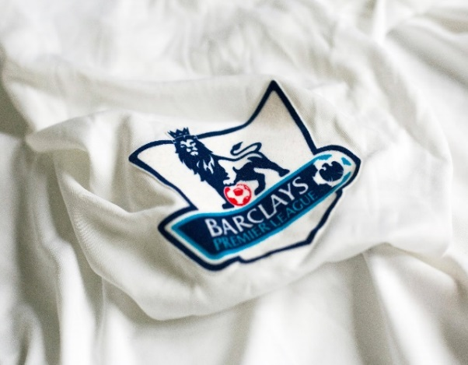
2.1.b. Commercialisation of physical activity and sport
By the end of this topic you should …
Understand the influence of the media on the commercialisation of physical activity and sport; different types of media:
  Social
  Internet
  TV/visual
  Newspapers/magazines.
Understand the relationship between sport, media and commercialisation in a ‘golden triangle’
Be able to describe the advantages and disadvantages of commercialisation in sport and the impact on players, the sponsors, the officials, the sport and the spectators.
Learning
Outcomes

Slide 3
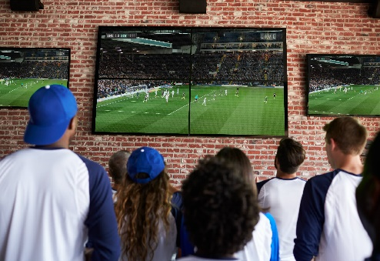
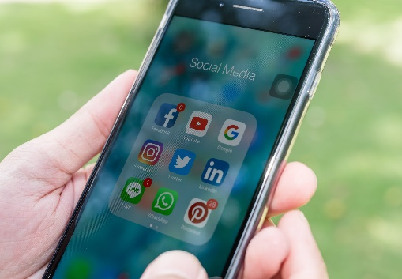
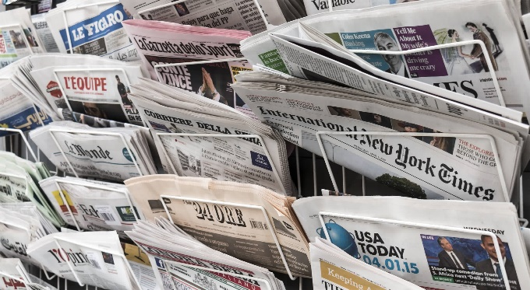

The influence of the media on the commercialisation of physical activity and sport
There are FIVE different types of media.
Television / visual
Social Media
Newspapers / Magazines
Internet
Radio

Slide 4
The influence of the media on the commercialisation of physical activity and sport
Influences of media include:-
Event time changes
  Live Football and rugby being shown on different days (Friday nights, Sundays, Monday nights)
  Olympic events & International events being shown at irregular times because of the demands of TV companies showing the event live in different countries.
Rules changes
  2016 netball rule changes to make game faster and more attractive to television companies & viewers
  Table tennis, 21 points changed to 11 points to win a game.
Adapted versions of sports
  British basketball championships, 12 minute games with powerplays and shooting zones for 5 points
  1 hour cricket to fit programming times
  Fast 5 netball.

Slide 5
The influence of the media on the commercialisation of physical activity and sport
Influences of media include:-
Technological innovations
  Replays and slow motion improve the home viewer’s experience
  ‘Hawkeye’ in tennis, Television match officials in rugby and VAR in football have all improved the viewer’s experience.
Sponsorship
Due to the extent of coverage, sponsorship and advertising revenue has increased tremendously for players, clubs and National Governing Bodies of sport.

Slide 6
The influence of the media on the commercialisation of physical activity and sport
Negative influences of media include:
Only main sports shown, so minority sports do not gain exposure.
More money to major sports and performers, so less funds to minority sports.
Can expose poor behaviour by teams/performers and potential danger of some activities.
Role models behaviour is exposed, poor behaviour on and off the performance area is exposed, and quickly.
The exposure/advertising of some sponsors may be unethical. Examples include alcohol, smoking products and gambling companies.
Pay per view channels/events may make it difficult for low-income families to watch their favourite sports.
Media’s influence on game programming might be seen as too great.
Where games/events are shown live, spectators may chose to watch on television rather than go to the live game as it is cheaper and they get a better experience from replays, pundits etc.
If you are watching you are not being active, so media can add to the ‘couch potato’ syndrome.

Slide 7
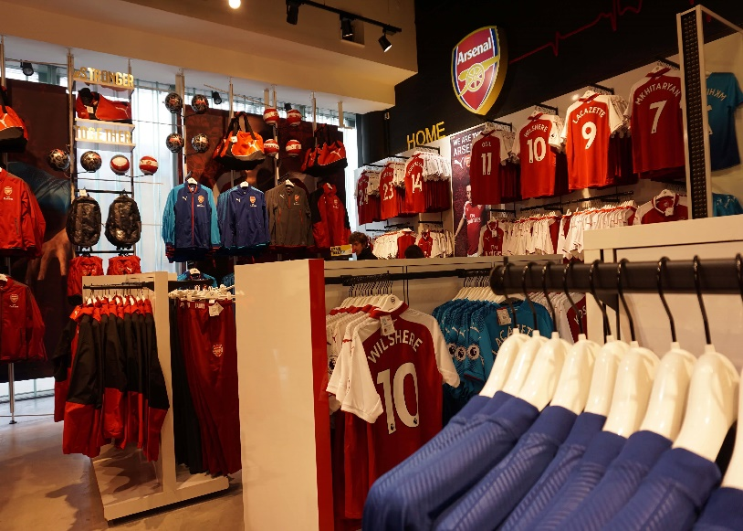
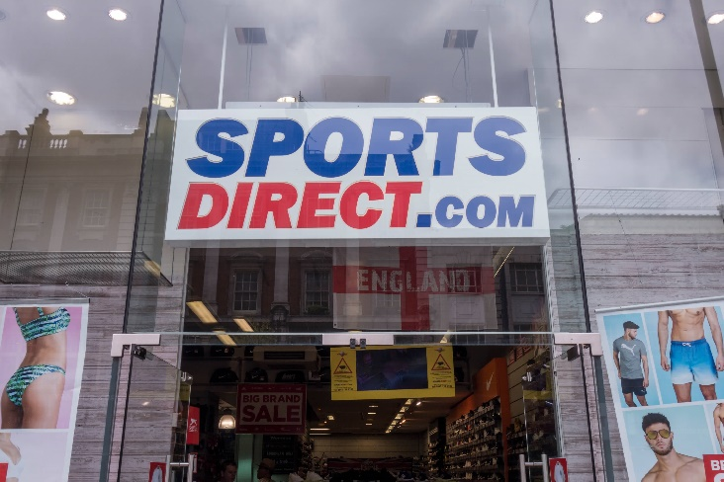
Commercialisation of physical activity and sport
Sport is now a global product. High-profile sports attract massive media interest and huge sponsorship deals.
What is Commercialisation?
Definition: Commercialisation refers to the influence of commerce, trade
on an industry (e.g. SPORT) to make a profit.

Slide 8
Commercialisation of physical activity and sport
Sport, media and sponsorship are closely linked in a what is known as the
‘GOLDEN TRIANGLE’
Sponsorship
Each side of the triangle benefits from the other sides in some way
therefore, each side is dependent on the other sides in some way
usually financially or for promotion.
Sport
Media
Task: Describe an example of how the ‘golden triangle’ operates in sport?

Slide 9
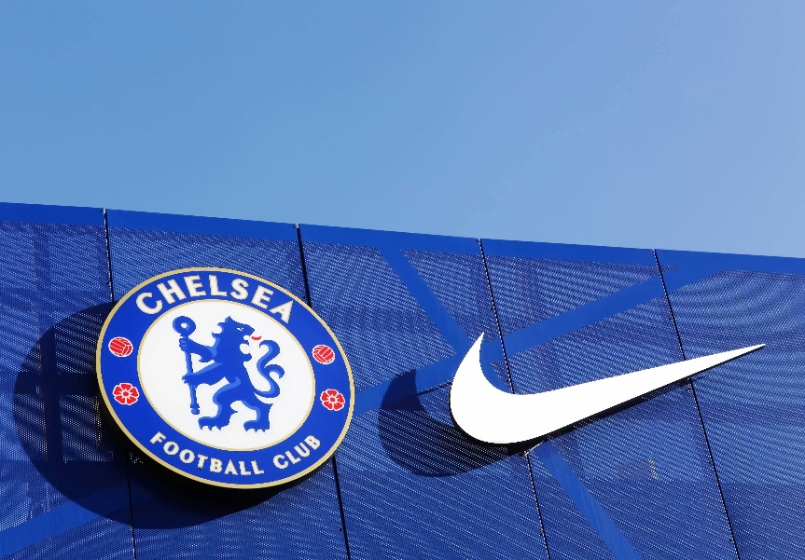
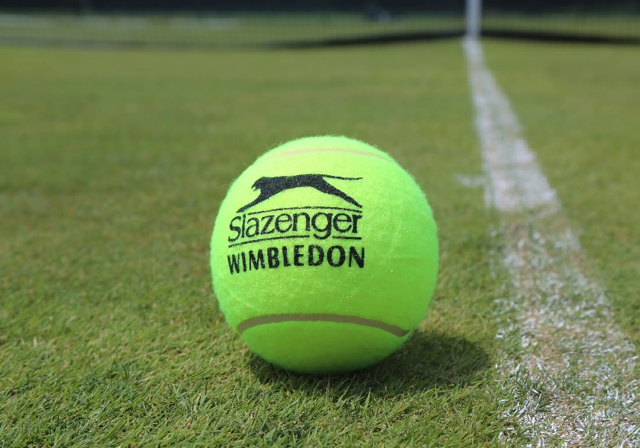
Commercialisation of physical activity and sport
Influence of sponsorship
The exercise and sport market is now very big business, with large amounts of money being spent by commercial companies on sports’ participants, clubs and events.

Slide 10
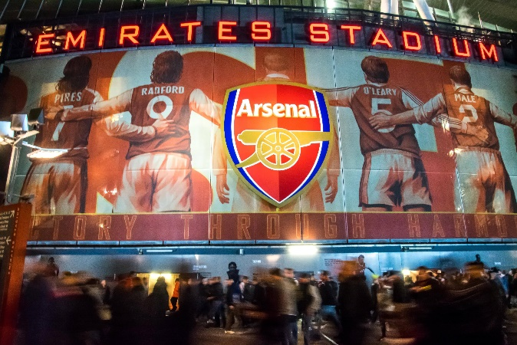
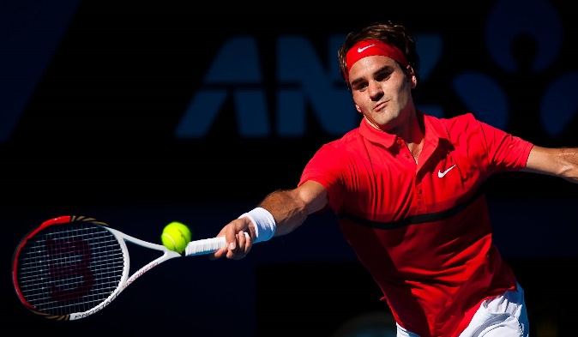
Commercialisation of physical activity and sport
Types of sponsorship
Depending on the sport, team or athlete involved, the sponsorship can run into millions of pounds or for local clubs it might be a few hundred pounds.
Here are three examples of sponsorship in sport:
Financial
money may be invested into teams or sports by external sources or wealthy individuals.
Clothing and equipment
Teams usually get a shirt sponsor and often individual players will get deals for footwear. Companies will often sponsor a players equipment, usually one of the companies who manufacture the equipment.
Facilities (stadiums and grounds) - New stands or grounds will often be named after the sponsor who has put money towards the development.

Slide 11
Commercialisation of physical activity and sport
Positive & negative effects of sponsorship for the performer
Advantages | Disadvantages
Allows athletes to earn income as a full time job
Performers gain maximum exposure to promote their personal brand
Can lead to additional roles post playing career within the sport (TV pundit)
Relieves financial worries.
Can result in deviant behaviour due to the pressure of success
Generally, favours male over female and able bodied over disabled
Sponsorship might be short term
Performers may have to advertise a product that they do not like
Performers might be contracted to put in appearances and attend public speaking.

Slide 12
Commercialisation of physical activity and sport
Positive & negative effects of sponsorship for the sport
Advantages | Disadvantages
Raises the profile of the sport due to increased exposure
Provides an increased level of funding to improve resources, coaching or facilities
Gives the sport financial security for a period of time
Attracts the best players in the world to that sport.
Commercialisation tends to support the popular sports leaving the ‘lesser’ sports to lose out
Changes to the sport format and rules have being introduced to make the sport audience friendly
The influence of TV has caused an increase in adverts and TV timings and lost some of sports traditions.

Slide 13
Commercialisation of physical activity and sport
Positive & negative effects of sponsorship for the official
Advantages | Disadvantages
Offers a professional career and earn an income from officiating
Media coverage leads to officials gaining a high profile
Advancements in technology/better equipment/facilities which assists with decisions.
Bad decisions highlighted and analysed by media
Personal and sporting behaviour has to be controlled as the image of the sport, coaches and players are on view to the world
Some sports get more funding and therefore officials are paid better.

Slide 14
Commercialisation of physical activity and sport
Positive & negative effects of sponsorship for the audience/spectator
Advantages | Disadvantages
Offers a wider choice of sports available to watch
Viewing experience has been enhanced due to investment into technology and audience participation
Fans can watch their team when on holiday
Cheaper than watching games live.
Can pull fans away from watching their club/team live as it is cheaper to watch at home
Encourages spectating not participating
Can become very expensive for fans/spectators
Can affect view experience due to increased TV breaks and time outs.

Slide 15
Commercialisation of physical activity and sport
Positive & negative effects of sponsorship for the sponsor/company
Advantages | Disadvantages
Sport can offer an excellent opportunity for the sponsor to promote a product/service to a widespread audience
Advertising brand name
Promote a caring attitude and increasing goodwill
Tax concessions help the company.
Poor behaviour from athletes/ clubs can cause negative press
Smaller sponsors might struggle to compete with larger more global brands
Some sponsors are not suitable to be promoted within sport. i.e. tobacco or alcohol, gambling
Investing in teams and individuals can backfire if they do not achieve success i.e. teams not qualifying for major competitions.

Slide 16
What can you remember?
Apply it!
Commercialisation in sport
What is meant by a ‘golden triangle’?
Explain the advantages and disadvantages to spectators of an increased commercialisation in sport?
Compare
the advantages of commercialisation for the sponsor and the performer?
Compare
the positives and negatives of a brewery sponsoring an Over 35’s team compared to a U16’s team.
Notes:
Photos by: LOCOG

Slide 17
OCR Resources: the small print
OCR’s resources are provided to support the delivery of OCR qualifications, but in no way constitute an endorsed teaching method that is required by the Board, and the decision to use them lies with the individual teacher. Whilst every effort is made to ensure the accuracy of the content, OCR cannot be held responsible for any errors or omissions within these resources.
Our documents are updated over time. Whilst every effort is made to check all documents, there may be contradictions between published support and the specification, therefore please use the information on the latest specification at all times. Where changes are made to specifications these will be indicated within the document, there will be a new version number indicated, and a summary of the changes. If you do notice a discrepancy between the specification and a resource please contact us at:
resources.feedback@ocr.org.uk.
© OCR 2018 - This resource may be freely copied and distributed, as long as the OCR logo and this message remain intact and OCR is acknowledged as the originator of this work. OCR acknowledges the use of the following content:
Please get in touch if you want to discuss the accessibility of resources we offer to support delivery of our qualifications: resources.feedback@ocr.org.uk
2 > English Premier league emblem on jersey / ninopavisic / Shutterstock.com / ED 3 > Rear View Of Friends Watching Game In Sports Bar On Screens / Monkey Business Images / Shutterstock.com 3 > A newspaper rack holding several international newspapers / Lawrey / Shutterstock.com / ED 3 > Hands of man use Iphone with applications of social media / Vasin Lee / Shutterstock.com / ED 3 > Retro old radio front mint green background / BrAt82 / Shutterstock.com 7 > Official store in front of Emirates Stadium Home of Arsenal FC / mohd farid / Shutterstock.com / ED | 7 > Exterior signage of Sports Direct store / Willy Barton / Shutterstock.com / ED 9 > Chelsea football club and Nike logo on a wall at Stamford Bridge stadium / ricochet64 / Shutterstock.com / ED 9 > Slazenger Wimbledon Tennis Ball on grass tennis court / By Leonard Zhukovsky / Shutterstock.com / ED 10 > The Emirates Stadium during the match day with a lot of gunners or Arsenal fan walking / Tanasut Chindasuthi / Shutterstock.com / ED 10 > Roger Federer / Neale Cousland / Shutterstock.com / ED

