Slide 1

Paper 2- Socio-cultural Issues and Sports Psychology
Exam questions & Mark Schemes

Slide 2
2.2.a Engagement patterns of different social groups in physical activities and sports

Slide 3
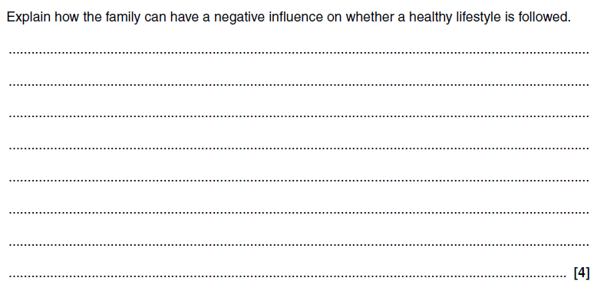
Factors affecting participation and performance

Slide 4
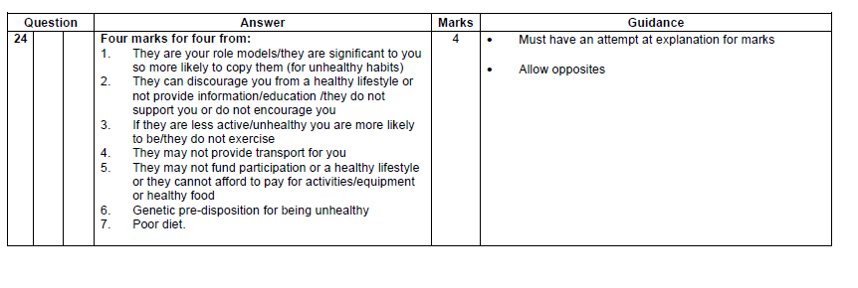
Answers

Slide 5
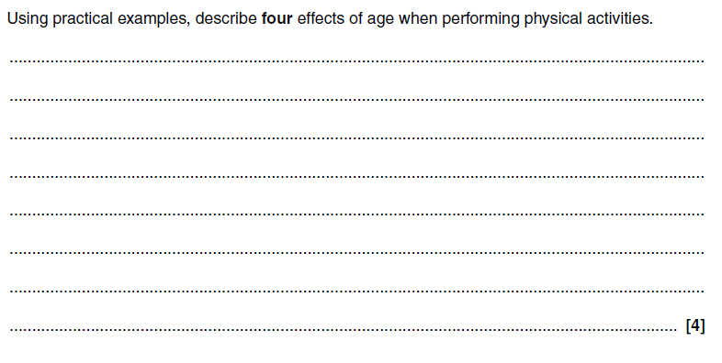
Factors affecting participation and performance

Slide 6
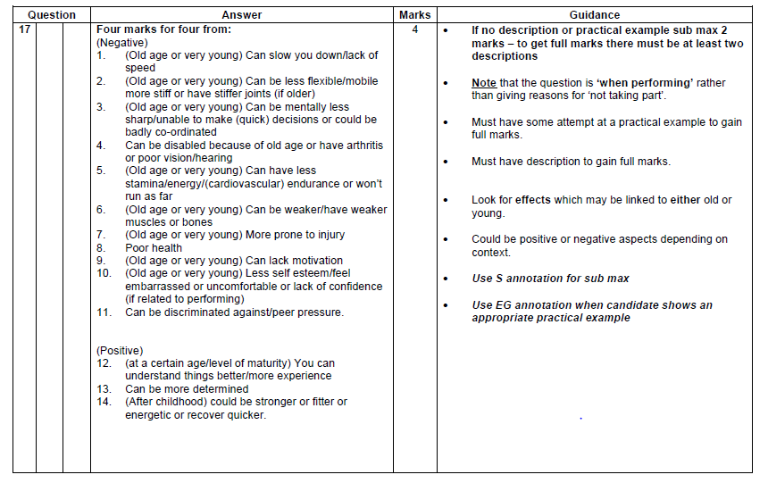
Answer

Slide 7
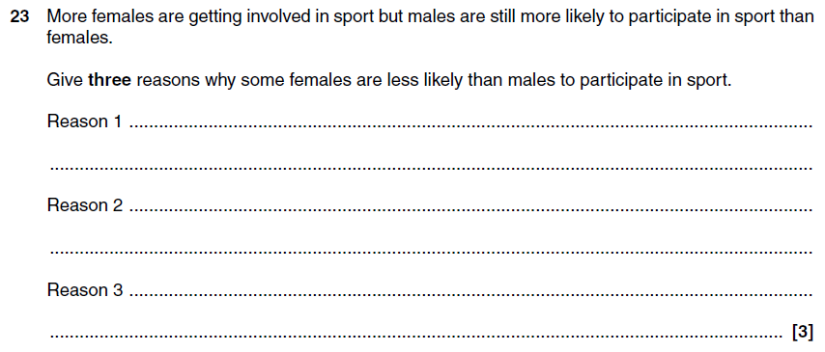
Factors affecting participation and performance

Slide 8
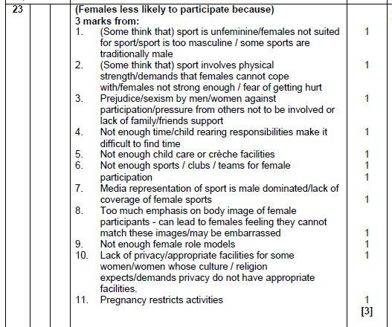
Answer

Slide 9
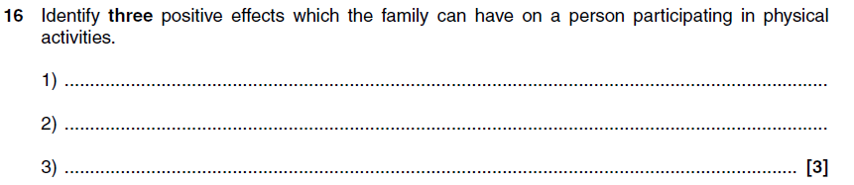
Factors affecting participation and performance

Slide 10
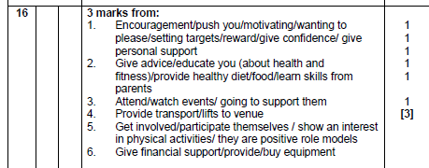
Answer

Slide 11
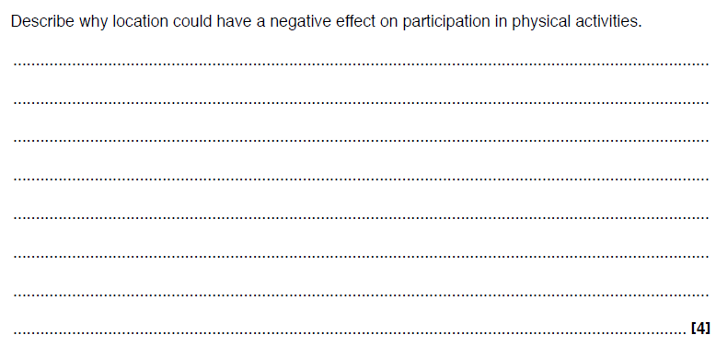
Factors affecting participation and performance

Slide 12
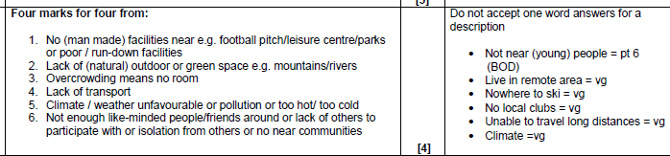
Answer

Slide 13
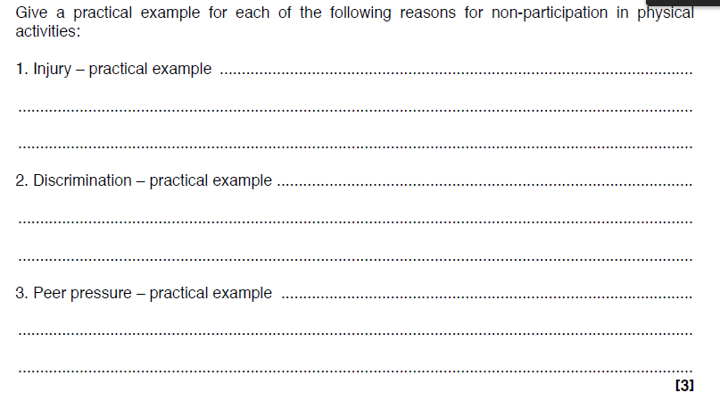
Factors affecting participation and performance

Slide 14
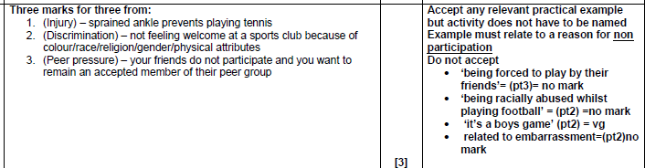
Answer

Slide 15
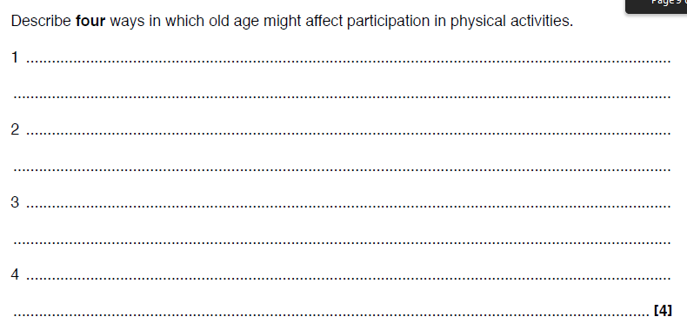
Factors affecting participation and performance

Slide 16
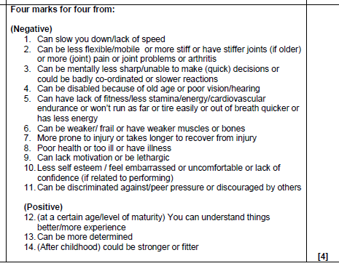
Answer

Slide 17
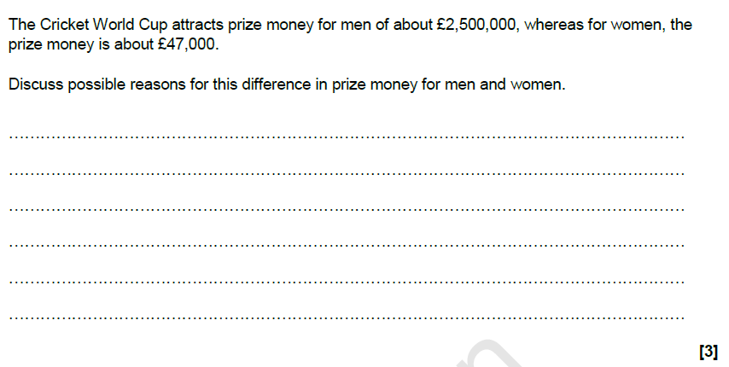
Factors affecting participation and performance

Slide 18
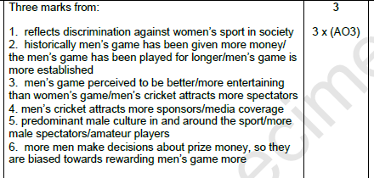
Answer

Slide 19
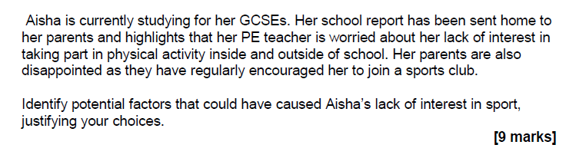
Factors affecting participation and performance

Slide 20
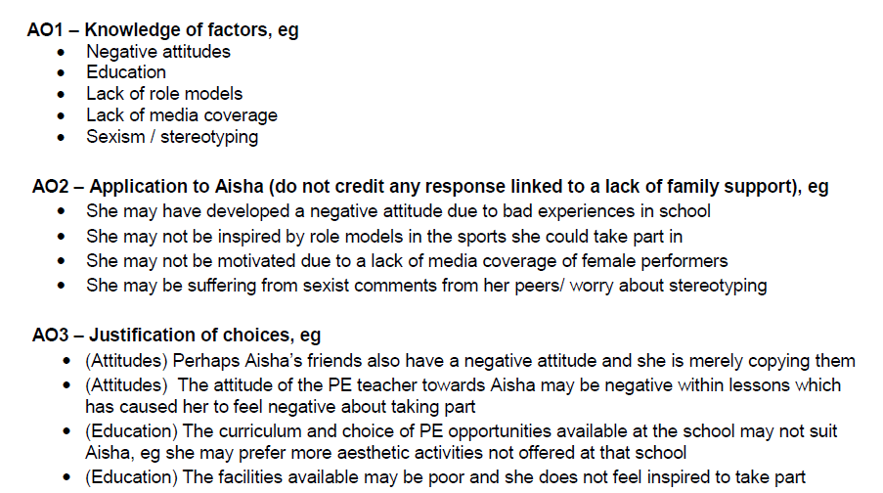
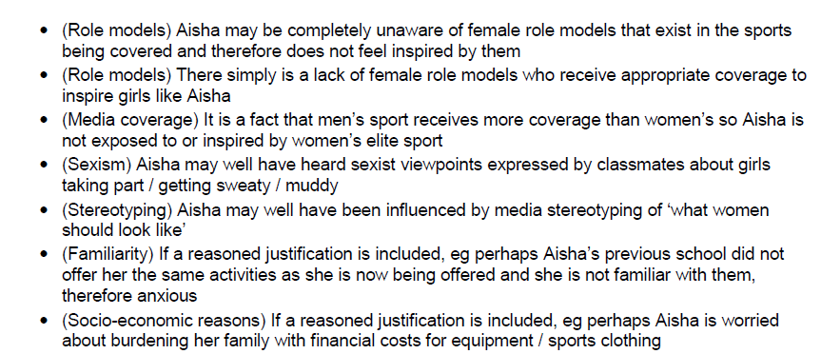
Answer

Slide 21
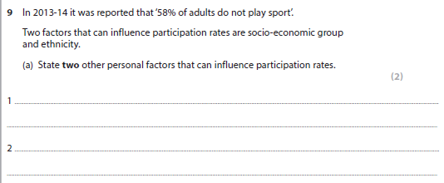
Factors affecting participation and performance

Slide 22
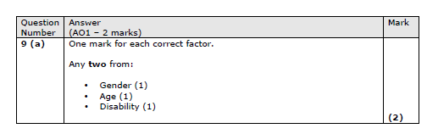
Answer

Slide 23
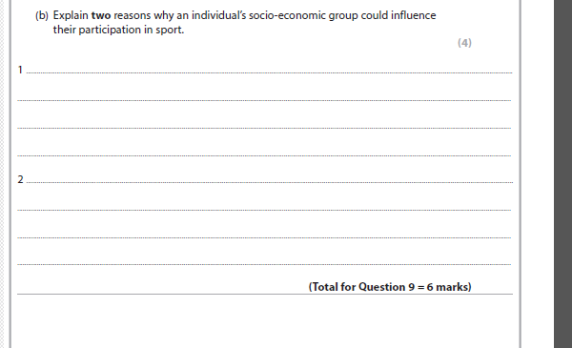
Factors affecting participation and performance

Slide 24
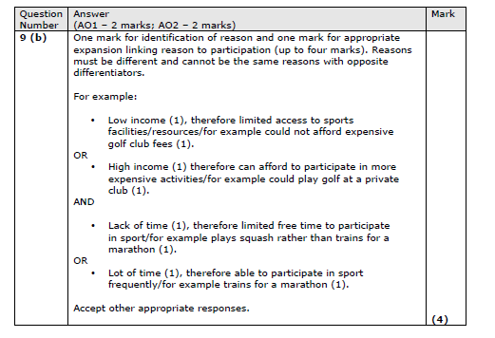
Answer

Slide 25
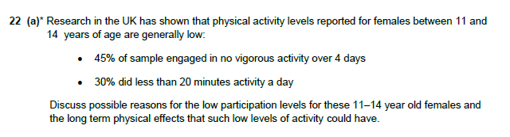
Factors affecting participation and performance

Slide 26
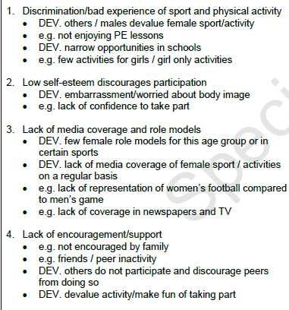
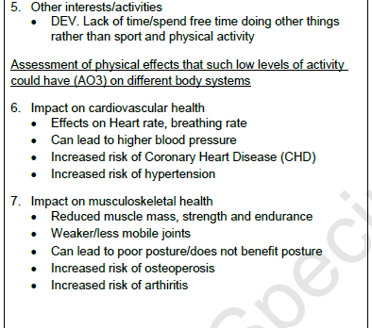
Answer

Slide 27
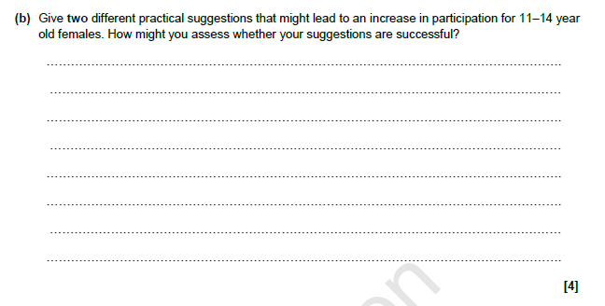
Factors affecting participation and performance

Slide 28
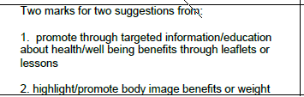
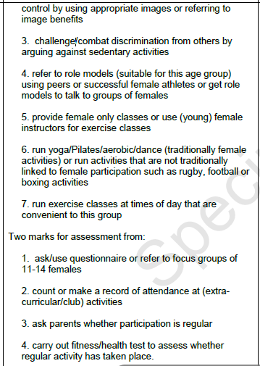
Answer

Slide 29
2.1.b. Commercialisation of physical activity and sport

Slide 30
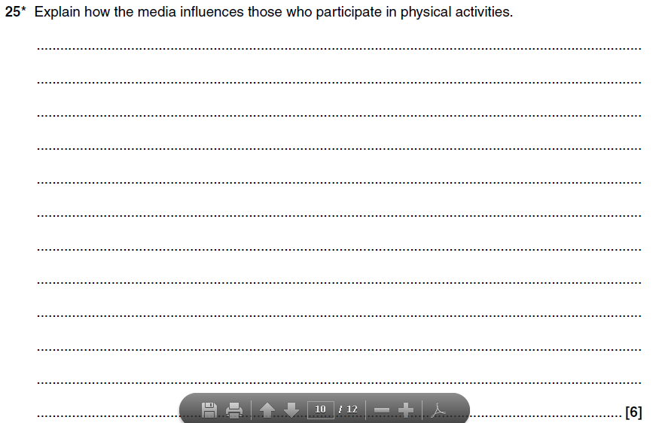
Commercialisation

Slide 31
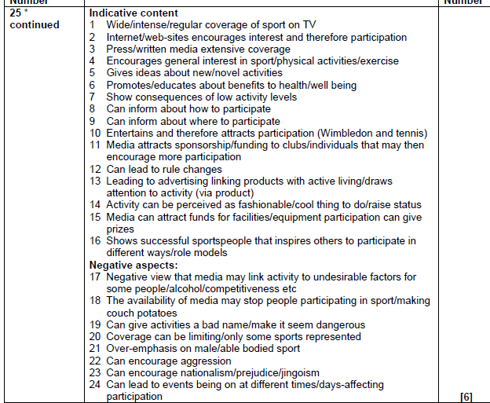
Answer

Slide 32
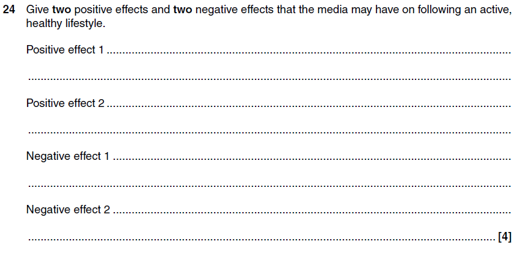
Commercialisation

Slide 33
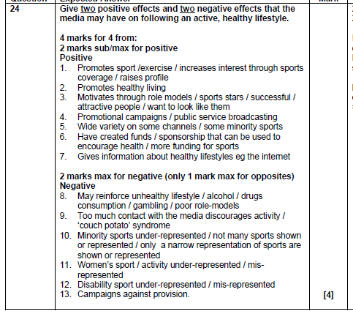
Answer

Slide 34
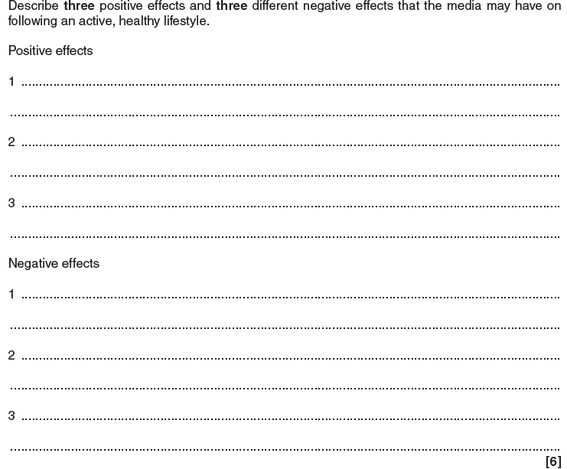
Commercialisation

Slide 35
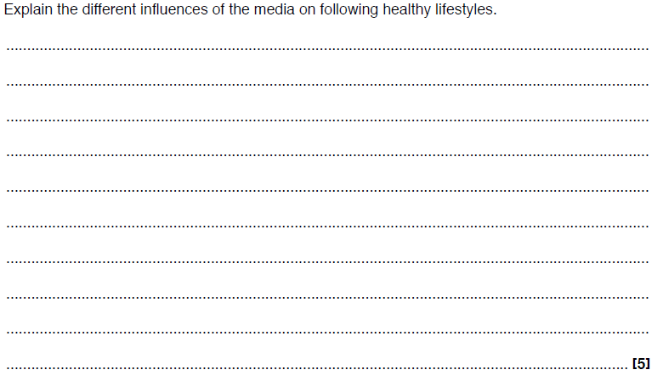
Commercialisation

Slide 36
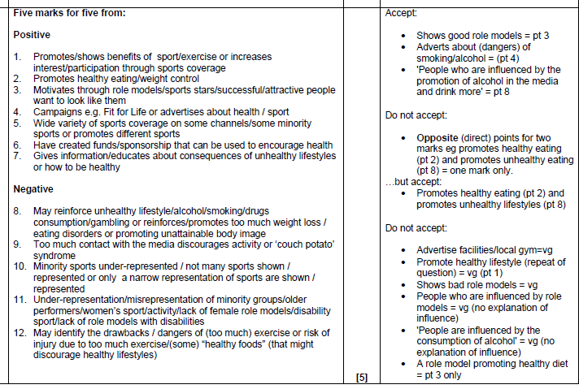
Answer

Slide 37
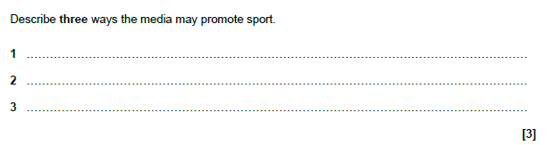
Commercialisation

Slide 38
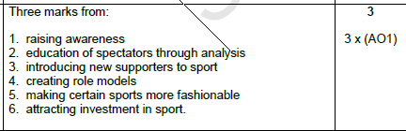
Answer

Slide 39
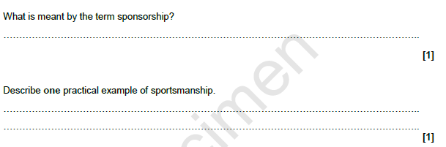
Commercialisation

Slide 40
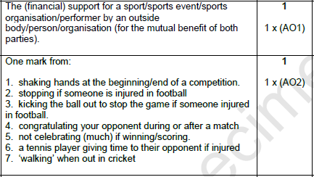
Answer

Slide 41
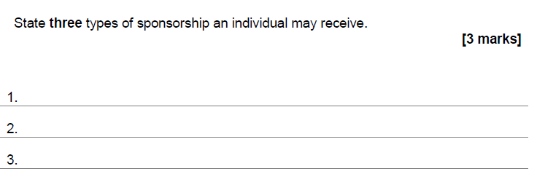
Commercialisation

Slide 42
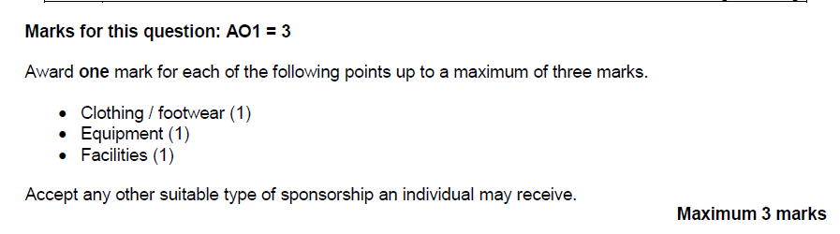
Answer

Slide 43
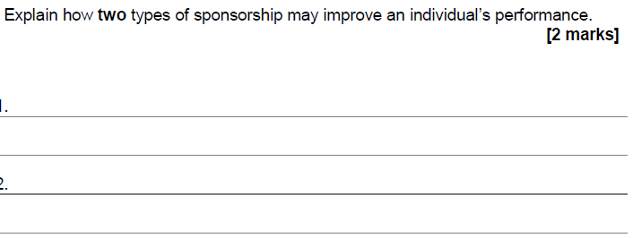
Commercialisation

Slide 44
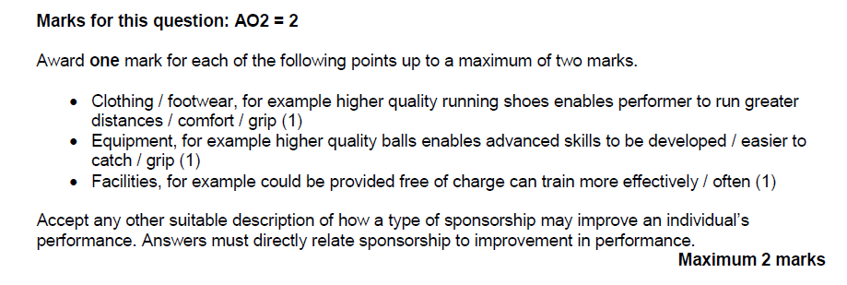
Answer

Slide 45
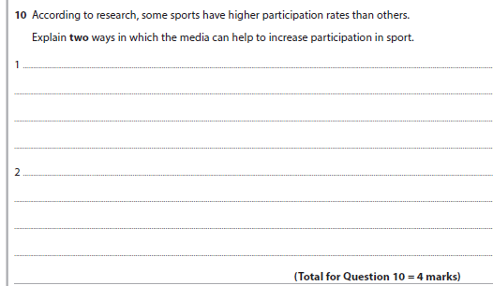
Commercialisation

Slide 46
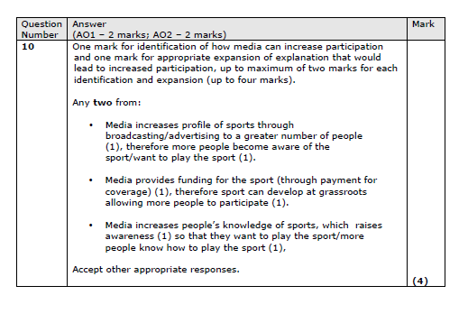
Answer

Slide 47
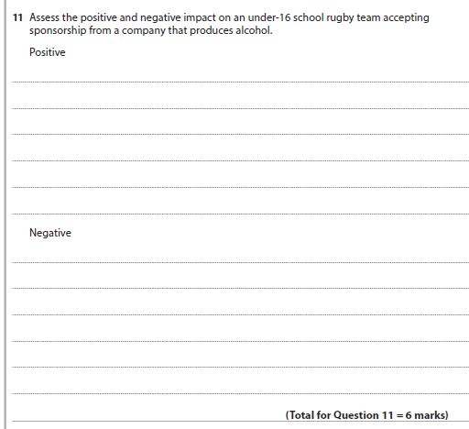
Commercialisation

Slide 48
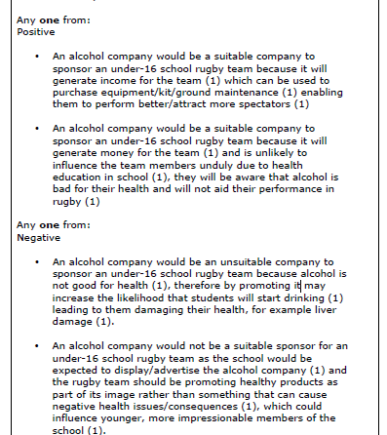
Answer

Slide 49
2.1.c. Ethical and socio-cultural issues in physical activity and sport

Slide 50

Ethics in Sport

Slide 51
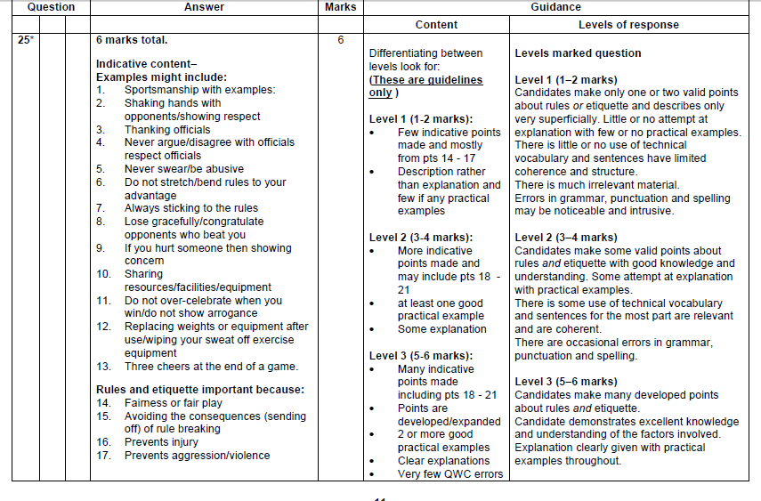
Answers

Slide 52
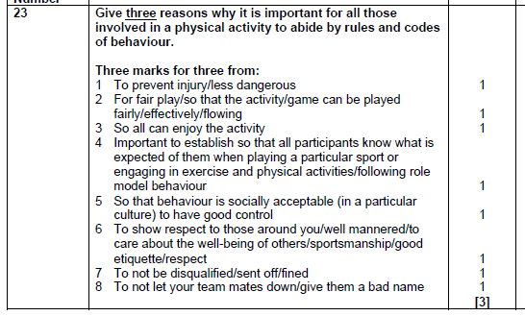
Answer

Slide 53

Ethics in Sport

Slide 54

Ethics in Sport

Slide 55

Answer

Slide 56

Ethics in Sport

Slide 57

Answer

Slide 58

Ethics in Sport

Slide 59

Answer

Slide 60

Ethics in Sport

Slide 61

Answer

Slide 62

Ethics in Sport

Slide 63

Answer

Slide 64

Ethics in Sport

Slide 65

Answer

Slide 66

Ethics in Sport

Slide 67

Answer

Slide 68

Ethics in Sport

Slide 69

Answer

Slide 70

Ethics

Slide 71


Answer

Slide 72

Ethics

Slide 73

Answer

Slide 74

Ethics

Slide 75

Answer

Slide 76

Ethics

Slide 77

Answer

Slide 78

Ethics

Slide 79

Answer

Slide 80

Drugs

Slide 81

Answers

Slide 82

Drugs

Slide 83

Answer

Slide 84

Drugs

Slide 85

Answer

Slide 86

Answer

Slide 87

Drugs

Slide 88

Drugs

Slide 89

Answer

Slide 90

Drugs

Slide 91

Answer

Slide 92

Drugs

Slide 93

Answer

Slide 94
2.2 Sports psychology

Slide 95

Feedback

Slide 96

Answer

Slide 97

Feedback

Slide 98

Answer

Slide 99

Feedback

Slide 100

Answer

Slide 101

Feedback

Slide 102

Answer

Slide 103

Feedback

Slide 104

Answer

Slide 105

Goal setting

Slide 106

Answer

Slide 107

Goal setting

Slide 108

Answer

Slide 109

Goal Setting

Slide 110

Answer

Slide 111

Goal setting

Slide 112


Answer

Slide 113


Goal setting

Slide 114

Answer

Slide 115

Mental preparation

Slide 116

Answer

Slide 117

Mental preparation

Slide 118

Answer

Slide 119

Mental preparation

Slide 120


Answer

Slide 121

Mental preparation

Slide 122

Answer

Slide 123

Mental Preparation

Slide 124

Answer

Slide 125

Mental preparation

Slide 126

Answer

Slide 127

Characteristics of skilful movement

Slide 128

Answers

Slide 129

Characteristics of skilful movement

Slide 130

Answer

Slide 131

Characteristics of skilful movement

Slide 132

Answer

Slide 133

Characteristics of skilful movement

Slide 134

Answer

Slide 135

Characteristics of skilful movement

Slide 136

Answer

Slide 137

Characteristics of skilful movement

Slide 138

Answer

Slide 139

Characteristics of a skilful movement

Slide 140

Answer

Slide 141

Characteristics of a skilful movement

Slide 142

Answer

Slide 143

Skill

Slide 144

Answer

Slide 145

Skill

Slide 146

Answer

Slide 147

Skill

Slide 148

Answer

Slide 149

Skill

Slide 150

Answer

Slide 151

Guidance

Slide 152

Answer

Slide 153

Guidance

Slide 154

Answer

Slide 155

Guidance

Slide 156

Answer

Slide 157

Guidance

Slide 158

Answer

Slide 159
2.3 Health, fitness and well-being

Slide 160

Components of diet

Slide 161

Answer

Slide 162

Components of diet

Slide 163

Answer

Slide 164

Components of diet

Slide 165

Answer

Slide 166

Components of diet

Slide 167

Answers

Slide 168

Components of diet

Slide 169

Answer

Slide 170

Components of diet

Slide 171

Answer

Slide 172

Components of diet

Slide 173

Answer

Slide 174

Components of diet

Slide 175

Answers

Slide 176

Components of diet

Slide 177

Answer

Slide 178

Components of diet

Slide 179

Answer

Slide 180

Components of diet

Slide 181

Answer

Slide 182

Components of a diet

Slide 183

Answer

Slide 184

Components of a diet

Slide 185

Answer

Slide 186

Components of a diet

Slide 187

Answer

Slide 188

Healthy lifestyles

Slide 189

Answer

Slide 190

Healthy lifestyles

Slide 191

Answer

Slide 192

Healthy lifestyles

Slide 193

Answer

Slide 194

Healthy lifestyles

Slide 195

Answer

Slide 196

Healthy lifestyles

Slide 197

Answer

Slide 198

Healthy lifestyles

Slide 199

Answer

Slide 200

Healthy lifestyles

Slide 201

Answer

Slide 202

Healthy lifestyles

Slide 203

Answer

Slide 204

Healthy lifestyles

Slide 205

Answer

Slide 206

Healthy lifestyles

Slide 207

Answer

Slide 208

Healthy lifestyles

Slide 209

Answer

Slide 210

Healthy lifestyles

Slide 211

Answer

Slide 212

Healthy lifestyles

Slide 213

Answer

