Slide 1
Pe revision
Miss Taylor

Slide 2
Revision tasks
For each of the papers you must pick one topic to revise – this must be a topic that you have previously identified as a weakness from an exam or from when you have highlighted the end of topic specifications in your book.
Once you have picked which topic you are going to revise – navigate to that topics slide.
On the slide for each topic there are 3 tasks for you to complete and then a mini quiz. You must do these in the relevant exercise book.
  Paper 1 Topics = YELLOW exercise book.
Once you have completed the revision tasks in your book you then need to upload a photo of your work to that weeks assignment.
You will have the Wednesday and Thursday lesson to complete your work.
Use BBC Bitesize to help you with your tasks. https://www.bbc.co.uk/bitesize/examspecs/ztrcg82

Slide 3
Socio-cultural issues and sports psychology
Paper 2

Slide 4
2.1a Engagement Patterns of different social groups in physical activities and sports
Revision tasks

Slide 5
Task 1: Physical activity and sport in the UK
Gender
Task 1: copy out the tables. The sport of golf is seen by some people as a sport that prevents certain groups from participating. Explain the barriers to participation in this sport. Use you own knowledge and research to gain evidence to support answers.
Socio-Economic Group
Ethnicity
Age
Disability

Slide 6
Task 2: Participation in physical activity and sport
Task 2: below is a list of all the factors that can affect participation. For each one you need to state a positive and negative effect. EXTENSION: give practical examples for each.
Age
Gender
Ethnicity
Religion/culture
Family
Education
Time/work commitments
Cost/disposable income
Disability
Opportunity/access
Discrimination
Environment/climate
Media coverage
Role models
Extension Task: can you explain how the following strategies are used to improve participation.
Promotion
Provision
Access

Slide 7

Mini Quiz
Task: without your notes answer the following questions.
How might family influence your sporting participation?
How might role models influence your sporting participation?
How can media coverage influence participation rates in sport?
If you would like to take up skiing but cannot afford to get to the local ski centre 40 miles away which two factors are affecting your participation?
Name and explain a factor that a 35 year old woman may be affected by.
How might disability influence your sporting participation?
If you participated in volleyball at school and decided to join a club as a result which factor has affected your participation.
Give an example of how discrimination may affect participation.
Name and explain a factor that a 65 year old man may be affected by.
If a disabled person is unable to get into a sports facility because there is no wheelchair ramp then which factor is acting as a barrier.

Slide 8
2.1b commercialisation of physical activity and sport
Revision tasks

Slide 9
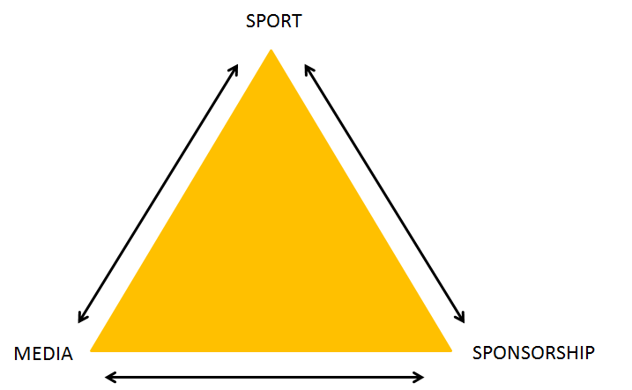
Task 1: Commercialisation in Sport
Task 2: Draw the golden triangle and explain how each side benefits one another.
Extension Task: identify the positive and negative effects of the media on commercialization and apply these to practical examples.

Slide 10
TASK 2: Sponsorship
Task 3: You are the owner of Nike you need to pick an athlete who you are going to sponsor and create a sponsorship profile.
Sponsorship Profile
Athlete Name:
Reason for sponsoring the athlete:
How are you sponsoring the athlete? (clothing and equipment, facilities, financial’ | How will this help the athlete?
Effects of sponsorship on the athlete | Effects of sponsorship on the sport | Effects of sponsorship on the sponsor | Effects of sponsorship on the spectators | Effects of sponsorship on the athlete

Slide 11
Mini Quiz
Task: without your notes answer the following questions.
Name three of the four types of media.
Name the three sides of the Golden Triangle.
Give an example of how a rugby team might use social media.
Who is a company more likely to want to sponsor, a premier league football team or a British basketball league team? Why?
State how the media benefits sport and sport benefits the media in regards to the Golden Triangle.
How will less popular sports teams be affected by not receiving as much media attention as other teams?
Name two of the three types of sponsorship in sport.
Give one reason why companies choose to sponsor sports events, teams or athletes.
Explain how increased commercialisation and media coverage has impacted positively on officials in sport.
Explain why a sponsor is likely to not want to be associated with a sports person who has behaved badly in some way.

Slide 12
2.1c Ethical and Socio Cultural issues in physical activity and sport
Revision tasks

Slide 13
Task 1: Ethics in Sport
Task 1: copy and complete the spider diagram! Write the definition of each of the key words and then around that give practical examples of each one.
Sportsmanship Definition
Ethics in Sport
Gamesmanship Definition
Deviance Definition
Extension Task: underneath your diagram write a paragraph explaining why sportsmanship is important and why there has been a decline.

Slide 14

Task 2: drugs in sport
Task 2: create a poster for athletes making them aware of the 3 different drugs: Anabolic Steroids, Stimulants and Beta Blockers.
The poster must include:
Reasons why sports performers use drugs
The effect the drug has on performance (sporting examples)
The side effects of the drug
The impact drug use has on sport itself.

Slide 15
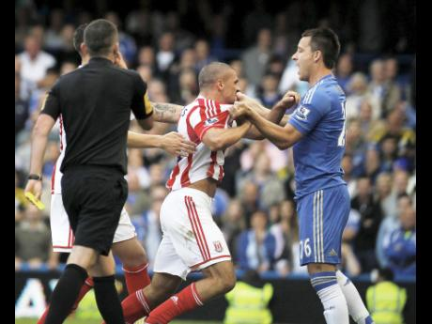
Task 3: Violence in Sport
Task 3: create a diagram the shows the reasons for player violence. Extension can you give a practical example for each reason?

Slide 16
Mini Quiz
Task: without your notes answer the following questions.
Shaking hands before and after a game is an example of what?
Describe gamesmanship.
Give an example of deviance.
Give two reasons why an athlete may take performance enhancing drugs.
How do anabolic steroids affect performance?
Give a sporting example of someone who may use beta blockers.
How would using anabolic steroids benefit a sprinters performance?
A racing driver would use which performance enhancing drug to remain alert?
Why do sports not want people taking drugs in their sport?
Give two reasons why a sports person may be violent.

Slide 17
2.2 Sports Psychology
Revision tasks

Slide 18
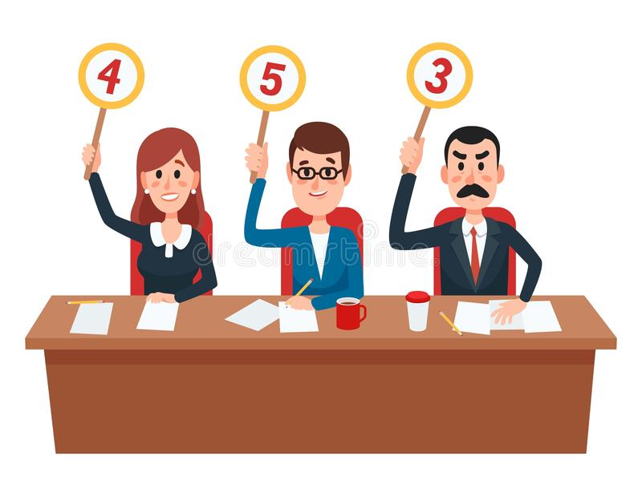
Characteristics of a skillful movement
Task: what are the definitions for the characteristics of a skillful movement? Then explain with practical examples how each one can be used to judge an athletes performance.

Slide 19
Classifications of skills
Research task: you need to research the two continuums
When researching make sure you use a recognised resource e.g. OCR GCSE PE book, or include ‘OCR GCSE PE’ when searching on the internet.
For each continuum you need to find:
1) the extremes on the end of the continuum
2) characteristics / descriptions of each extreme
3) examples of skills you can easily place on the continuum
4) justify why you have placed each skill in the position that you have.
Present your findings in to our BLUE exercise book.
Extension questions:
Why do you think a continuum is useful when classifying skills?
Can you find information about the pacing continuum and can you find the link between the pacing continuum and the environmental continuum?

Slide 20
Goal setting
Task 1: The table below has descriptions and examples of SMART goal setting although they are mixed up. Work out which is the correct description and example then write the correct answers in your book (write it out in full).
Goal setting principle | Description | Example
Specific | The goal should be written down so you can tick it off when achieved. | Writing in your diary “I want to be top goal scorer in our football club”.
Measurable | You should say when you want to achieve the goal by, and might have short term goals as stepping stones towards a longer term goal. | Wanting to win the hockey league because you came 2nd last year.
Achievable | Having a way to test if you have achieved your goal. | Wanting to run 13.5s in 100m.
Recorded | The goal should be within your capabilities and not too hard. | Wanting to run 13.5s in 100m.
Timed | Stating exactly what you want to achieve. | Wanting to win today's tennis game.
Extension task: Now write YOUR goal and describe why it hits the SMART principles

Slide 21
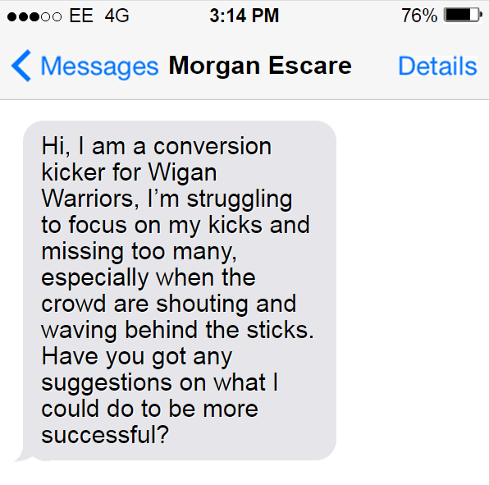
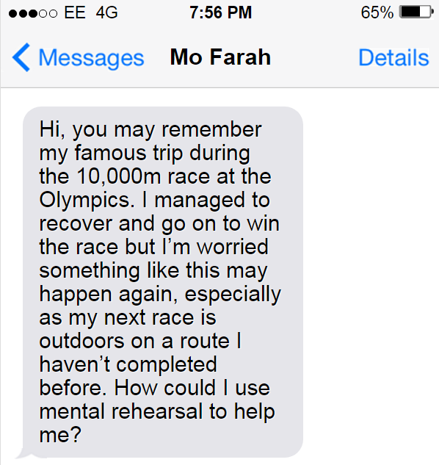
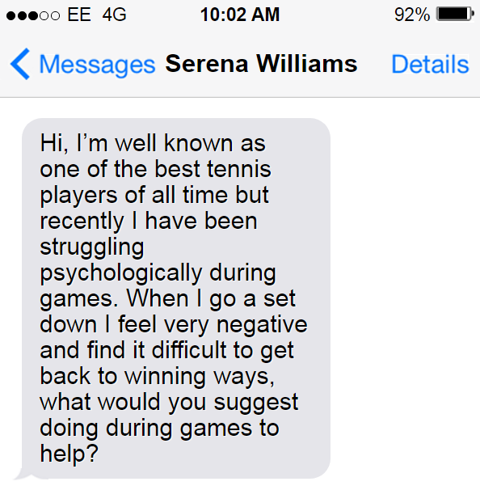
Mental Preparation
Task: Read the scenarios in the text messages from the athletes and suggest a mental preparation technique they could use to improve their performance. Give a specific sporting example of how they could use it / how it would help.

Slide 22
Types of Guidance
Task copy out the tables and complete for each of the types of guidance.
Visual: Write Definition
Practical Example:
ADVANTAGES | DISADVANTAGES
Verbal: Write Definition
Practical Example:
ADVANTAGES | DISADVANTAGES
Manual: Write Definition
Practical Example:
ADVANTAGES | DISADVANTAGES
Mechanical: Write Definition
Practical Example:
ADVANTAGES | DISADVANTAGES

Slide 23
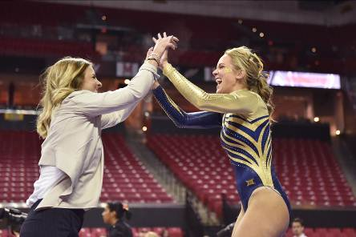
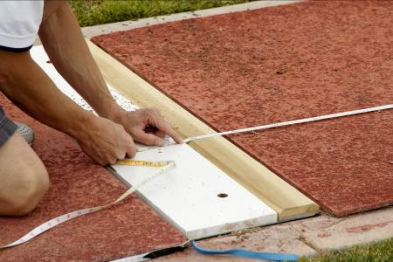
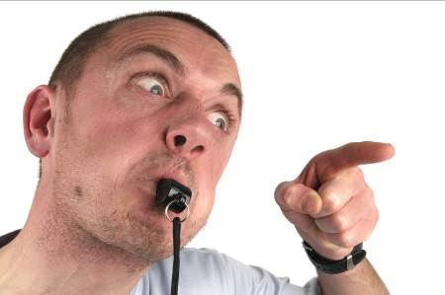
Types of Feedback
Task identify the 6 types of feedback. You must provide a definition and practical example of each one.
Intrinsic
Extrinsic
Knowledge of performance
Knowledge of results
Positive
Negative

Slide 24
Mini Quiz
Task: without your notes answer the following questions.
Give an example of a skilful movement in sport that would be described as having good coordination?
Other than coordination, name two other characteristics of skilful movement.
In relation to the difficulty continuum, what is a simple skill?
Is a pass in football an open or closed skill? Explain why.
Give one reason why it is important for athletes to set goals.
What does SMART stand for in relation to SMART goals.
Which aspect of SMART is not being followed in this goal – ‘I want to increase the amount of goals I score from 4 to 25 over my next 6 games’
Name two methods of mental preparation.
Give a sporting example of somebody who may use mental rehearsal and explain why.
Giving a demonstration is which type of guidance?

Slide 25
2.3 Health, fitness and well-being
Revision Tasks

Slide 26
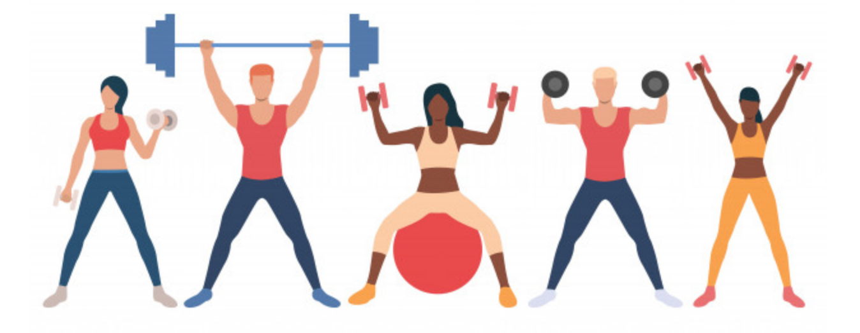
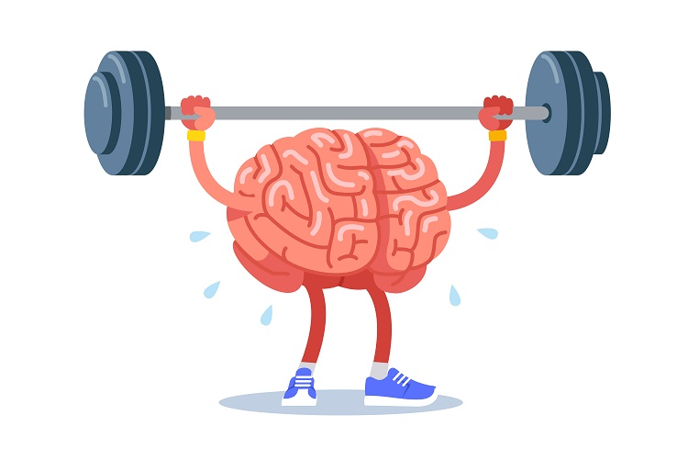

Task 1: Benefits of physical activity
Task 1: copy out and complete the tables. EXTENSION: explain why/how using practical examples.
Physical
List as many PHYSICAL benefits of participating in physical activity
Emotional
List as many EMOTIONAL benefits of participating in physical activity
Social
List as many SOCIAL benefits of participating in physical activity

Slide 27
Task 2: Consequences of living a sedentary lifestyle
Task 1: copy out and complete the tables. EXTENSION: explain why/how using practical examples
Physical
List as many PHYSICAL consequences of a sedentary lifestyle
Emotional
List as many EMOTIONAL consequences of a sedentary lifestyle
Social
List as many SOCIAL consequences of a sedentary lifestyle

Slide 28
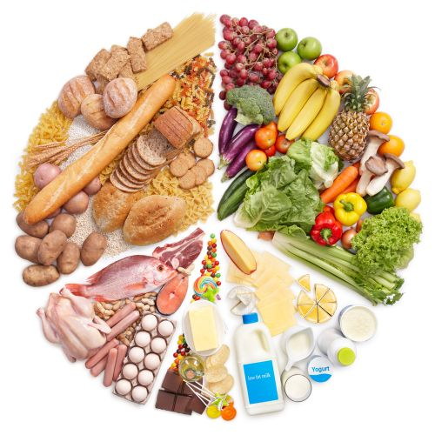
Task 3: diet AND nutrition
Task 3: create a poster explaining the importance of diet and hydration in physical activity.
The poster must include:
Definition of a balanced diet
Identify all of the components of a diet, giving examples of each
Practical examples linked to the components (how they have an effect on performance)
Importance of hydration and its effect on sport
Consequences of dehydration

Slide 29
Mini Quiz
Task: In your green mini quiz books, without your notes answer the following questions.
For this mini quiz you are going to answer whether the effect is a benefit of an active lifestyle or a consequence of an sedentary lifestyle and categorise it as a physical, emotional or social effect.
For example for ‘increased fitness’ you would write that it is a ‘physical health benefit of exercising’.
Less chance of obesity.
Low self-esteem/confidence.
Improved posture.
Can make new friends.
Increased stress levels.
Can cause loneliness.
Less chance of coronary heart disease.
Increased bone density.
Allows you to feel part of a group.
Increased/high blood pressure.

