Slide 1
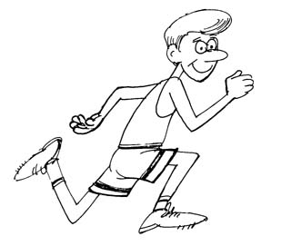
Paper 1- Physical Factors Affecting Performance
Exam questions & Mark schemes

Slide 2
1.1.a. The structure and function of the skeletal system

Slide 3
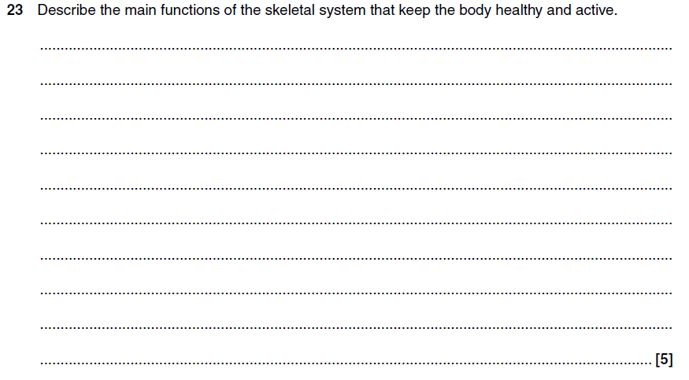
The skeletal System

Slide 4
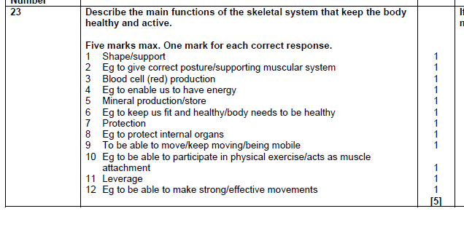
Answer

Slide 5
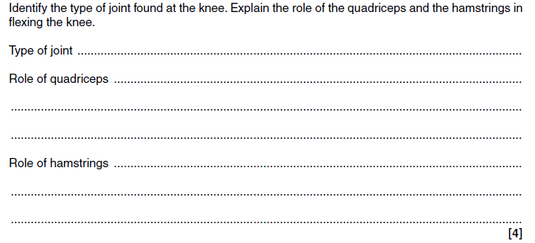
Skeletal system

Slide 6
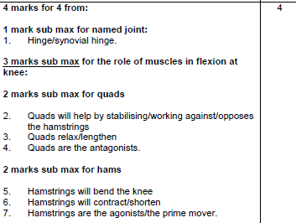
Answer

Slide 7
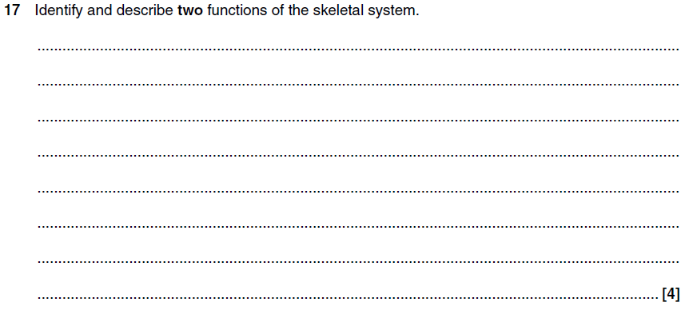
The skeletal system

Slide 8
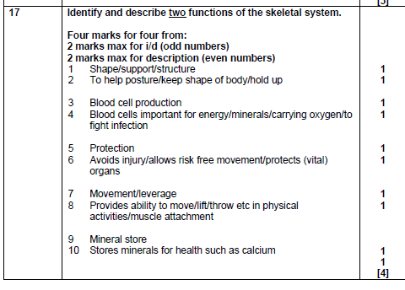
Answer

Slide 9
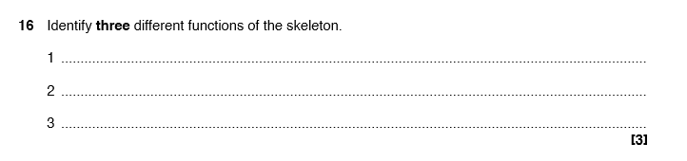
The Skeletal System

Slide 10
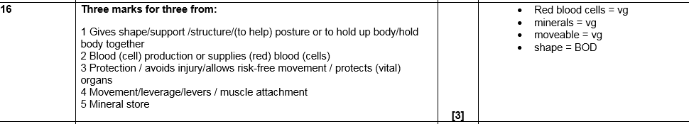
Answer

Slide 11
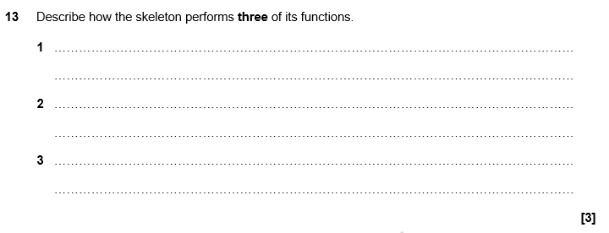
The Skeletal System

Slide 12
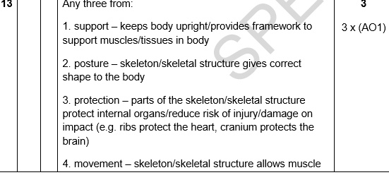
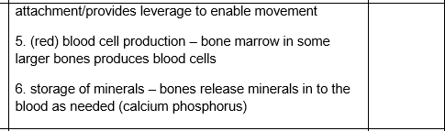
Answer

Slide 13
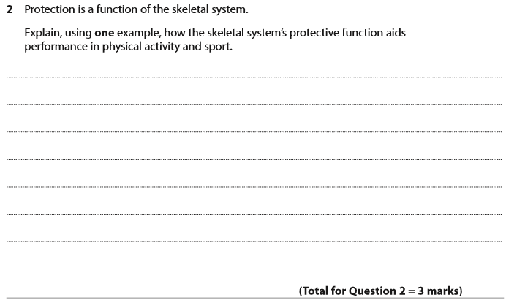
The Skeletal System

Slide 14
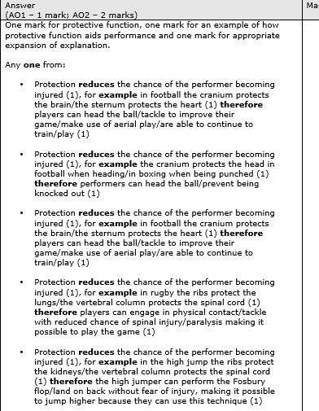
Answer

Slide 15
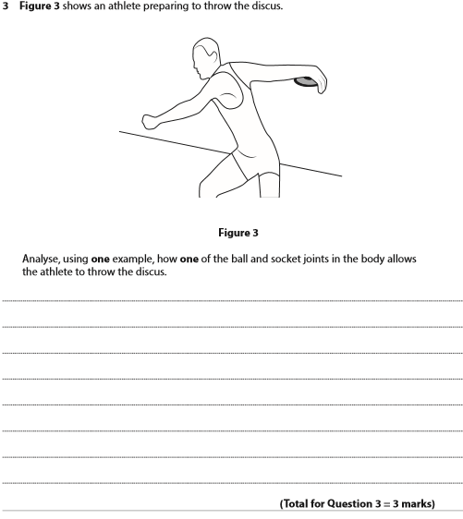
Joints

Slide 16
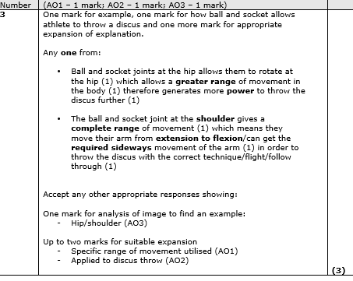
Answer

Slide 17
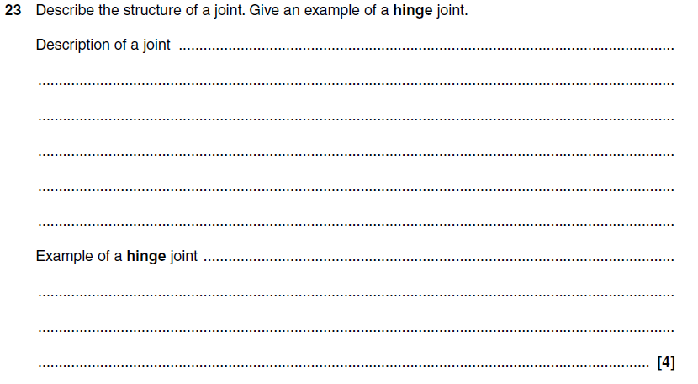
Joints

Slide 18
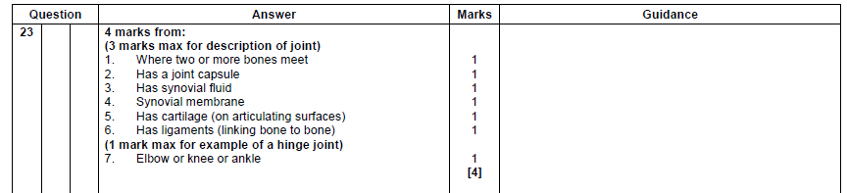
Answer

Slide 19
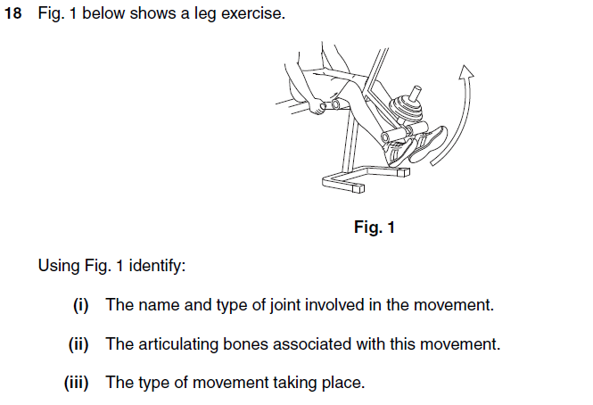
Joints

Slide 20
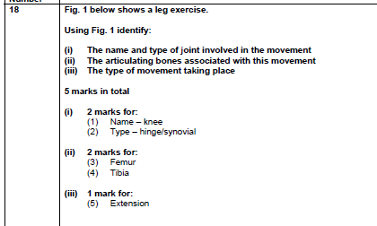
Answer

Slide 21
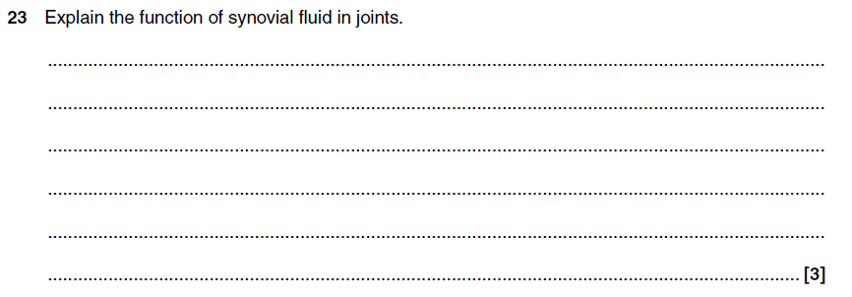
Joints

Slide 22
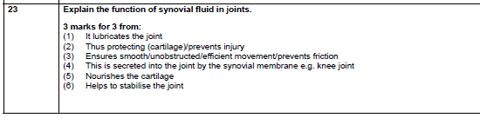
Answer

Slide 23
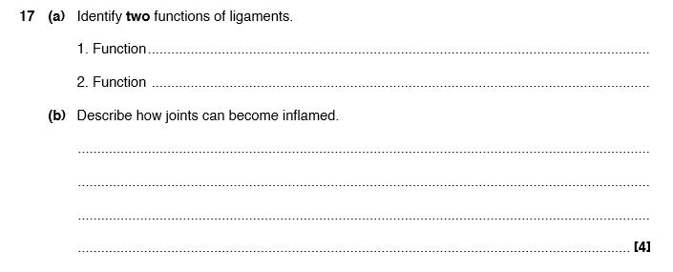
Joints

Slide 24
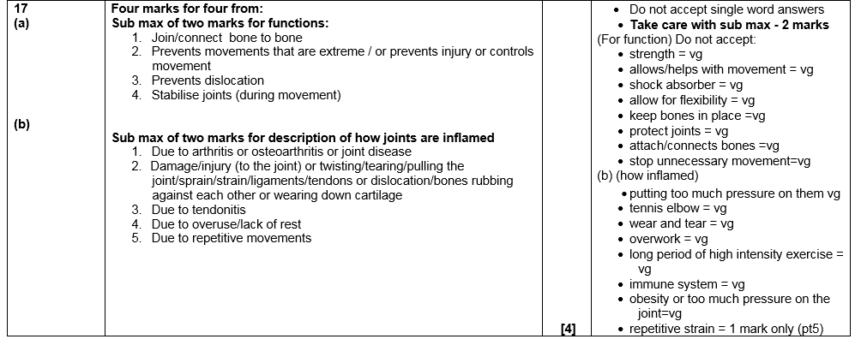
Answer

Slide 25
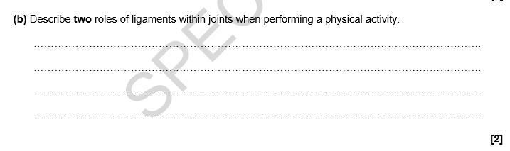
Joints

Slide 26
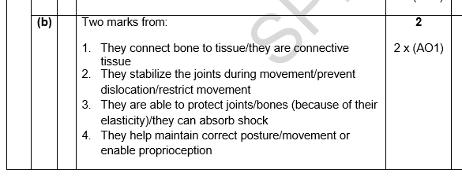
Answer

Slide 27
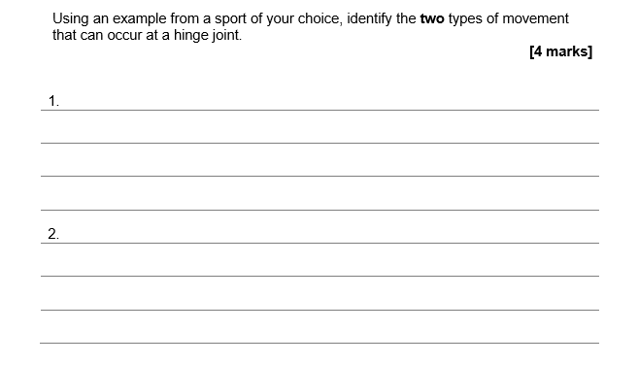
Joints

Slide 28
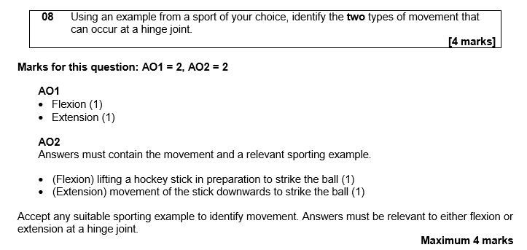
Answer

Slide 29
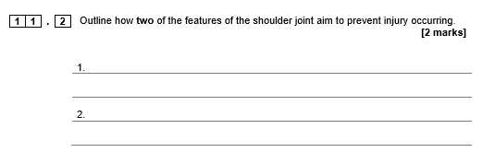
Joints

Slide 30
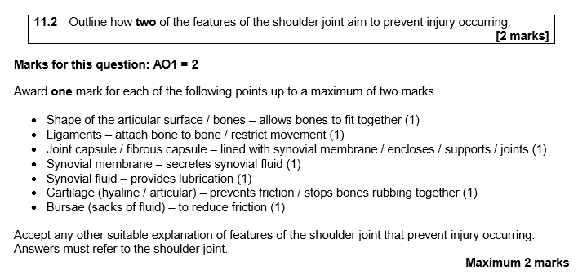
Answer

Slide 31
1.1.b. The structure and function of the muscular system

Slide 32
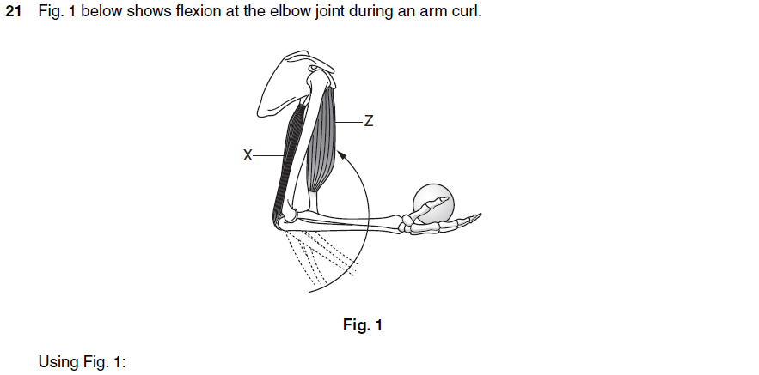
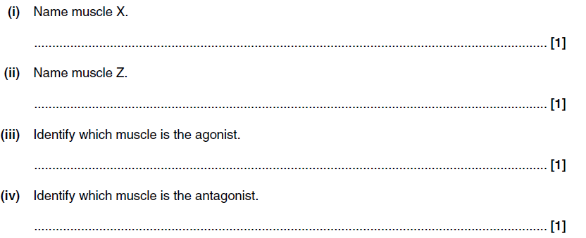
Muscles

Slide 33
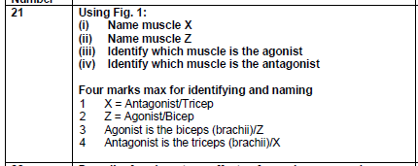
Answer

Slide 34
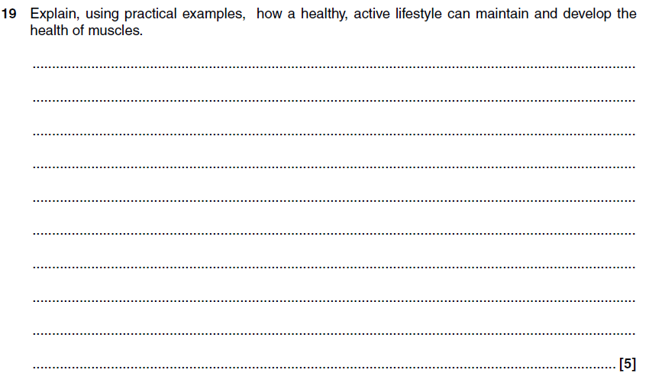
Muscles

Slide 35
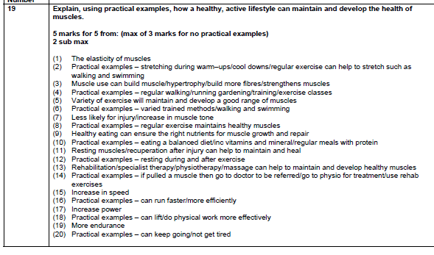
Answer

Slide 36
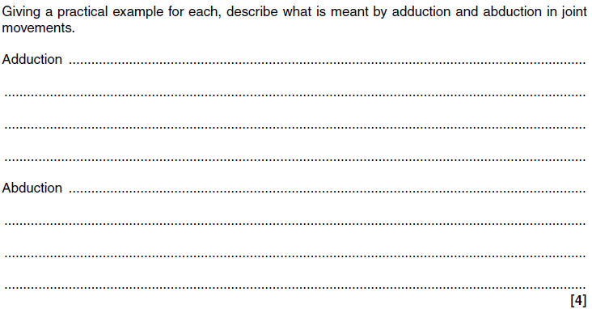
Muscles

Slide 37
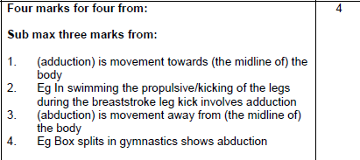
Answer

Slide 38
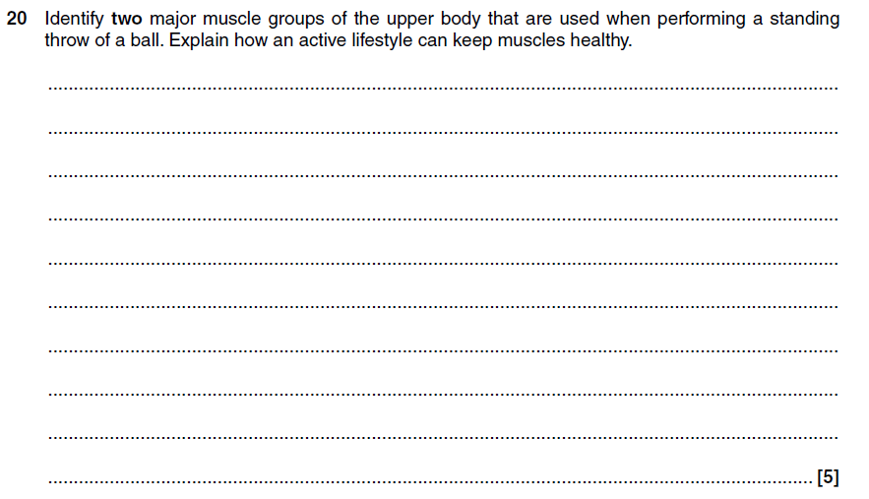
Muscles and Movement

Slide 39
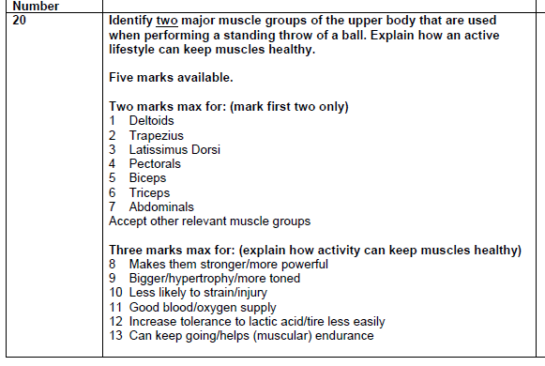
Answer

Slide 40
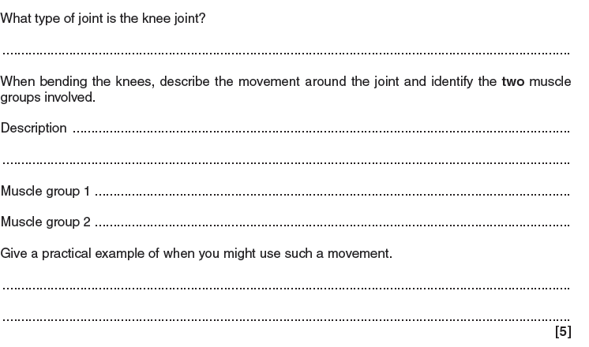
Muscle and movement

Slide 41
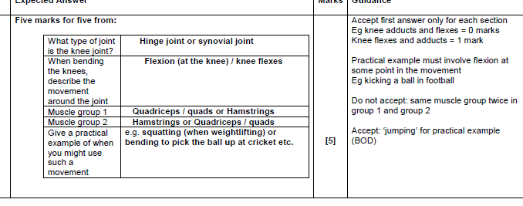
Answer

Slide 42
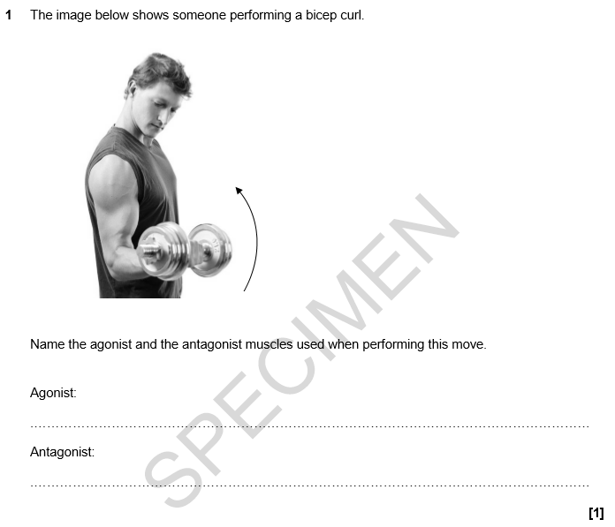
Muscles

Slide 43
Answer

Slide 44
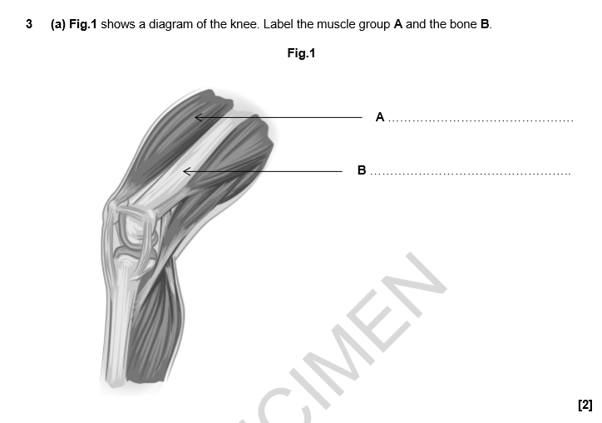
Muscles

Slide 45

Answer

Slide 46
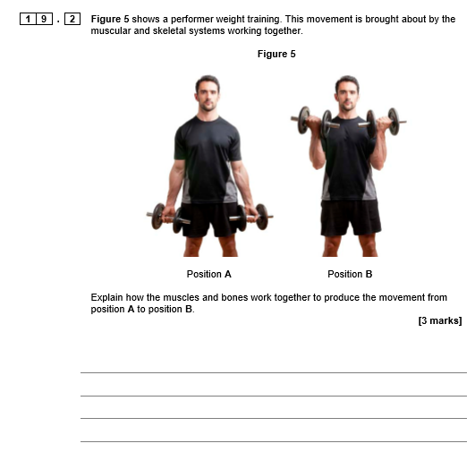
Muscles

Slide 47
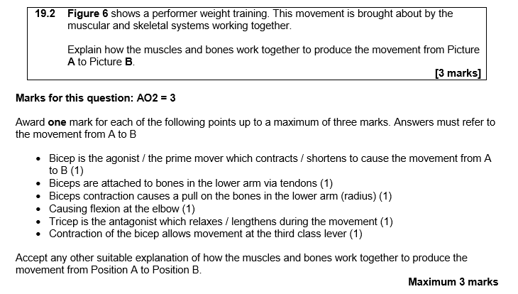
Answer

Slide 48
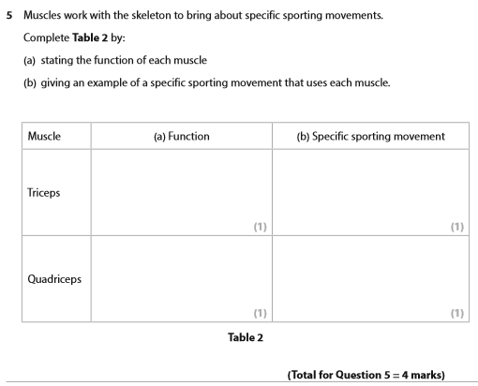
Muscles

Slide 49
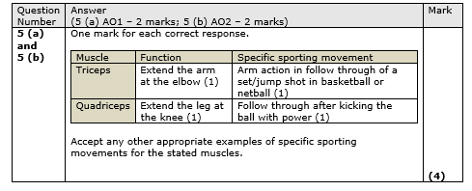
Answer

Slide 50
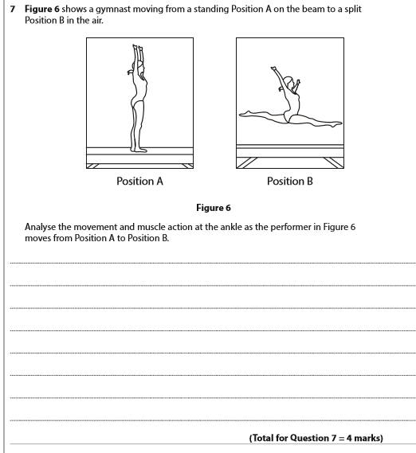
Muscles

Slide 51
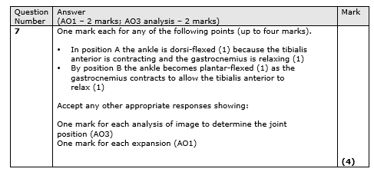
Answer

Slide 52
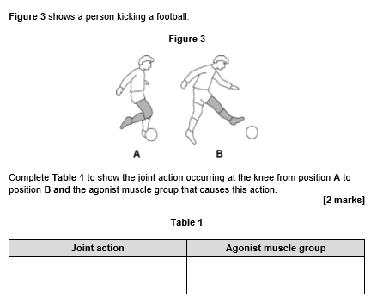
Muscles

Slide 53

Answer

Slide 54
1.1.c. Movement analysis

Slide 55

Levers

Slide 56

Answer

Slide 57

Levers

Slide 58

Answer

Slide 59

Levers

Slide 60

Answer

Slide 61

Levers

Slide 62

Answer

Slide 63

Levers

Slide 64

Answer

Slide 65

Levers

Slide 66

Answer

Slide 67


Levers

Slide 68

Answer

Slide 69

Levers

Slide 70

Answer

Slide 71


Levers

Slide 72

Answer

Slide 73


Levers

Slide 74

Answer

Slide 75


Levers

Slide 76

Answer

Slide 77

Planes & axes

Slide 78
Answer

Slide 79


Planes & axes

Slide 80

Answer

Slide 81

Planes & axes

Slide 82

Answer

Slide 83

Planes & Axes

Slide 84

Answer

Slide 85

Planes & Axes

Slide 86

Answer

Slide 87

Planes & Axes

Slide 88

Answer

Slide 89
1.1.d. The cardiovascular and respiratory systems

Slide 90

Respiratory System

Slide 91

Answer

Slide 92

Respiratory System

Slide 93

Answer

Slide 94

Respiratory System

Slide 95

Answer

Slide 96

Respiratory System

Slide 97

Answer

Slide 98

Respiratory System

Slide 99

Answer

Slide 100

Respiratory System

Slide 101

Answer

Slide 102

Respiratory system

Slide 103

Answer

Slide 104

Respiratory System

Slide 105

Answer

Slide 106

Cardiovascular system

Slide 107

Answer

Slide 108



Cardiovascular system

Slide 109


Answer

Slide 110

Cardiovascular system

Slide 111


Answer

Slide 112

Cardio-vascular system

Slide 113


Answer

Slide 114

Cardiovascular system

Slide 115


Answer

Slide 116

Cardiovascular system

Slide 117

Answer

Slide 118

Cardiovascular system

Slide 119

Answer

Slide 120


Cardiovascular System

Slide 121

Answer

Slide 122

Cardiovascular system

Slide 123

Answer

Slide 124

Cardiovascular system

Slide 125

Answer

Slide 126

Cardiovascular system

Slide 127

Answer

Slide 128
1.1.e. Effects of exercise on body systems

Slide 129

Effects of exercise

Slide 130

Answer

Slide 131

Effects of exercise

Slide 132

Answer

Slide 133

Effects of exercise

Slide 134

Answer

Slide 135

Effects of exercise

Slide 136

Answer

Slide 137

Effects of exercise

Slide 138

Answer

Slide 139

Effects of exercise

Slide 140

Answer

Slide 141

Effects of exercise

Slide 142


Answer

Slide 143
1.2.a. Components of fitness

Slide 144

Components of fitness

Slide 145

Answer

Slide 146

Components of fitness

Slide 147

Answer

Slide 148

Components of fitness

Slide 149

Answers

Slide 150

Components of fitness

Slide 151

Answer

Slide 152

Components of Fitness

Slide 153

Answer

Slide 154

Components of Fitness

Slide 155

Answer

Slide 156

Components of fitness

Slide 157

Answer

Slide 158

Components of fitness

Slide 159

Answer

Slide 160

Components of fitness

Slide 161


Answer

Slide 162

Components of Fitness

Slide 163

Answer

Slide 164
1.2.b. Applying the principles of training

Slide 165

Principles of training

Slide 166

Answer

Slide 167

Principles of training

Slide 168

Answer

Slide 169

Principles of training

Slide 170

Answer

Slide 171

Principles of training

Slide 172

Answer

Slide 173

Principles of training

Slide 174

Answer

Slide 175

Principles of training

Slide 176


Answer

Slide 177

Principles of training

Slide 178

Answer

Slide 179

Optimising training

Slide 180


Answer

Slide 181

Optimising Training

Slide 182

Answer

Slide 183

Optimising training

Slide 184

Answer

Slide 185

Optimising training

Slide 186

Answer

Slide 187

Optimising training

Slide 188

Answer

Slide 189

Optimising training

Slide 190


Answer

Slide 191

Optimising training

Slide 192

Answer

Slide 193

Optimising training

Slide 194

Answer

Slide 195

Warm-up and cool down

Slide 196

Answer

Slide 197

Warm-up and cool down

Slide 198

Answer

Slide 199

Warm-up and cool down

Slide 200

Answer

Slide 201

Warm-up and cool down

Slide 202

Answer

Slide 203

Warm up and cool down

Slide 204

Answer

Slide 205

Warm up and cool down

Slide 206

Answer

Slide 207

Warm up and cool down

Slide 208

Answer

Slide 209

Warm up and cool down

Slide 210

Answer

Slide 211
1.3.c. Preventing injury in physical activity and training

Slide 212

Potential hazards

Slide 213

Answer

Slide 214

Hazards

Slide 215

Hazards

Slide 216

Answer

Slide 217

Reducing the risks

Slide 218

Answer

Slide 219

Reducing the risks

Slide 220

Answer

Slide 221

Reducing the risks

Slide 222

Answer

Slide 223

Reducing risks

Slide 224

Answer

Slide 225

Hazards & risks

Slide 226

Answer

Slide 227

Hazards & risks

Slide 228




Answer

Slide 229

Hazards & risks

Slide 230

Answer

