Slide 1

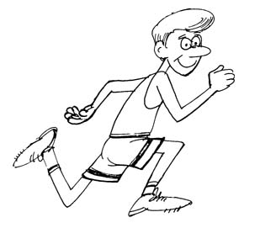
GCSE Physical Education
Revision Cards
Paper 2-Socio-cultural factors effecting performance
RED: Identify GREEN: Explain PURPLE: Example/Effect
BLACK: Exam questions

Slide 2
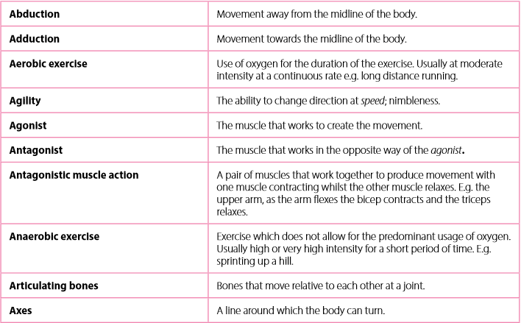
Key terms

Slide 3
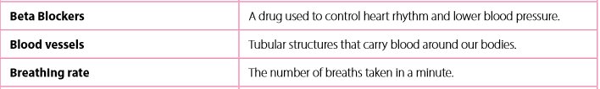
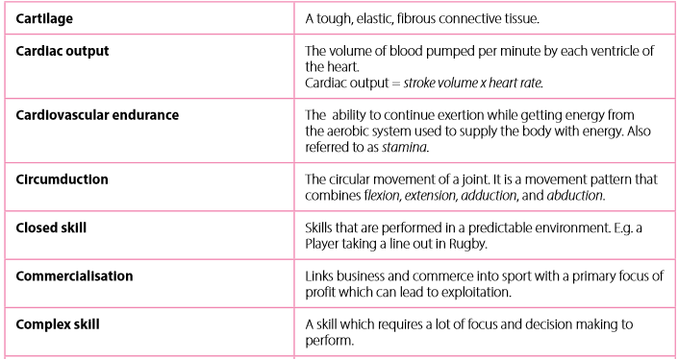
Key terms

Slide 4
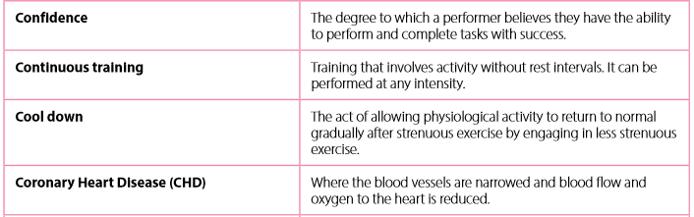
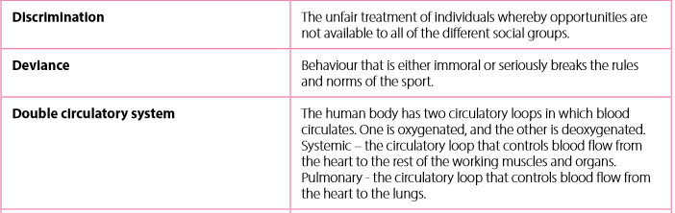
Key terms

Slide 5

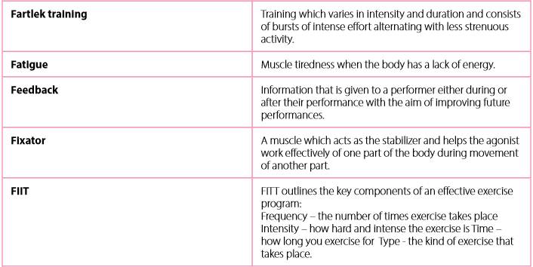

Key terms

Slide 6
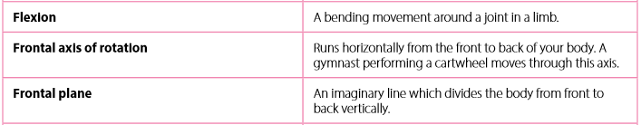
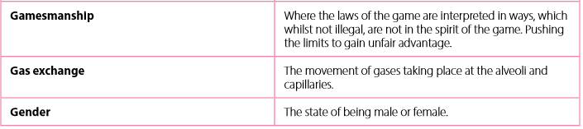
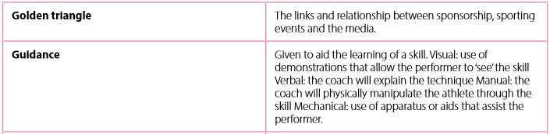
Key terms

Slide 7
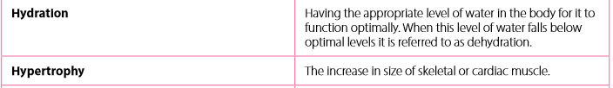
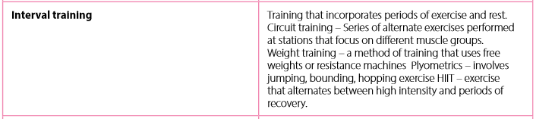
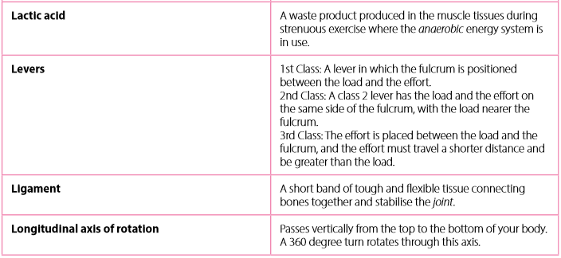
Key terms

Slide 8
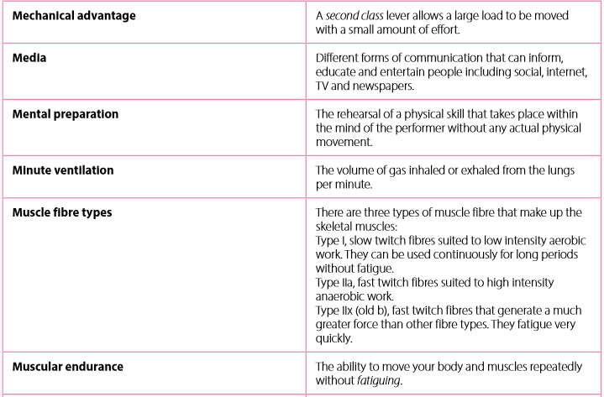
Key terms

Slide 9
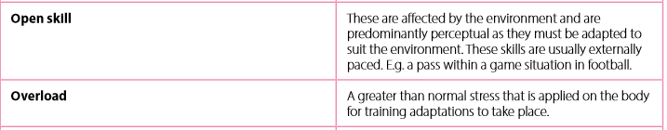
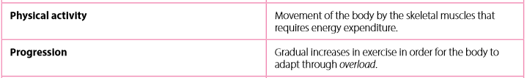

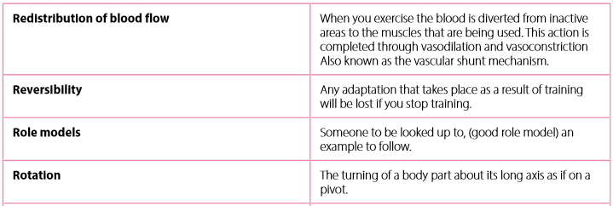
Key terms

Slide 10
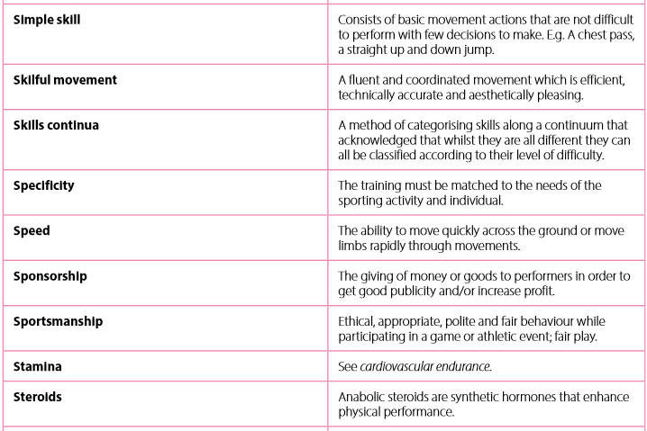
Key terms

Slide 11
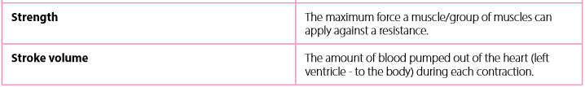
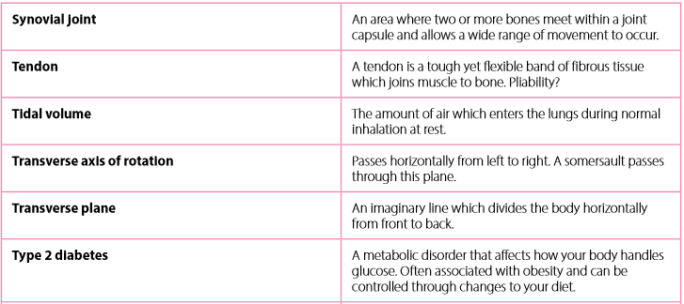

Key terms

Slide 12
How to structure an exam question?
Identify – Explain- Example/effect
Phase 1
How many marks is the question worth and how long should I spend answering it? (roughly 1 mark = 1 minute answering)
Phase 2
What is the question asking me? Underline the keywords
E.g. Briefly explain the terms cardiac output and stroke volume and the relationship between them.
Phase 3
First Keyword Analysis
What does the word explain, describe, define, apply, compare or select mean?
Phase 4
Phase 5
Break the Question down into sections and use this format to create sentences.
Topic Analysis – bullet point related factors. What are the key points? If it asks for a practical example ensure you include one.

Slide 13
Physical Activity and Sport in the UK
LO: To Identify the current trends in participation in physical activity and sport
33% of adults participate in 30minutes of PA per week.
55% of 16-24 participate in sport once a week for 30 min’s or more.
40% of men and 31% of women participate in PA at least once a week.
51% of men compared with 36% of women are more likely to participate in sport.
40% of men compared to 14% of women take part in organised competitive sport.
17.2% of disabled participate once a week (39%)
38% of ethnic minorities participate once a week (39%)
The 5 most popular activities among adults in the UK are (UK 2015)
Walking-46%
Swimming-35%
Keep fit/yoga (including aerobics and dance)-22%
Cycling-19%
Cue Sports-(including billiards, snooker and pool)17%
What are the three most popular sports in the UK and what are the main reasons for this popularity 3-8 marks.

Slide 14
Promotion, Provision and Access
LO: To Describe the strategies that can be used to improve participation
The three important factors that can deliver successful strategies for improving participation are:
Promotion = convincing people they should take up sport
Provision =Providing facilities, equipment, coaching.
Access = Giving people opportunity to participate by making it easier for them to engage in sport.
These are all delivered by a number of agencies such as
UK Sport
Sport England
UK Sports Institute
Youth Sports Trust
Outline three strategies to improve participation in sport (6 marks)

Slide 15
Participation in Physical Activity and Sport
LO: To Explain how different factors can affect participation
Religion- Positives- Run specialist classes e.g. women only classes, facilities rules relaxed e.g. clothes can be worn in swimming baths, targeted advertising to minority groups.
Negatives- High ethnic areas don’t have many facilities e.g. leisure centres Have family and home commitments e.g. have a large family and are expected to stay at home.
Gender- Positives- An increase in non competitive sports e.g. Aerobics/Zumba More role models E.g. after coverage of Olympics, women looked up to Jessica Ennis. More media coverage e.g. more women’s sports now on T.V such as women’s football. women now not banned from certain sports
Negatives- Some sports are linked to either males or females. E.g. Boxing. Lack of female sports/teams. E.g. more rugby teams for men. Not enough female role models. Lack of media coverage. Discriminated against . E.g. some males or groups may think women are not good/physically strong enough. Sport seen as masculine e.g. Rugby and football. Due to other responsibilities e.g. have to stay at home to take care of the family.
Describe four reasons why gender effect participation in physical activity (4 marks)

Slide 16
Participation in Physical Activity and Sport
Age- Positives- Increase in age means more experienced. E.g. will have better knowledge of the game. Post puberty the body increases in strength and endurance. E.g. can last for longer in games. Can be more determined with age. E.g. increased mental determination to want to succeed.
Negatives-Increase in age can lead to illness. E.g. heart disease. Increase in injuries due to weaker bones/muscles. E.g. arthritis. Older people can face discrimination. E.g. they may not feel good enough/fit enough to play. Lack of transport to get to facilities. Lack of energy. Lack of motivation e.g. cant be bothered or feel to tired to play.
Disability- Positives –Sport for all encourage disabled athletes. E.g. walking football. Leisure centres have made there facilities more accessible. E.g. wheelchair ramps. Adaptations to mainstream sports. E.g. Walking football
Negatives – Limited access to faculties. E.g. no ramps or no wheelchair. May have physical difficulties that limit performance. E.g. Lack of strength, power. May not have transport to get to facilities. Limited specialist equipment. E.g. no balls with bells in for blind football. Discriminated against e.g. people may think they cant play due to their disability. Lack of role models. E.g. not enough coverage on T.V for people to want to aspire to be like.
Using practical examples identify 4 effects age has on performance ( 4 marks )

Slide 17
Participation in Physical Activity and Sport
Family- Positive They give personal support. E.g. Push you and encourage you. Provide transport to get them to places. e.g. take you to your games. Provide financial support. E.g. Pay subs for their team and buy equipment. They are good role models. E.g. Tell them how to be healthy and exercise themselves.
Negative- Poor role models. E.g. Don’t follow a healthy lifestyle or play sport themselves. Don’t watch games. Don’t provide transport. No financial support. They push you too hard so don’t want to participate. They may discourage you.
Education- Positive Those who have had more opportunities in school with participate more. E.g. after school clubs. Schools provide facilities and equipment. e.g. provide badminton equipment to play. Organised sport competitions give more opportunity. E.g. play in the school team against other schools.
Negative- Poor facilities and equipment in school can lead to lack of participation. E.g. no badminton equipment so no chance to play that sport. Negative teaching experiences. E.g. the teachers knowledge of the sport was not good which led to a lack of enjoyment. Lack of success in certain sports. E.g. always loosing in lesson or at fixtures.
Explain three positive and three negative effects family has on participation ( 6 marks )

Slide 18
Participation in Physical Activity and Sport
Environment and Climate
Positives- Having access to green space will mean more opportunities to play outdoor sports. E.g. Football. Different areas have different facilities. E.g. if you live near the coast you can go sailing. Some large city and urban areas have more indoor facilities. E.g. Indoor football centres.
Negatives- Some sports can be quite expensive due to no natural facilities. E.g. Skiing. Some climates can be too hot to participate in. E.g. countries such as bahrain. Playing surface may be unfit. E.g. Frozen or waterlogged due to the weather. Humidity might be too high.
Describe why location could have a negative effect on participation (4 marks )

Slide 19
Common Sense Answers
Cost
Time
Discrimination
Role Models
Media Exposure
Resources
Ability
Fitness
Health
Access

Slide 20
Reasons for and Reasons for Non-Participation
Health reasons- E.g. You may exercise to manage stress. After work/school.
Feel good-E.g. Exercise can release hormones that make you feel better.
Live Longer-E.g. eating healthier and doing exercise will increase life expectancy
Image-E.g. Going to the gym will increase muscles/decrease fat. Make you look good.
Enjoyment- E.g. Play football after school because you enjoy it.
Make friends- E.g. Join an exercise class to meet new people.
As a job- E.g. You play Rugby professionally, it is your job.
Health reasons-E.g. An older man may have arthritis so finds it hard to participate.
Discrimination- E.g. A woman is not allowed to join a golf club as it is male only.
Injury- E.g. You may have broken your leg so cant participate.
Technology- E.g. Some children prefer to play on consoles or watch TV rather than take part in sport.
Lack of Opportunity-E.g. You may want to join a sports club but there is none around your area.
Lack of Transport- E.g. You may not have the transport to get to certain sports clubs/facilities.
Age- E.g. You may be too old to participate in some activities due to weak muscles/bones
Disability-E.g. A person with a disability may not be able to go swimming due to a lack of specialist equipment.
Explain why some young people might choose to follow an active healthy lifestyle (4-6 marks )

Slide 21
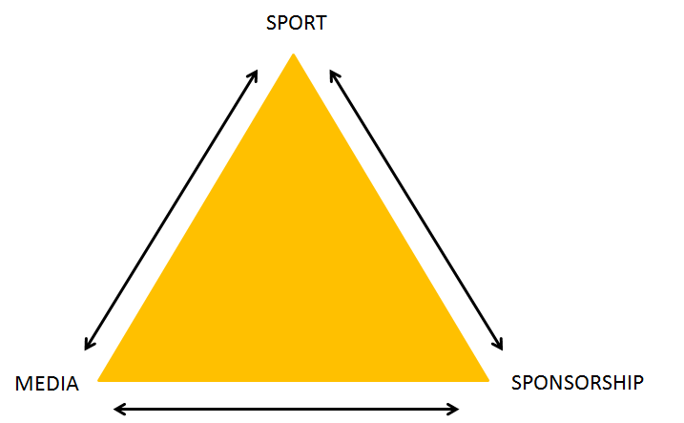
Commercialisation of sport
LO: To Explain the effects of media on the commercialisation of physical activity and sport.
Commercialisation- This refers to the influence of commerce, trade or business on an industry (Sport) to make a profit.
Commerce- Buying or selling on a large scale.
Types of media
Television-BBC, ITV, Channel 4, Channel 5, cable and digital.
Press- Tabloids, broadsheets, magazines.
Radio- national, local-capital fm.
Internet-including social media.
Cinema- documentaries and movies.
Explain the relationship between the sport, the media and sponsorship (6 marks)

Slide 22
Media
LO: To Explain the effects of media on the commercialisation of physical activity and sport.
Positive effects of the media-
Negative effects of the media-
Promotes sport and raises the profile. E.g. Wimbledon promotes and raise the profile of tennis.
Wide variety of coverage. E.g. Range of media sources such as T.V and radio shows sports on a regular basis.
Motivation through positive role models. E.g. Jessica Ennis gets young girls into athletics.
Sponsorship & funding E.g. Barclays sponsors football premier league.
Gives information on healthy lifestyles. E.g. A newspaper shows exercises and healthy foods.
Entertainment & inspiration. E.g. Role models such as Jessica Ennis at the Olympic Games.
Reinforce unhealthy lifestyles e.g. smoking & alcohol. E.g. Sponsorship of poor companies
Couch potato syndrome E.g. more people watching sport on T.V than actually playing.
Minority sports underrepresented E.g. Lack of Netball shown.
Women's and disability sport underrepresented. E.g. Paralympics not as much coverage as Olympics.
Poor role models E.g. Lance Armstrong- cheating.
Changes in rules and schedule times. E.g. Major changes to premier league matches on weekends.
Explain how the media influences healthy, active lifestyles. Explain the positive and negative effects of the media upon participation in sport. (4-6 marks)

Slide 23
Sponsorship
LO: To Explain the effects of sponsorship on the commercialisation of physical activity and sport.
Definition
The financial support for a sport/sports event/person by an outside organisation
Types of sponsorship-Clothing, equipment, footwear and facilities
Positive effects of sponsorship
Provides money for athletes to train and compete. E.g. Athletics performers could not commit so much time to this without sponsorship.
Pays for competitions- E.g. Pays for the competition to run or an individual to enter a competition.
Promotes sport.
Facilities/equipment- E.g. keeps them up to date.
Increases participation E.g. Provides funding for new clubs and coaches
Provides transport-E.g. pays for coaches to take teams to away fixtures.
Provides coaching- E.g. Pays for coaches to coach teams in sport.
Negative effects of sponsorship
Middle ranking sports- poorly sponsored. E.g. Snooker and BMX
Women poorly sponsored. E.G. Women’s football players do not receive as high profile sponsors as men.
Unsuccessful athlete. E.g. Sponsors only sponsor athletes are doing really well such as Wayne Rooney.
Fragile sponsorship deals-E.g. Negative image/bad publicity/injury could lead to loss of sponsorship.
Bad lifestyle habits E.g. smoking/alcohol
Explain the effects of reduced sponsorship on participation in physical activities (6 marks)

Slide 24
Abiding by the Rules, Etiquette and sportsmanship
Example of rules
E.g. In boxing when the bell rings you must stop- Points deducted
E.g. In football you are not allowed to handle the ball-Free kick or penalty
Importance of Rules/Etiquette
Fair play
Avoid getting sent off
Prevents injury
Enjoyable
Be a good role model
To show respect
To keep the game flowing
Etiquette/Sportsmanship
Shaking hands at the start and end of a game
Thanking officials
Loose gracefully
Don’t over celebrate
Three cheers at the end of the game
Touching gloves in boxing
Clapping the batsman in in cricket
Describe what is meant by sportsmanship/Give practical examples of sportsmanship/Identify why the rules and sportsmanship is important. (4-6)
LO: To Explain the value of sportsmanship and etiquette. To Identify practical examples of sportsmanship and etiquette
Sportsmanship
This involves the behaviour that shows fair play, respect for opponents and gracious behaviour, whether winning or losing. The unwritten rule.
Etiquette (good manners)
This involves a convention or an accepted way of behaving in a particular situation.

Slide 25
Deviance, Aggression and violence
LO: To Explain the reasons for gamesmanship, deviance.
To Apply practical examples
Gamesmanship
The use of unethical, although often not illegal, methods to win or gain a serious advantage in a game of sport.
Performers use gamesmanship to seek an unfair advantage.
Examples
E.g. The forward who dives in football for a penalty.
E.g. Athlete who pushes another runner in the 800m.
Deviance
This involves human behaviour that is against your society’s norms and values. Behaviour of this kind is often against the law.
E.g. Performance enhancing drugs
E.g. Competitors behaviour- fights in a match
E.g. Spectators behaviour
E.g. Hooliganism in football
E.g. Cheating – golf
Describe two examples of gamesmanship in a physical activity of your choice (2 marks)

Slide 26
Deviance, Aggression and violence
LO: To Explain the reasons for deviance, violence and aggression.
To Explain why we become violent/aggressive.
To Apply practical examples
Aggression/Violence
This usually known as the intent to harm others outside the rules of the game.
It can be hard to distinguish between what is violent and aggressive behavior and what is not.
Two types of aggression
Indirect: is aimed at an object to gain an advantage
E.g. To intimidate a batsman in cricket
Direct: Aimed directly at a player i.e. physical contact
E.g. To hit a player during a hockey game
Reasons why we show aggression/violence
CANT HELP IT-This relates to the instinct theory.
FRUSTRATED-As a result of loosing.
RETALIATION- We lash out and be aggressive to get rid of the feeling. Reaction to a bad tackle
ANNOYED- We get annoyed by poor decisions by official.
COPY OTHERS-To fit into a group we may behave in certain way. This may be to copy role models.
OVER AROUSAL during game due to adrenaline all increase which leads to anger/aggression.
TAUNTING- Either from the crowd or other players
Describe how indirect aggression can be used to improve performance (3 marks )

Slide 27
Drugs in Sport
LO: To Explain the different types of drugs and their effects on a performer
Anabolic Steroids
Positives-
Increase muscle growth
Train harder
Enable quicker recovery
Increase strength & aggression.
Mask injury.
Negatives-
masks injury.
Aggression
high blood pressure
shrinks testicles
growth of facial hair for women.
Can get banned
kidney failure & heart problems
Beta Blockers
Positives-
Reduce muscle spasms
Control the heart rate
Keeps athlete calm
Lowers blood pressure
Negatives-
Causes heart attacks
Headaches
Dizziness
Stimulants
Positives-
faster reactions
Quicker recovery times
increase alertness
Amphetamines
Negatives-
Increased heart rate
Increased blood pressure
Aggression
Liver/brain damage
Describe the negative effects of illegal blood doping used for enhancing performance ( 4 marks )

Slide 28
Drugs in Sport
LO: To Explain the reasons why sports performers use drugs.
Impact on Performer
Positives
Perform better
More strength/power
Increase speed
More aggressive
Train longer and harder
Lower heart rate
Negatives
Health problems
High blood pressure
Masks injury
Disqualification
Psychological problems
Addcition
Impact on Sport
Bad reputation (poor role models)
Disqualification
Money to test
Let the team down
Describe the effects of performance enhancing drugs on the performer (4-6 marks)

Slide 29
Characteristics of a Skilful Movement
LO: To Describe the characteristics of a skilful movement. Applying practical examples
Efficiency- Not making unnecessary movements/waste energy. E.G. A basketball player not making unnecessary movements when dribbling p court.
Predetermined-Know what you are going to do before you do it. E.g. For example a football player will know where there are going to place their shot before they do it.
Coordinated-Ability to use two or more body parts together. E.g. A tennis players movements are linked well together in a serve.
Fluent- One move flows into the next. E.g. A dancers routine has moves that flow from one to the next.
Aesthetic- Looks good. E.g. A gymnasts floor routine is performed with tension, extension and control so looks good.
Identify and Describe using Practical examples the Characteristics of a skilful movement (2-5 marks)
Skilled | Unskilled
No wasted effort Knows what their doing Smooth and fluent Looks good Nearly always successful Good technique | Wastes effort Slow Don’t know what they are doing Jerky movements Awkward Rarely successful

Slide 30
Classification of Skills
LO: To Explain how skills are classified using practical examples
Open-closed continuum- (Environmental)
Open skills- Are affected by the environment E.g. Pass in football. E.g. A chest pass in netball
Closed skills- Are not affected by the environment e.g. Golf putt. E.g. a penalty in football
Simple and complex continuum (difficulty- based on decisions and judgements that need to be made)
Simple skills- skill is straightforward and hardly any decisions have to be made. E.g. A sprint start start in swimming.
Complex skills- skill is complex, many decisions have to be made and possibly learnt in stages. E.g. A pass in hockey. E.g. A slip catch in cricket
Explain how a coach would vary a training session when coaching open and closed skills (3 marks)

Slide 31
Goal setting
The importance of goal setting-
Training increases- setting a goal to improve flexibility will help you to train to improve this.
Anxiety decreases- to focus on a set goal to finish a race in a certain time to help cope with the pressure of competition.
Confidence increases- When setting a goal of scoring 10 goals a season, when you achieve this it raises confidence.
Optimise performance- To set a target to score 20 goals in a season to improve your performance in football.
Explain the importance of setting goals with examples. Describe why goal setting is important in physical activity. (often a two part question with SMART) (5-6 marks)

Slide 32
Goal setting
Principle of SMART goal setting
Specific- specific to the individuals needs and goals. E.g. A footballer will target their cardio vascular endurance.
Measurable- The goal must be able to be assessed to track progress. E.g. To make 9st after an exercise programme.
Achievable- The goal must be within the capabilities of the performer. E.g. A runner to run 5km before they run 10km.
Realistic- The goal must be within the capabilities of the performer but still challenging. E.g. A badminton player must learn to hit the shuttle before placing it around the court.
Time- A time to complete the goal so progress can be tracked. E.g. an athlete must beat their PB by the end of the season.
Explain the SMART principle of goal setting. Explain how SMART helps someone to stick to an exercise programme. (Unless SMART is stated don’t mention it!) (5 marks)

Slide 33
Mental Preparation
LO: To Explain the effects of mental preparation for performance.
To Apply practical examples
Imagery
Imagery can improve concentration. It is the creation of pictures in our minds
Benefits
Relaxation.
Stress and anxiety.
Concentration
Confidence
Mental rehearsal
Internal & external imagery
Internal- Imagining yourself doing the activity- E.g. High jump, imagine yourself doing the run up,j ump and landing.
External- Imagine yourself outside of your body. E.g. racing car driver goes through the route before the race.
Benefits
Relaxation
Speeds up reactions
concentration & focus
Describe the effects of mental preparation on the performer of physical activities (4 marks)

Slide 34
Mental Preparation
LO: To Explain the effects of mental preparation for performance.
To Apply practical examples
Positive Thinking-Self talk
Positive about past experiences and future participation.
This can also work the opposite-Negative self talk.
Benefits-
Increase self confidence
Raise levels of aspiration
Reduce anxiety
Selective Attention
Focus on relevant cues.
Filter out unnecessary information. More experienced players do this better.
E.g. Blocking out the crowd when taking a penalty kick in football.
Factors affecting Selective attention-
Relevance-E.g. the goalkeeper may judge the strikers foot to be more relevant than actions of the crowd
Expectation-E.g. the goal keeper expects there to be a shot because of the strikers body position.
Vividness- E.g. a team mates shout is more likely to get your attention than a comment from the opposite team.
Explain why mental preparation can enable fair play and improve performance in physical activities (4 marks)

Slide 35
Guidance
The 4 types of guidance
Visual 3. Manual
Verbal 4. Mechanical
LO: To Explain the different types of guidance.
To Describe the advantages and disadvantages of each type
Visual Guidance
The use of images or demonstrations to help a learner.
Allows a mental image to be made
Demonstrations- Must be accurate to not confuse learner
Advantages-
Good for beginners
Easy to remember
Quick and effective
Disadvantages-
Wrong demonstrations = wrong movement learnt
Difficult to get a feel of the skill
Too complicated to understand.
Manual and Mechanical
The production of the correct movement by the use of mechanical aids or by the support of a coach.
Physical support by another person or mechanical device. E.g. supporting a gymnast over the vault
The response of the performer being directed physically by another person. E.g. Holding the arms of a golfer, forcing their arms through the movement.
Advantages-
Reduce fear in dangerous situations.
Performer feels safer = raise confidence
Gives performer idea of the feeling
Disadvantages-
Unrealistic feeling
Over reliant on sport
Can be dangerous
4. Sometimes does not give true sense of the feeling
Explain one advantage and one disadvantage of using manual guidance when developing a motor skill in sport (4 marks)

Slide 36
Guidance
LO: To Explain the different types of guidance.
To Describe the advantages and disadvantages of each type
Verbal Guidance
The use of speech to describe the desired movement
Motor skills are often difficult to describe.
Tactics/positional play- experienced.
Advantages-
Immediate & quick
Good for fine tuning a skill
Can be motivating
Disadvantages-
Wrong information can be given
Can be misleading/confusing
Cannot easily create mental image.
Coach needs to be aware of the following points when teaching verbal guidance:
Don’t speak for too long- Performers have short attention spans.
Some movements simply cannot be explained
Direct verbal guidance is better at early stages
Questioning techniques can encourage personal development.
Evaluate the use of verbal guidance to improve sports performance to a group of beginners in badminton (6-8 marks)

Slide 37
Types of Feedback
LO: To Describe the different types of feedback.
To Apply practical examples to their use.
Intrinsic- Feedback from yourself about how performing an activity feels. E.g. A swimmer feels his leg kick is giving him lots of power.
Extrinsic- Feedback from someone else who is watching such as a coach or instructor. E.g. Your coach praises you on your dribbling in football.
Knowledge of results- Outcome of performance. E.g. A gymnast finds out their score at the end of a gymnastic routine.
Knowledge of performance- Feedback on the performers skill or technique. E.g. Your coach tells you that you need more power in your Netball pass.
Positive- Receive praise E.g. Getting praise for your successful goal in football.
Negative- Receive criticism. E.g. Your coach tells you off for losing your tennis match.
Describe the different types of feedback and use practical examples/ Links with motivation- how can feedback motivate someone to follow a healthy active lifestyle. (4 -6 marks)

Slide 38
Health and Fitness
LO: To Define the terms health, fitness and well being.
To explain the different health benefits of physical activity and consequences of a sedentary lifestyle.
Healthy lifestyles- a state of complete physical, mental and social well-being and not merely the absence of disease or infirmity.
Eating a balanced diet
Regular exercise (30 mins of physical activity 5 days a week)
Children and young (5-18) should participate in moderate activity one hour a day.
Healthy BMI
No smoking
Sensible alcohol consumption
Minimise stress
No drugs
Well-being- a feeling or mental state of being contented, happy, prosperous and healthy.
Keeps heart muscles in shape
Reduce risk of heart disease
Reduce blood pressure
Reduce stress
Reduce diabetes risk
Better social life/make friends
Good cholesterol
Promotes feeling of well being
Explain the benefits of a sense of well being (6 marks)

Slide 39
Health and Fitness
LO: To Define the terms health, fitness and well being.
To explain the different health benefits of physical activity and consequences of a sedentary lifestyle.
Fitness- Usually related to physical fitness. A persons capacity to carry out life's activities without getting too tired.
Muscular endurance
Aerobic endurance
Flexibility
Power
Speed

Slide 40
Health and Fitness
LO: To explain the different health benefits of physical activity and consequences of a sedentary lifestyle.
Physical factor | Benefits from exercise | Consequence of inactivity
Injury | Helps injuries to heal and enable the body to retain its fitness levels. | E.g. More likely to suffer stresses and strains through ordinary life activities because of the lack of physical fitness.
Coronary heart disease (CHD) | Less likely to suffer from CHD. Exercise will help keep the heart & bloody supply healthy. | E.g. Lack of exercise may cause CHD with poor blood and oxygen circulation and build up of fat in the arteries.
Blood pressure | More likely to be normal levels for a healthy person. Normal blood pressure levels. 120/80. | E.g. Inactivity may cause a raised blood pressure. (hypertension)
Explain using practical examples the benefits of following a healthy active lifestyle (6 marks)

Slide 41
Health and Fitness
LO: To explain the different health benefits of physical activity and consequences of a sedentary lifestyle.
Physical factor | Benefits from exercise | Consequence of inactivity
Bone density | Bones will have normal bone density and less likely to be damaged during everyday activities. Can be more risk during sports | E.g. Bone density not as healthy. Bones will be weaker and more liable to damage.
Obesity | Less likely to be obese with regular exercise. Exercise will ensure that energy taken in is used well. | E.g. BMI more likely to show too much body fat and therefore cause diseases such as CHD.
Type 2 diabetes | Lower body fat and more normal blood sugar levels. | E.g. The body does not produce enough insulin and too much glucose. More chance of diabetes.
Outline three benefits of taking part in physical activity and sport to an individuals physical health and well being (3 marks)

Slide 42
Health and Fitness
LO: To explain the different health benefits of physical activity and consequences of a sedentary lifestyle.
Physical factor | Benefits from exercise | Consequence of inactivity
Posture | Normal posture with fewer problems with back muscles. Helps with flexibility. Improves your core muscles. | E.g. Poor posture can lead to muscle and skeletal damage.
Fitness | More energy for everyday life. | E.g. More likely to be unfit and therefore tire easily and be more likely to suffer muscle damage.
Using practical examples describe how the physical benefits of regular exercise can help with posture (3 marks)

Slide 43
Emotional well being
LO: To Explain the different emotional benefits of physical activity and consequences of a sedentary lifestyle.
Emotional factor | Benefits from exercise | Consequence of inactivity
Self-esteem/confidence | Exercise helps you feel better and more confident about the way you look. Exercise releases hormones that make you feel happier. | E.g. Low self esteem because a lack of energy and more likely to be obese.
Stress management | Stress of everyday life can be forgotten through exercise. Better stress management. | E.g. Dwell on life difficulties and may not have an outlet to release stress and anxiety.
Image | Good body image- they like the way they look to themselves and others. | E.g. Poor self image. Feeling of inadequacy- often linked to obesity.
Analyse how physical activity can benefit emotional health (4 marks)

Slide 44
Social well being
LO: To Explain the different social benefits of physical activity and consequences of a sedentary lifestyle.
Social factor | Benefits from exercise | Consequence of inactivity
Friendship | Helps people make friends with others who like exercise. Increase self esteem. | E.g. Not going out very much and not meeting new people. Lower levels of self confidence.
Belonging to a group | Enables people to belong to a team. Many opportunities for the more active to join groups and gain a sense of belonging. | E.g. Isolation and not part of a community. Individuals can become dispirited.
Loneliness | Opportunities to meet people, collective identity, less likely to be isolated. | E.g. Lack of people to talk to and social isolation can lead to loneliness.
Explain three social benefits of regularly attending a local gym (3 marks)

Slide 45
Diet and Nutrition
LO: To Describe the components of a balanced diet.
To Explain the effect of diet and hydration on physical activity
Carbohydrates-50%-55%-Main source of energy. High intensity. Sugars are simple and provide quick energy. E.g. sugar, jam. Bread are more complex and release over time. E.g. Bread, pasta.
Fats- 30%-Another energy source for low intensity exercise. They protect vital organs and help insulate the body. E.g. Red meat and dairy products.
Protein- 15%- Essential for growth and repair of muscles. Helps with production of haemoglobin, can be a source of energy. E.g. Meat, fish and chicken.
Fibre- Needed to help the bowls function properly and to prevent bowel disease. reduces cholesterol levels, reduces obesity. E.g. Fruit, vegetables, cereal.
Vitamins- Needed in small quantities. Helps body systems work effectively, prevents illness. Body cannot produce vitamins. Vital in energy production. E.g. fruit and vegetables
Minerals-Needed for strong healthy bones and teeth. Essential for blood, helps carry oxygen. Lost through sweating. Growth and development. E.g. Calcium
Water- Needed to hydrate the body and regulate body temperature. Replaces lost fluids, carries nutrients. Prevents dehydration.
Identify and explain why each component is important in a healthy balanced diet. (4-6 marks)

Slide 46
LO: To Identify the components of a balanced diet
Diet and Nutrition
Characteristics of a balanced diet
Food is meant to be enjoyed
Avoid to much FAT
Avoid too much SUGAR
Avoid too much SALT
Include VITAMINS and MINERALS
Eat 5 a day-FRUIT and VEGETABLES
Eat FIBRE
Maintain INTAKE and OUTPUT
Fats- 30%
Protiens-15%
Carbohydrates-55-55%
Healthy eating involves a daily calorie intake of approximately the following proportions:
Male = 2500 calories per day
Female= 2000 calories per day
Describe the characteristics of a balanced diet(4-6 marks)

