Slide 1

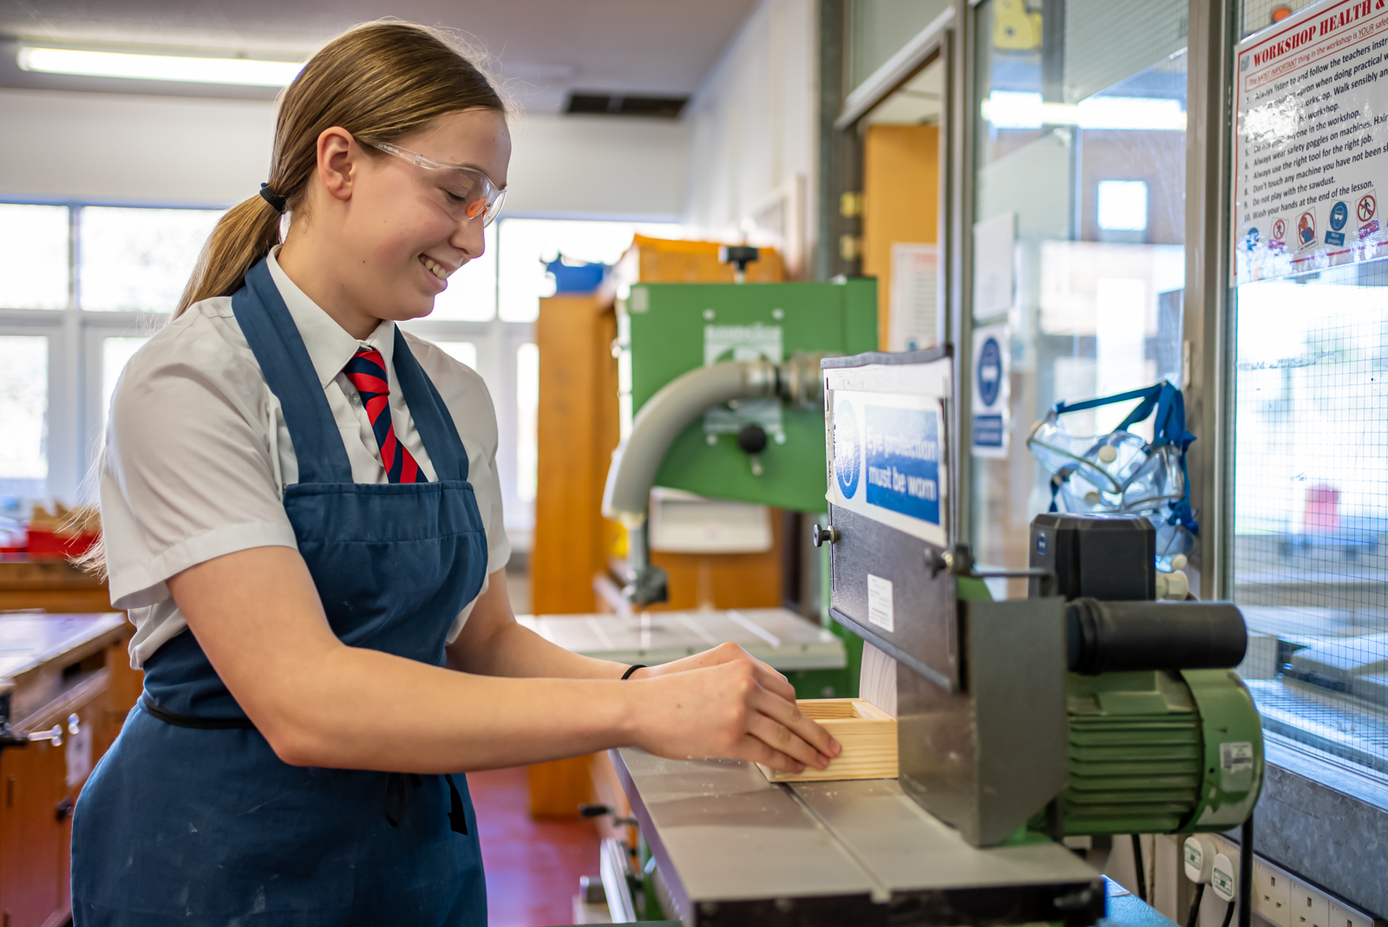

Options booklet
Year 9 Pre-Option
2026 - 2027

Slide 2


Options Guidance and Information
In Year 9, you will follow a similar curriculum to the one you have studied in Year 8, with a strong emphasis on English, Maths and Science. All students will continue to study French.
This year, we introduce the idea of studying subjects at GCSE through a system of pre-option choices. Students are able to study subjects that they are interested in taking forward to GCSE level. It is an opportunity to master some of the key concepts and skills surrounding the subject, and to access it in a more exploratory format. This booklet aims to give you details of all the subjects, which are available for you to study in Year 9 and give you guidance and advice about how to make your choices.
It is intended that you will choose to study subjects which you are interested in pursuing in Years 10 and 11. We hope that by studying subjects in Year 9, you will be well prepared for Years 10 and 11 and, be able to make well-informed choices.
How to make your choices
Once you have read through this booklet carefully, you need to choose the subjects you would most like to study in Year 9. The list of subjects you can choose from is shown below. You will complete this via a link to a Microsoft forms document, you will not be able to change your choices once they have been submitted, so consider these carefully.
You need to choose:
Four pre-option subjects (two from block A and two from block B)
A reserved choice for each option block
Block A |  | Block B
Drama |  | Business
Art |  | Music
DT |  | Sociology
RE |  | DT Food
Creative ICT
You will be asked to complete your choices via a Microsoft forms link. It is the intention that the choices will be made at home with the support of families, but our form tutors will be available to support the process.

Slide 3
Subject Information – Block A
Art & Design
In pre-option Art, students will develop a portfolio style project to prepare them for GCSE (if they choose to take it further). Students will be encouraged to be experimental and learn a variety of skills through applying different types of materials. These include mod roc, card relief collage, watercolours, acrylic paints, pen and pencil skills. Drawing from observation is a key feature of the course and students will develop their skills using a range of different media and sources. Reference will be made to the work of other artists and research will be carried out to create an artist profile. Students will also work to emulate the styles of different artists.
For further details, please see Mrs Jepson
Drama
Drama is an exciting opportunity for you to express yourself creatively, in a safe and fun environment, providing you with a platform to devise, perform, and evaluate your work and the work of others. During the one-year course, you will explore a range of theatre practitioners and their techniques, such as Stanislavski and Frantic Assembly.
Throughout the year, you will build skills such as self-confidence, teamwork, critical thinking, emotional resilience, communication, negotiation, problem solving and confidence.
The course is practical with some written elements, and the key features of the course include:
Exploration of the text & stage performance of Blood Brothers
Devising from a stimulus where you will create your own performance, using techniques from various styles. For example, Physical Theatre, Verbatim Theatre and Theatre in Education.
Rehearsing and performing two extracts from a play.
For further details, please see Miss Bliss

Slide 4
Subject Information – Block A
Religious Studies
This course allows you to explore some of the most challenging questions on matters of life and death— from abortion to euthanasia—while developing skills to think critically and argue persuasively. You’ll compare and critically assess philosophical and religious perspectives (Christianity and Islam) and tackle real-world ethical dilemmas like the death penalty, abortion, and animal rights.
Skills You Will Develop:
Stronger critical thinking and debate skills
Clear and persuasive writing
Creativity through thought experiments—engaging in hypothetical scenarios to test ideas, challenge assumptions, and explore different perspectives in a logical way
Big Questions You’ll Explore:
Can the death penalty ever be justified?
Do animals have moral rights?
Does a foetus have a right to life?
Should terminally ill people have the right to choose when to die?
Does it make sense to fear death?
For further details, please see Dr D’Aversa
Design Technology – Materials
The focus of the pre option course will be on student imagination, innovation and flair for designing and making. The course has an introduction to different material and techniques, so students can develop skills through working, in a range of designing media, modelling and production materials and the use of ICT.
Key Features of this course include:
The introduction to Design Technology theory basics
The use of practical skills, tools and techniques
The opportunity to take part in creative, design-based activities
Explore ways in which different factors affect how you design something.
Challenge yourself: which materials do you like to use?
For further details, see Mr Potter.

Slide 5
Subject Information – Block A
Creative ICT
The Creative ICT pre-option course will allow students to develop their skills at creating and manipulating digital images for a deliberate purpose. Using an applied, project-based approach students will learn how to synthesise images from a variety of sources to achieve a realistic goal.
Students will also learn about diverse types of digital image and how stylised images and logos are made so that they can be deployed to a wide range of uses. When images have been finalised students will consider how to prepare them in a way that is suitable for either online or print use.
To achieve the highest possible quality of outcome students will take on the essence of an iterative, agile methodology. Reflecting on their successes and developing planning and self-evaluative skills that will support their progress in all subjects.
Although much of the focus will be on refining practical skills students will have the opportunity to explore and analyse the way the images are used by businesses and media in the world around them. Using what they glean from this to sharpen their own ideas and make their work more effective.
For further details, see Mr Houghton

Slide 6
Subject Information – Block B
Music ​
The music pre-option course is all about developing your skills as a practical musician. You will continue learning a variety of popular instruments such as the piano, bass guitar, drums and electric guitar and will work as part of an ensemble to perform a variety of pieces and to compose your own piece of popular music. ​
Students will also be given the opportunity to use specialist music software to compose and the opportunity to access weekly peripatetic music lessons with a visiting professional musician on the instrument of their choice. ​
Finally, students will look to develop analytical skills through listening activities which develop a broad understanding of musical genres and key terminology. Musical genres include:
Western Classical Tradition
Popular Music ( 60s, Rock, 90s Pop, Musical Threatre, Music for Film & TV).
Traditional Music ( Folk, Blues, Jazz)
​For more information, please see Mrs Graham. ​
Food and Nutrition
During Y9, students have the opportunity to develop a number of skills surrounding the subjects of food and nutrition. It is a year to explore the world of food production and cooking.
They will develop their cooking skills and learn a variety of preparation, cooking and presentation techniques.
They will gain a deeper understanding of macro and micronutrients.
Students will understand food provenance learning where their food comes from, with the benefits of using local, seasonal foods.
Students will consider the environment and how to reduce food waste.
For further details, see Miss Grace
​

Slide 7
Subject Information – Block B
​Business Studies ​
​
The pre-option course allows students to explore and develop their enterprising minds. The course will be structured around project-based learning and will include elements such as: ​
​
Branding ​
Recruitment
Basic Finance ​
​
Students will be given the opportunity to use technology in order to work collaboratively on a variety of projects.
​
For further details, please see Ms Thompson
Sociology
During Y9, students have the opportunity to develop an understanding of Sociology including the Family, Education, Crime and Deviance and Stratification.
Students will learn how to think like a sociologist, the key ideas and theories behind the reasons why our society is structured the way it is including; How do we create our identity? How are social norms formed? Who decides on our laws? How do we define our culture?
They will have the opportunity to take part in some debates to widen their understanding of social issues.
They will develop their understanding of different family types and how these are changing.
Students will learn about the education system including success and failure.
Students will learn about why people commit crimes.
They will also cover why some people find themselves in poverty and how this impacts their lives.
For further details, see Mrs Wragg

Slide 8
Subject Information – Block B
Notes

